Slide 1
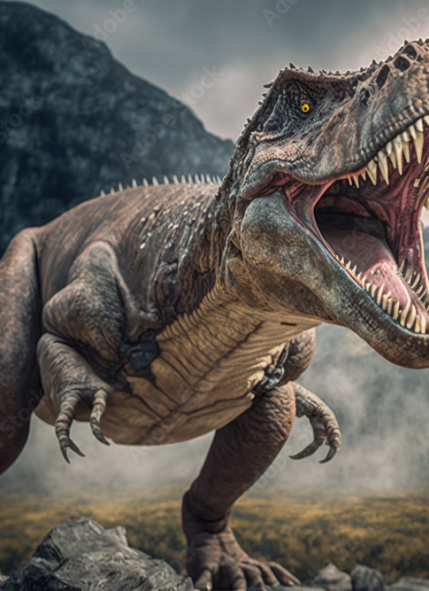
Mysteries Hidden in the Earth’s Layers: Hunt for a Tyrannosaurus Rex
Lisa Wininger
Michigan Geological Repository

Slide 2
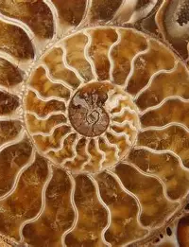
Paleontology and Fossils
Paleontology: scientific study of life in the geological past, using fossil evidence like bones, teeth, shells and imprints to understand ancient ecosystems and how life on earth changed over time

Slide 3
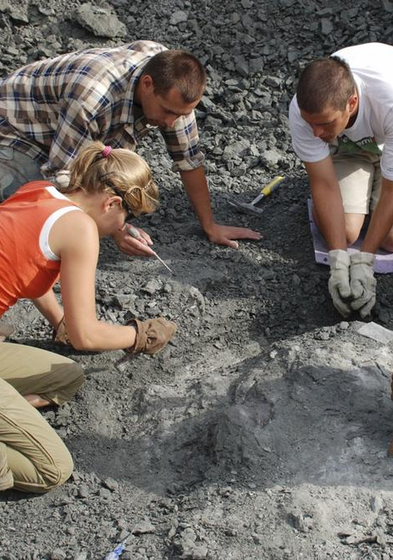
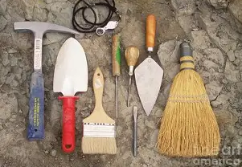
Finding Fossils: You Need a Team, Good Tools, and a Lot of Practice

Slide 4

First Dinosaur Fossil Discoveries
centuries ago, Indigenous people knew about fossils and included explanations in their storytelling
400 years ago, other fossil finders had many explanations for what they though fossils were, and how they came to be where they were found
Paleontology as a science began 1790-1820 and recognized extinction and extreme age of the fossils

Slide 5
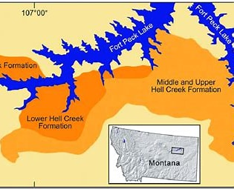
Modern Fossil Hunters/Scientists
“It belongs in a museum!”
Where to look depends on what you want to find- what you find depends on where you look!
What do you need to know?
How to do it right: who owns or controls the land, do you need permission to be there and to dig, how do you excavate safely?
What do you do with a dinosaur fossil find?

Slide 6
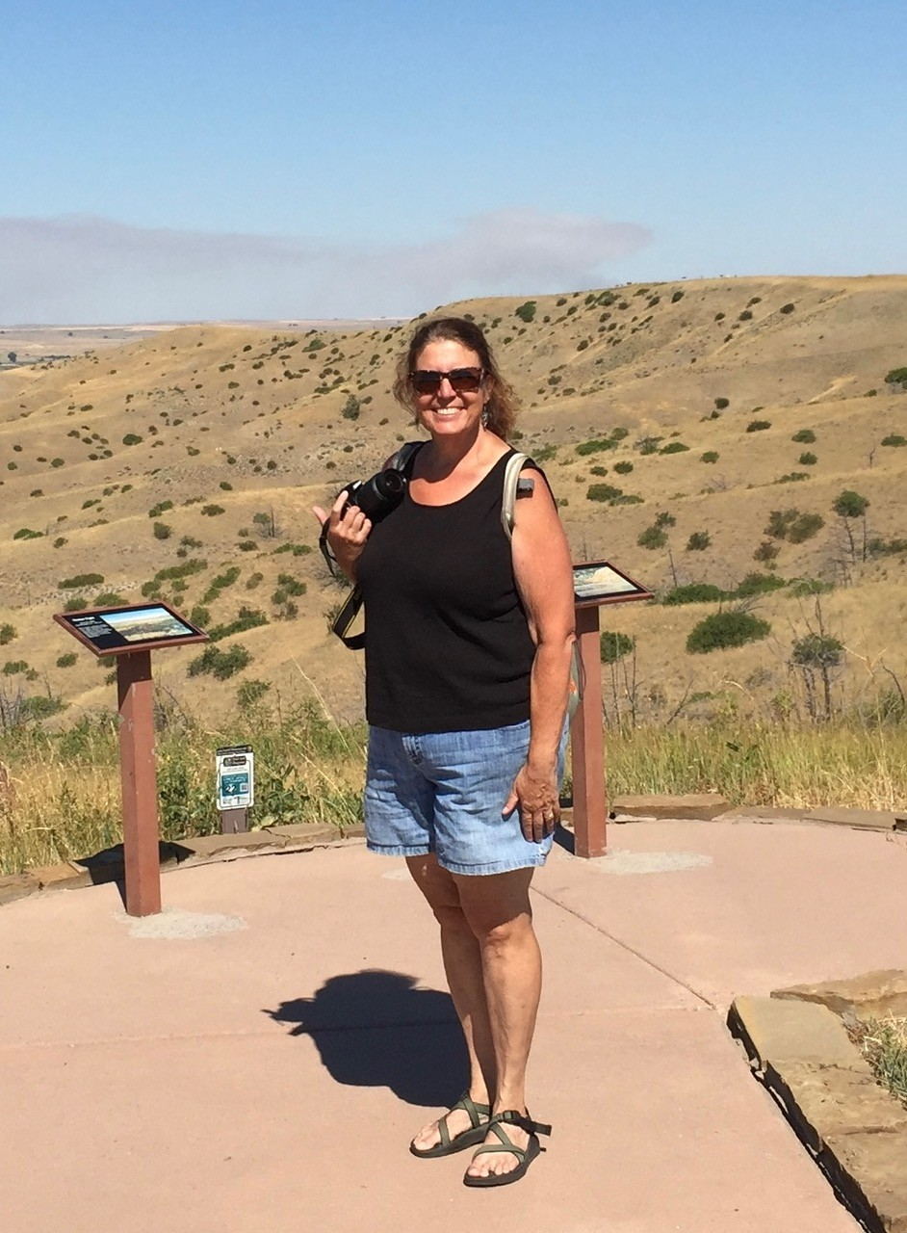
My Paleontology Adventure
Where: Hell Creek Montana
When:2016
Sponsored by: US Bureau of Land Management and the University of Washington
Team: 25 professors, teachers, college students and volunteers

Slide 7
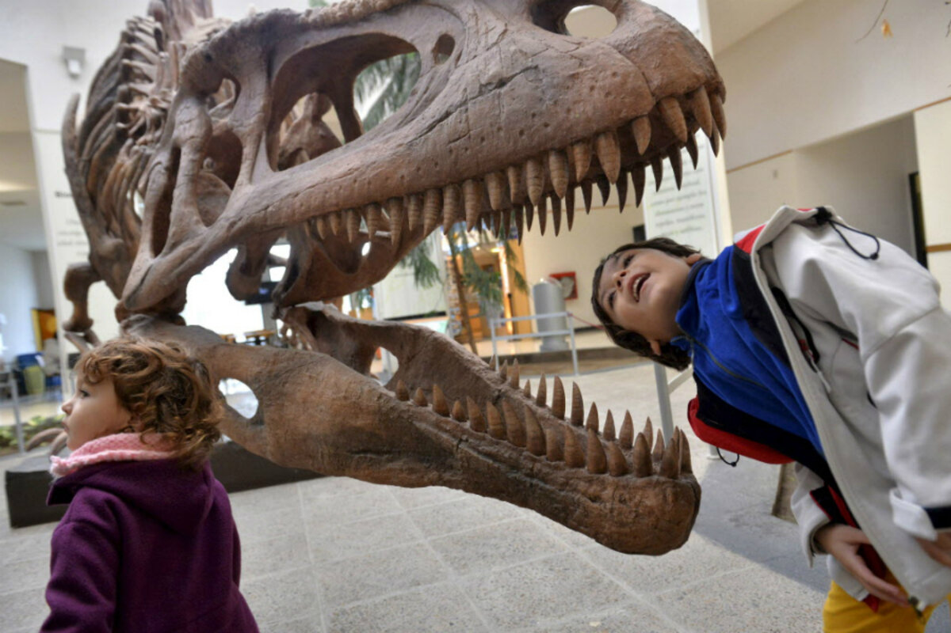
Teenage T-Rex: Tufts-Love T-Rex
The 4-foot-long skull was found beneath rock layers dated to the Cretaceous-Paleogene mass extinction event, which wiped out all non-avian dinosaurs.
In other words, this T. rex died just a few hundred thousand years before its species went completely extinct.
The fossil was named “Tufts-Love” after the two volunteers who discovered it: Jason Love and Luke Tufts.
Tufts-Love was about 15 years old when it died, some 66.3 million years ago. At 40 feet in length, this teenaged carnivore was about 85 percent as large as the biggest T. rex ever found.
Researchers have excavated about 20 percent of the whole skeleton and expect to find more remains buried at the site, though it’s unclear how intact the skeleton might be.

Slide 8
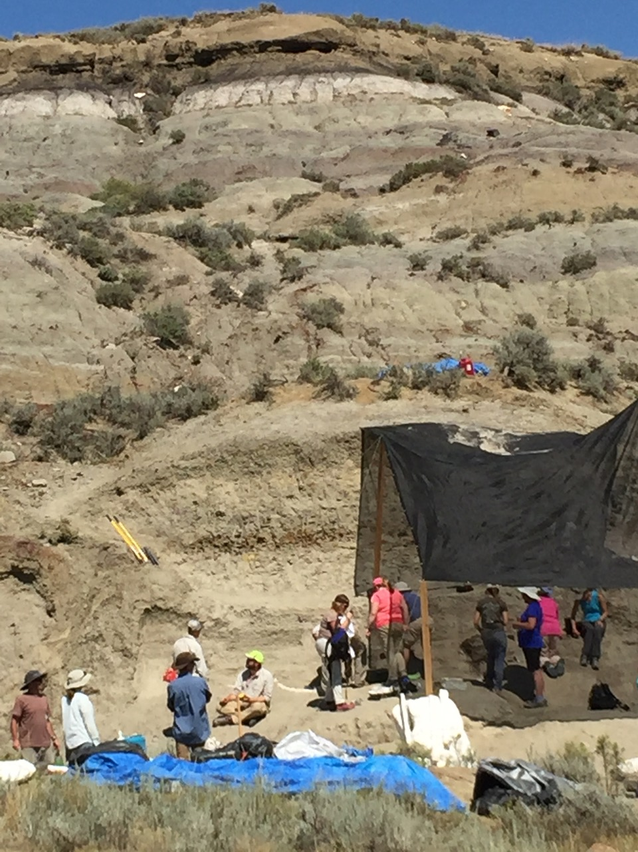
Found: Oddly Shaped Rocks Sticking Out of a Hillside (3 miles from a dirt road)

Slide 9
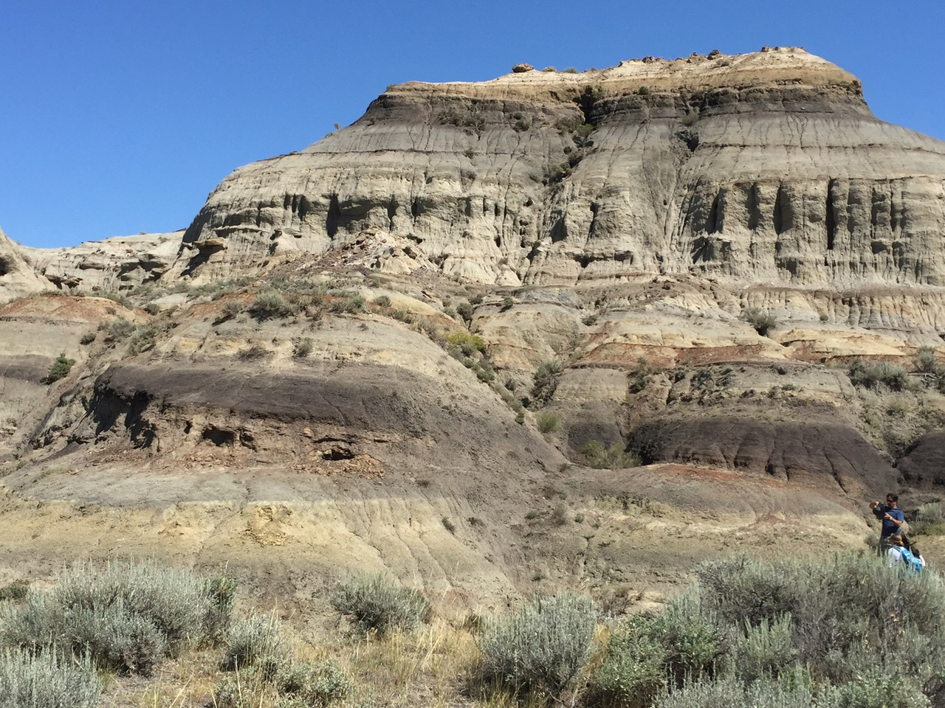
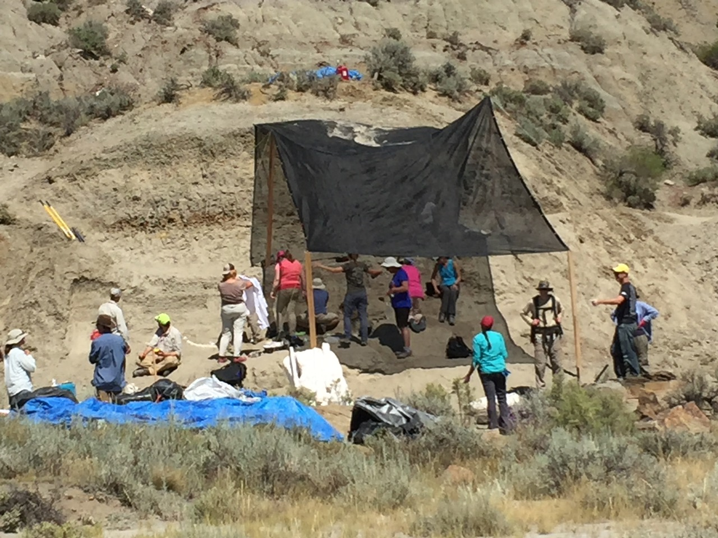
Why Is This a Promising Place to Look for Fossils?

Slide 10
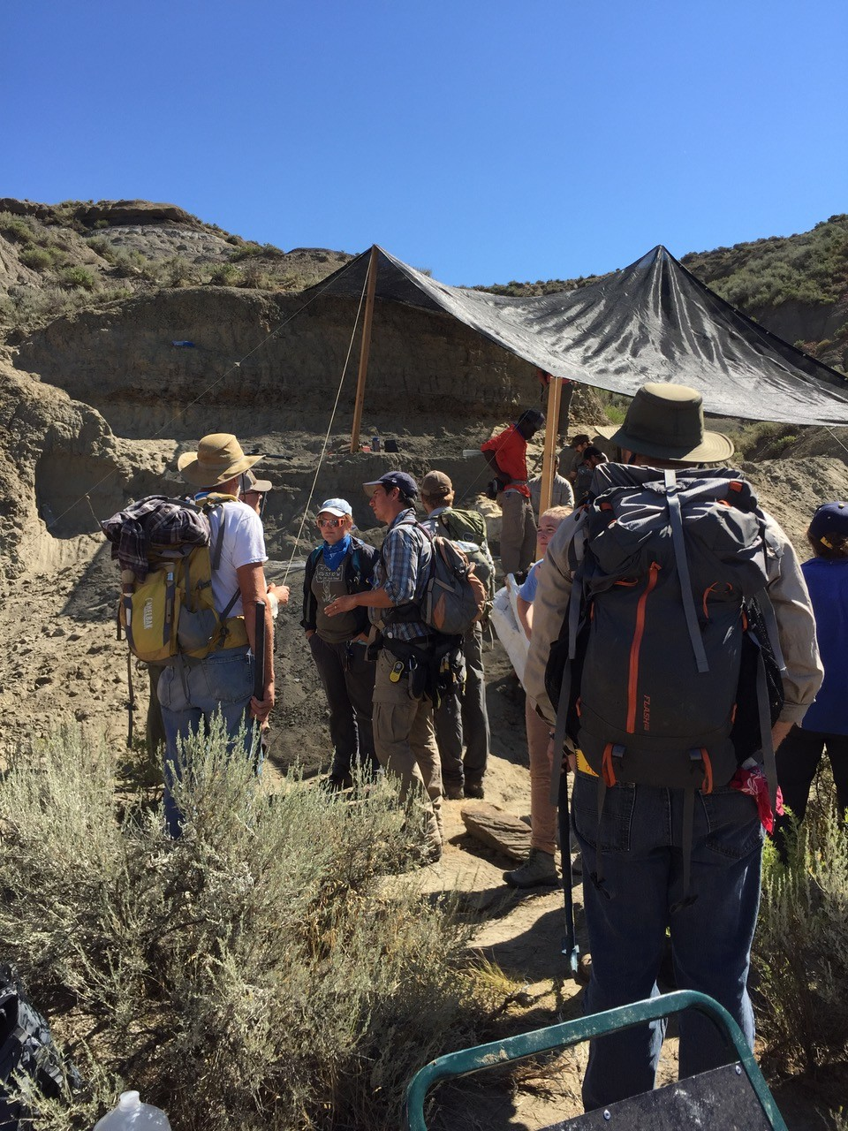
Conditions: 110+ temperature, dusty, dry, and no shade!

Slide 11
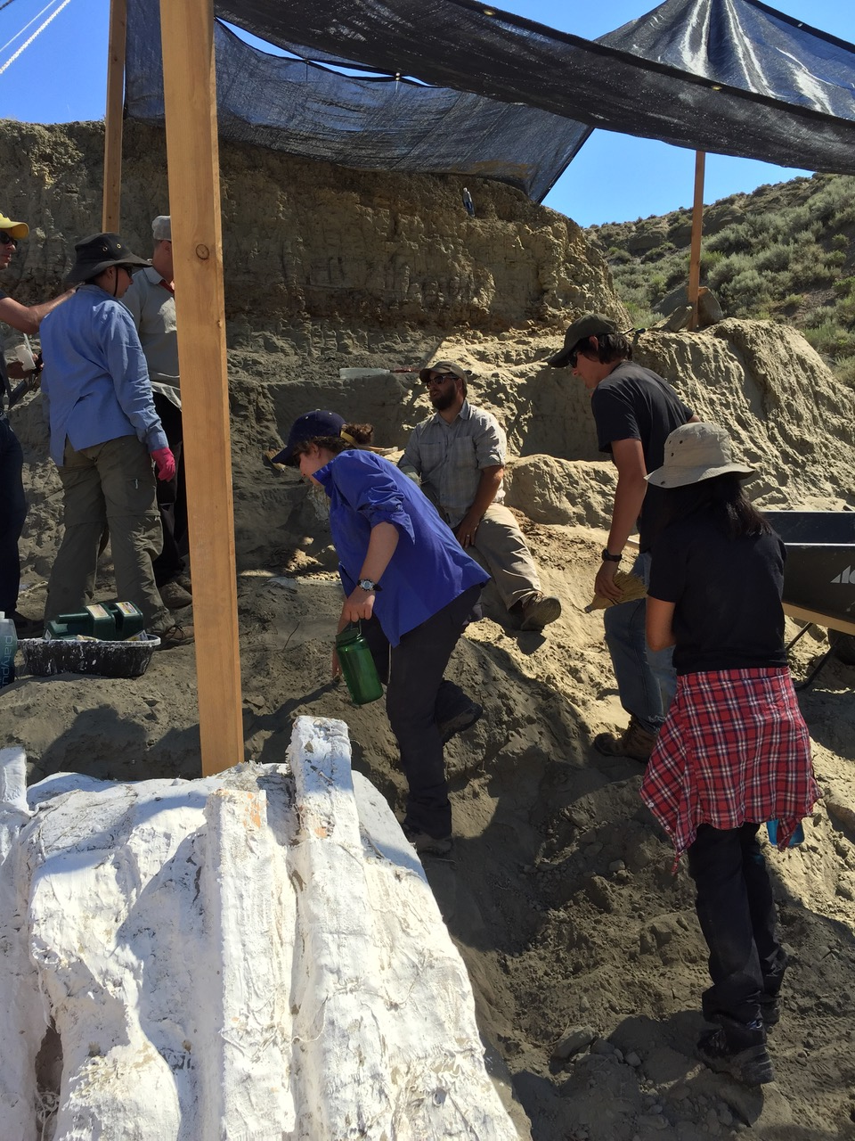
Terracing Away a Mountain to Find a Fossil Skeleton

Slide 12
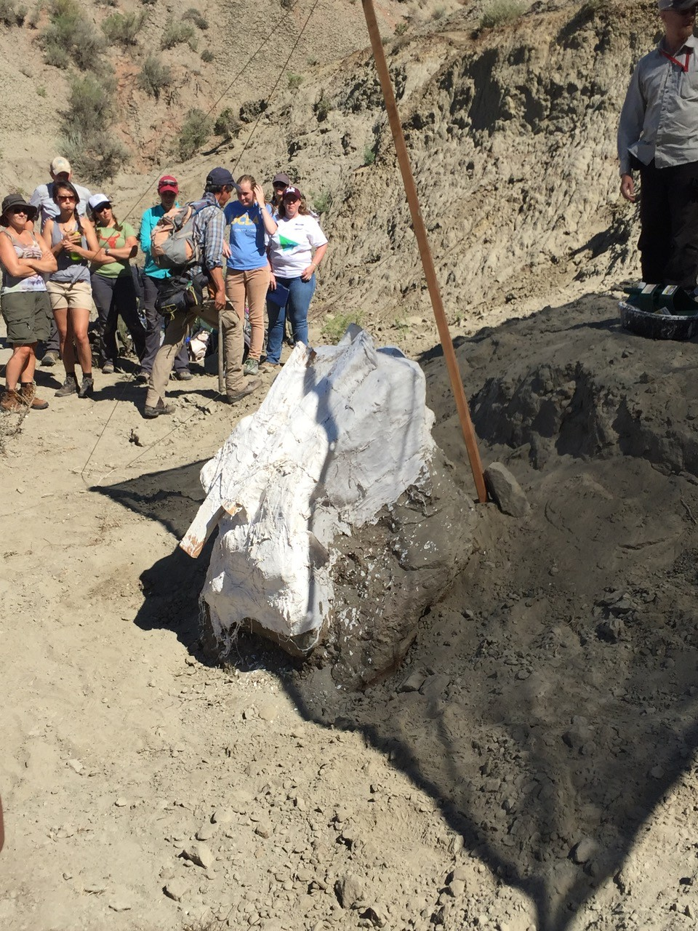
Skull Packed and Wrapped in Plaster Cast: weighs approximately one ton!
How to transport it? No vehicular access to site, nearest road 3 miles walking, but lots of ingenuity

Slide 13
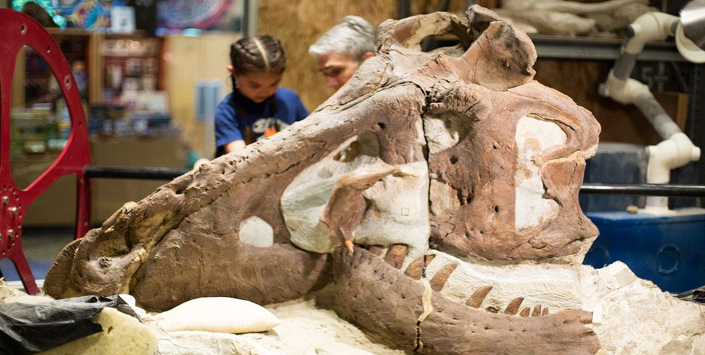
speaking impact
Your ability to communicate effectively will leave a lasting impact on your audience
Effectively communicating involves not only delivering a message but also resonating with the experiences, values, and emotions of those listening

Slide 14
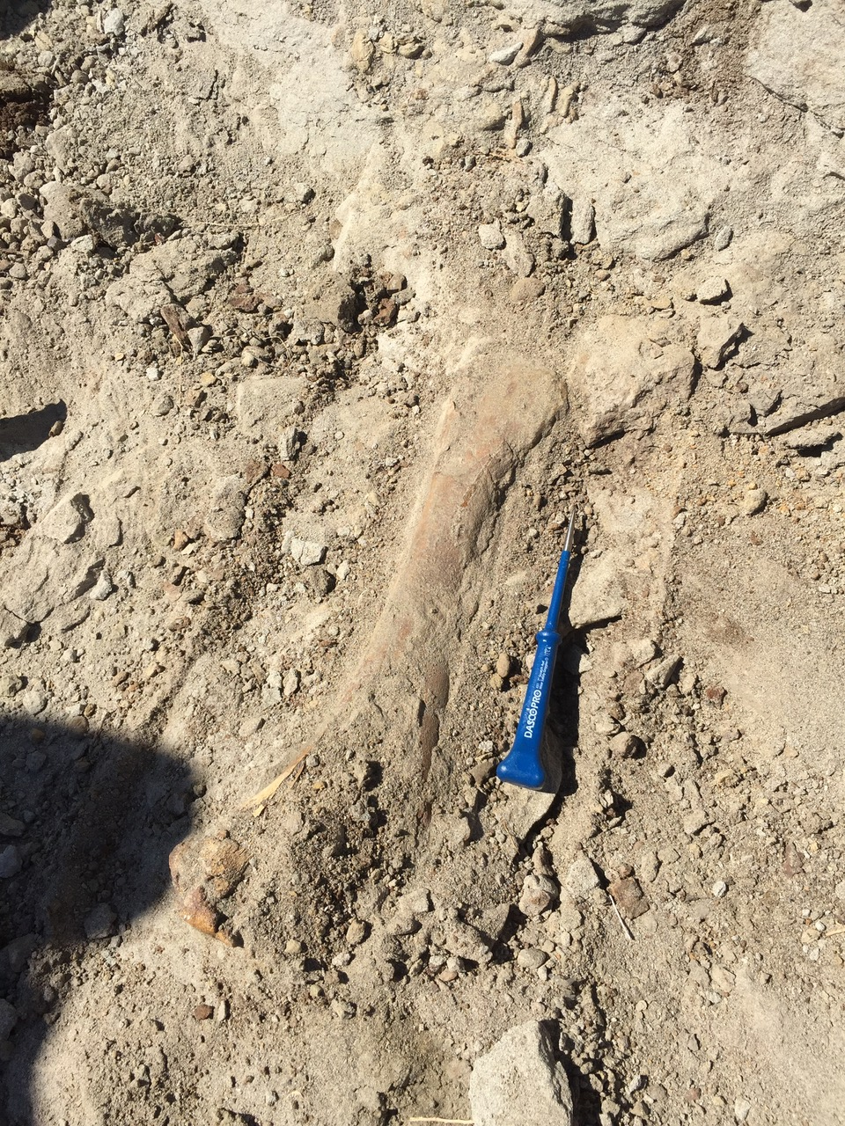
Other fossils were found in the same area, but did they all belong to Tufts-Love? How can you know?

Slide 15
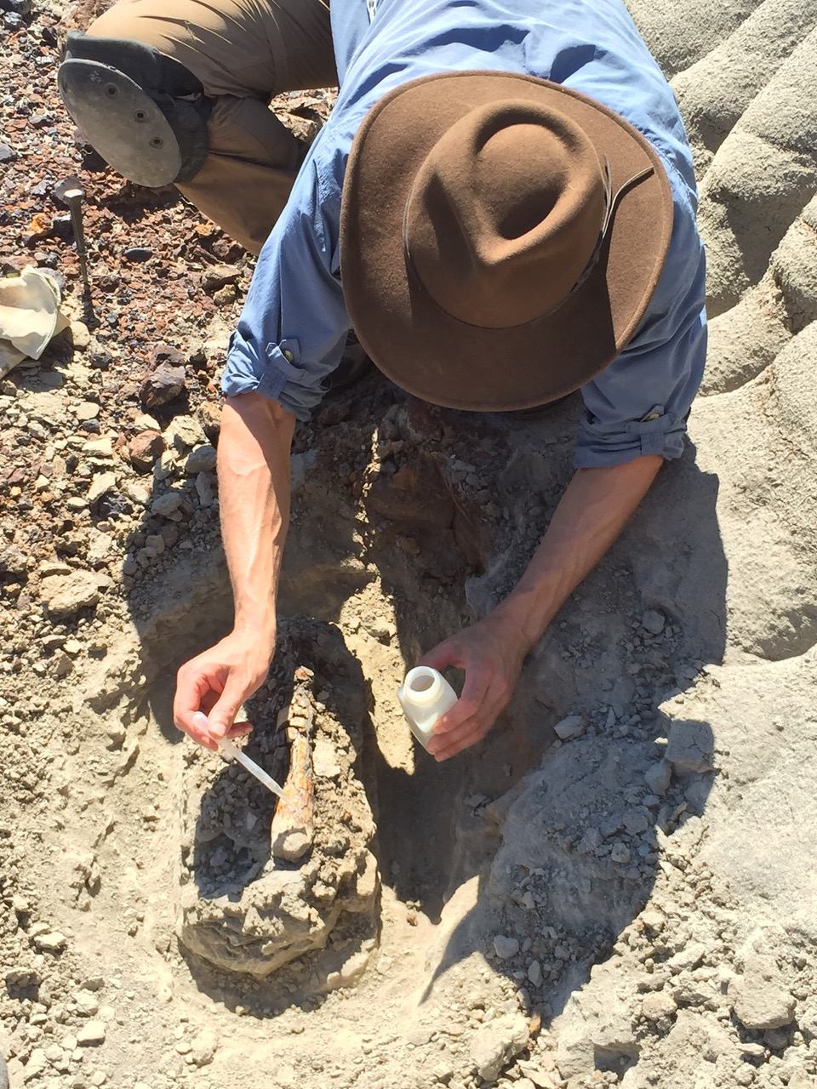
Field kits have chemicals, cameras, picks, and fixatives

Slide 16
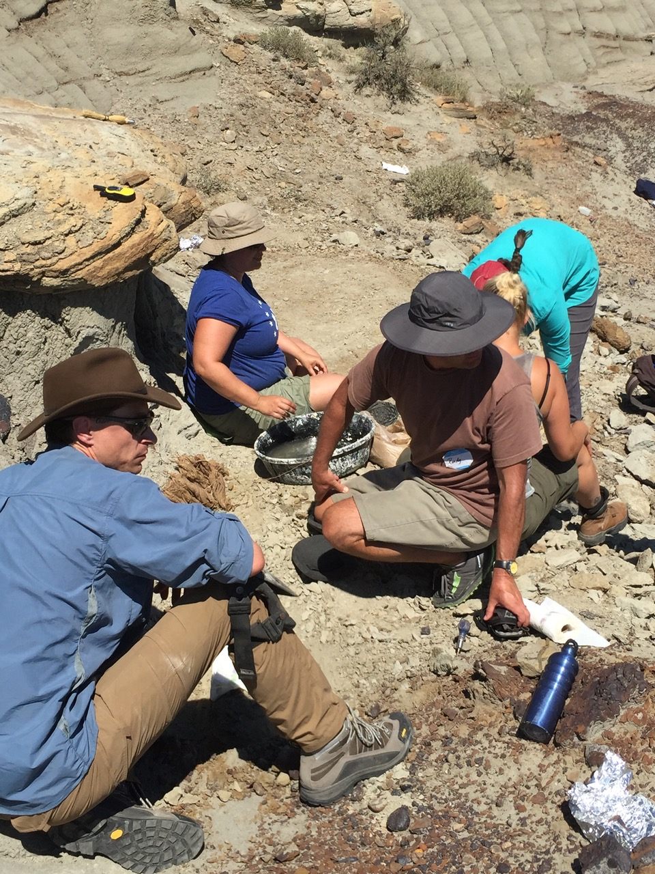
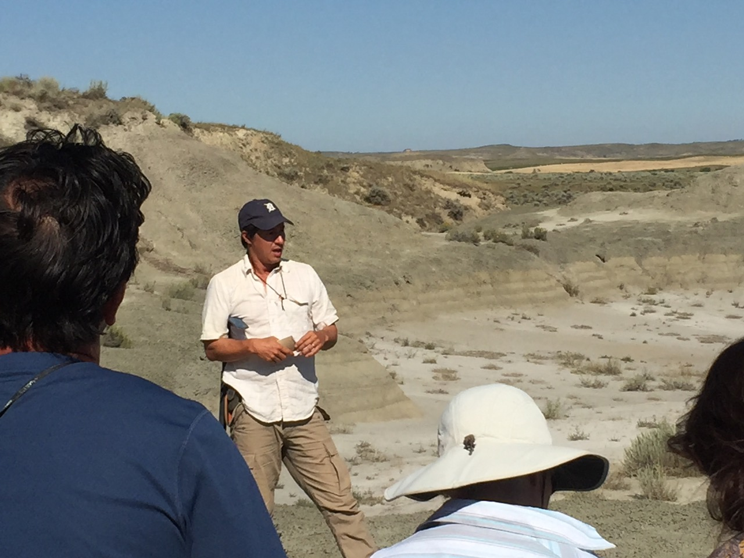
Our dig leader, Dr. Greg Wilson!

Slide 17
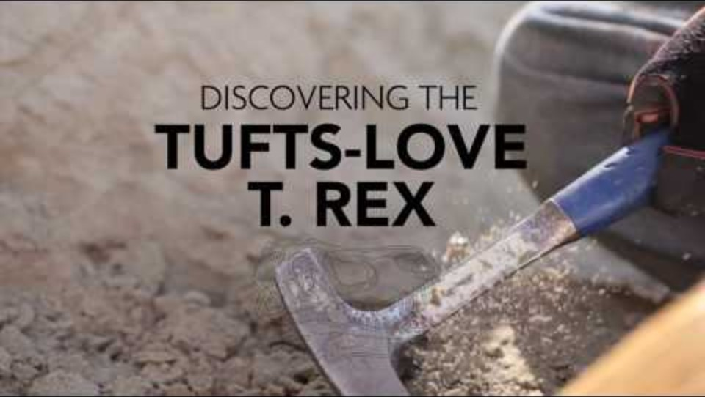
What Comes Next?

Slide 18
Tech Tools to Use When Excavating
Cameras
Drones
LIDAR
Remote sensing instrumentation
Laptop in heavy duty case
X-ray imaging
GPS instrumentation
K-T boundary, marking the destruction of non-avian dinosaurs at the end of the Cretaceous period. The layer contains iridium, likely derived from a large meteor impacting the Earth

Slide 19
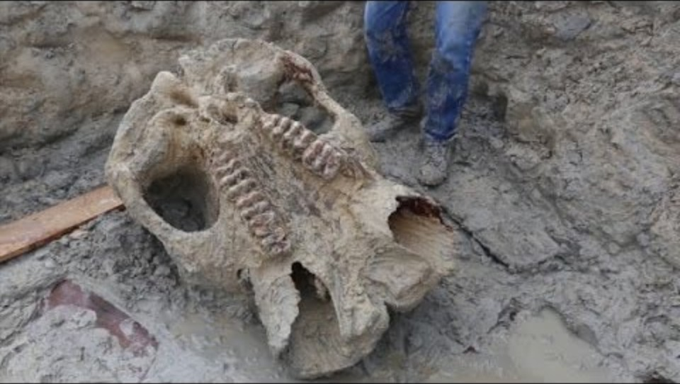
Mysteries in Earth Layers
In Michigan, what mysteries can be found in the layers under our feet?
Are there fossils in Michigan?
Are there dinosaur fossils in Michigan?
What underground resources is Michigan famous for?

Slide 20
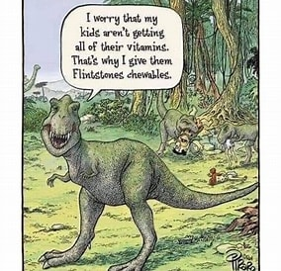
Thank you!
Lisa Wininger
Michigan Geological survey
Western Michigan Department of Geological and Environmental Sciences
Lisa.a.Wininger@wmich.edu
(269)532-3048

