Slide 1


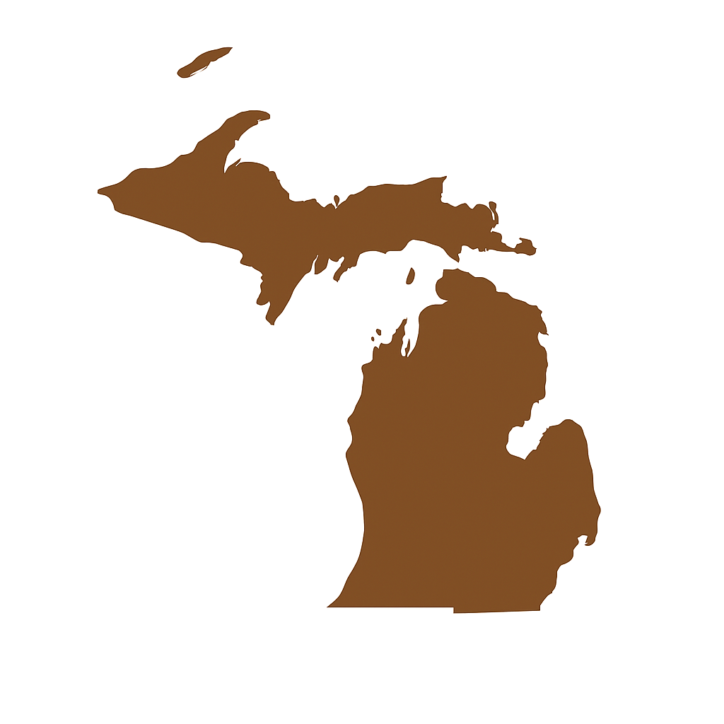




ORGANISMS FROM LAND AND SEA IN MICHIGAN

Slide 2
Content
Marine fossils
Ammonoid
Bivalve
Brachiopod
Bryozoan
Coral
Crinoid (Sea Lily)
Fish
Gastropod (Snail)
Nautiloid
Stromatolite
Trilobite
Terrestrial fossils
Ferns and Horsetails
Lepidodendron / Stigmaria
Petrified Wood
Mammoth
Mastodon
Popular fossils that are not found in Michigan
Dinosaurs
Megalodon
Meganeura

Slide 3
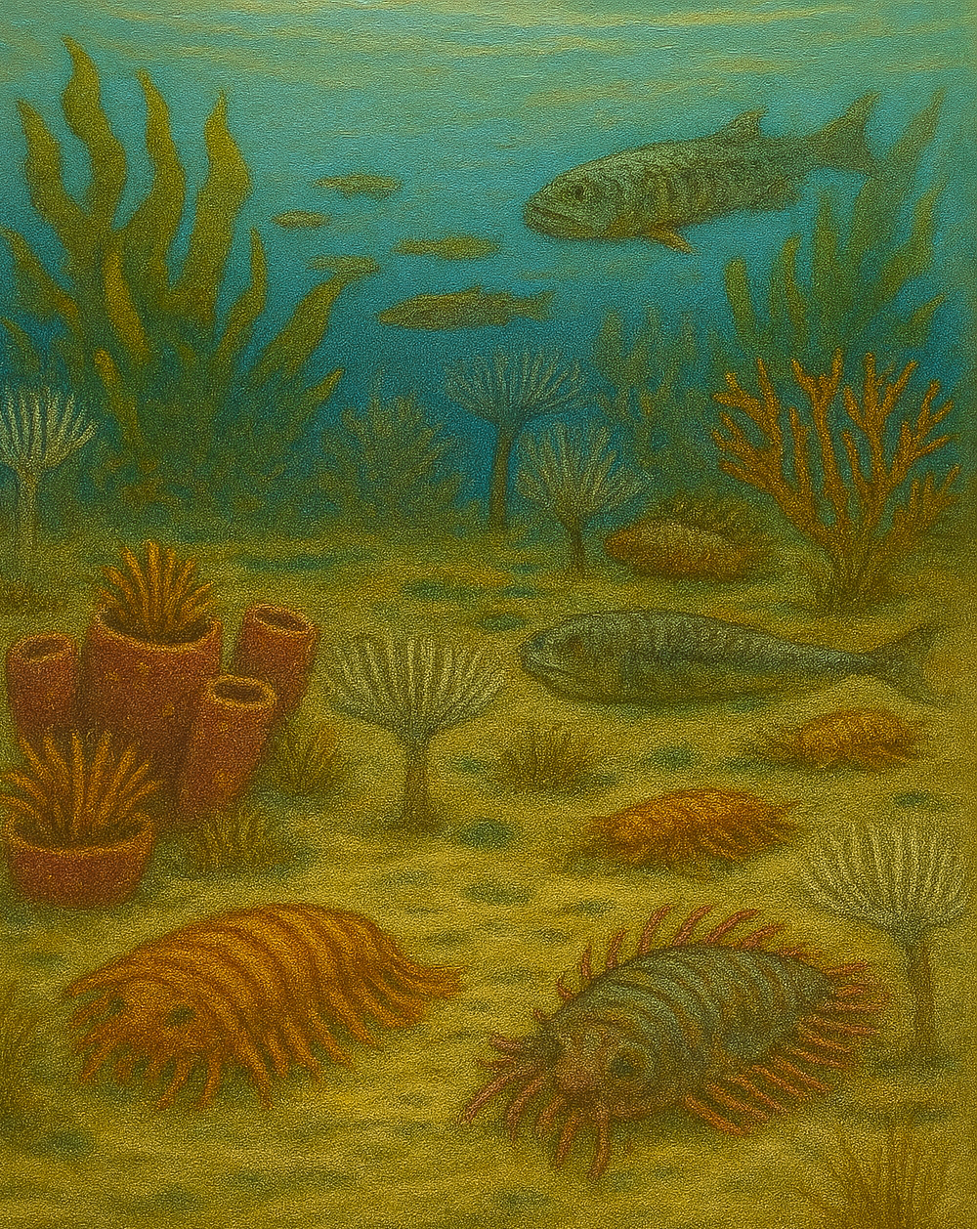
Marine Fossils

Slide 4
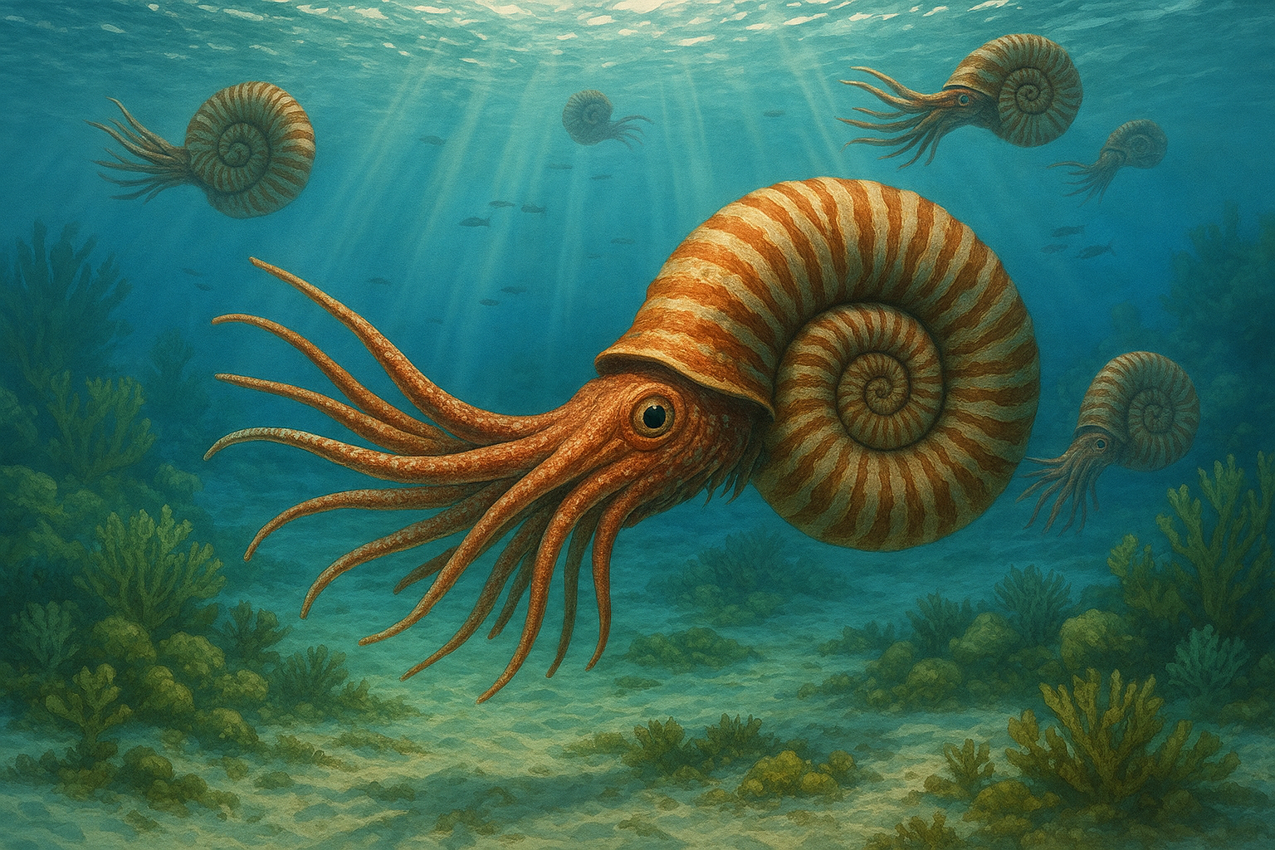
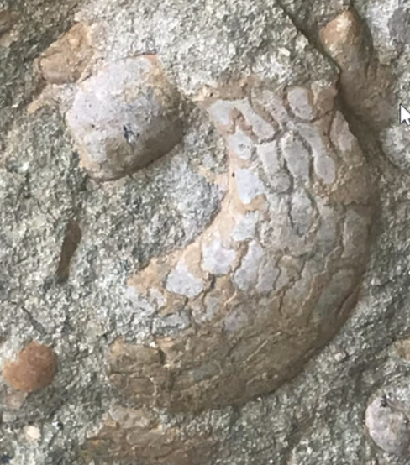
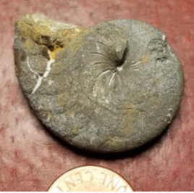
Ammonoid
Ammonoids were marine animals similar to calamari and octopuses, although they had coiled shells that looked like curly rams’ horns. Ammonoids floated through the water like little submarines, using jet power to zoom around and catch tiny sea creatures.
AI reconstruction of a Mesozoic ammonoid.
Ammonoids are now extinct. They first appeared around 409 million years ago and lived until 66 million years ago, when they died out with the dinosaurs. The best-known group, the ammonites, lived from about 200 to 66 millions years ago. Michigan's ammonoids are much older, around 390 million years old, and went extinct long before the first ammonites appeared. Fossils of early ammonoids, like goniatites and Merocanites, can be found in Jackson County in Michigan’s Lower Peninsula.
Merocanites from Jackson, Michigan (by Mike Palescuk) and Pyritized goniatite from Lucas, Ohio (by Mary Ann Szwabowski). Courtesy of the Michigan Basin Fossils Project.

Slide 5
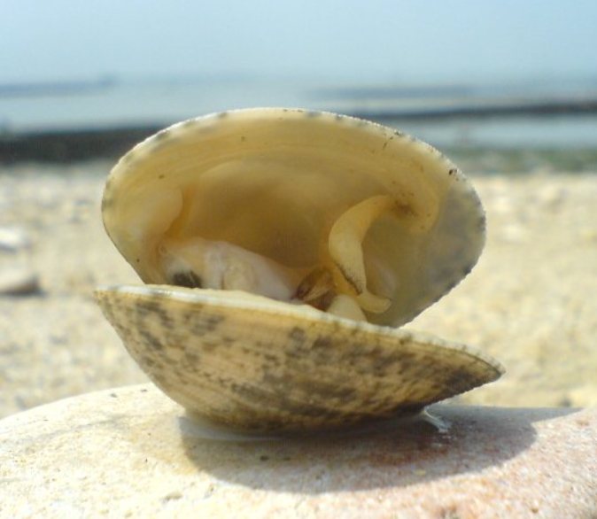
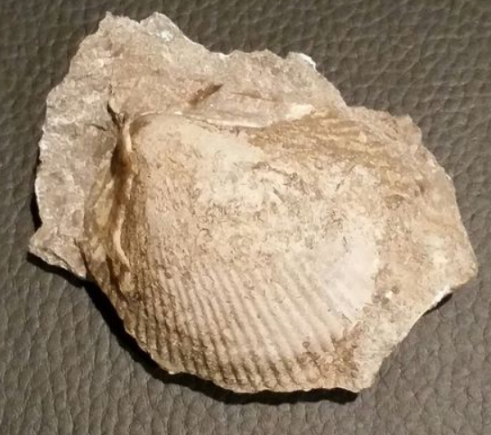
Bivalve
Bivalves are marine animals with two shells, or valves, that open and close like a hinged box, using a strong muscle. They live on or just under the seafloor. To eat, they open their shells just a little and pull water inside. Tiny hairs called cilia move the water through their bodies, letting them trap plankton and algae.
Common clam. Licensed under CC BY-SA 1.0. Source: Wikimedia commons
Bivalves have been around for more than 500 million years and are still alive today. Perhaps you have heard about clams, mussels, and oysters. All of them are types of bivalves.
Devonian bivalve from Alpena, Michigan. Photo by Michael Lask, courtesy of Michigan Basin Fossils Project.
When Michigan was covered by a shallow sea around 390-350 million years ago, bivalves lived alongside corals, brachiopods, and other marine creatures. Some Devonian rocks in Michigan have layers with clusters of small bivalves packed together. These fossils can be found in places like Rockport State Recreation Area, Alpena County, Jackson County, and other limestone and shale beds across the state.

Slide 6
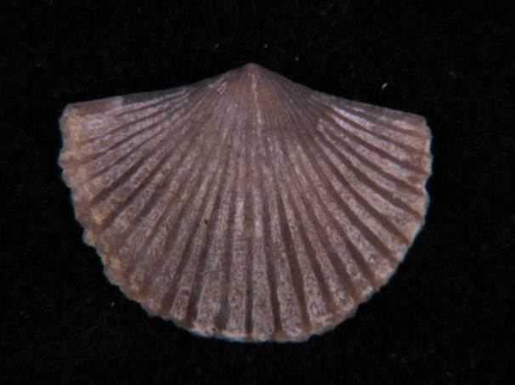
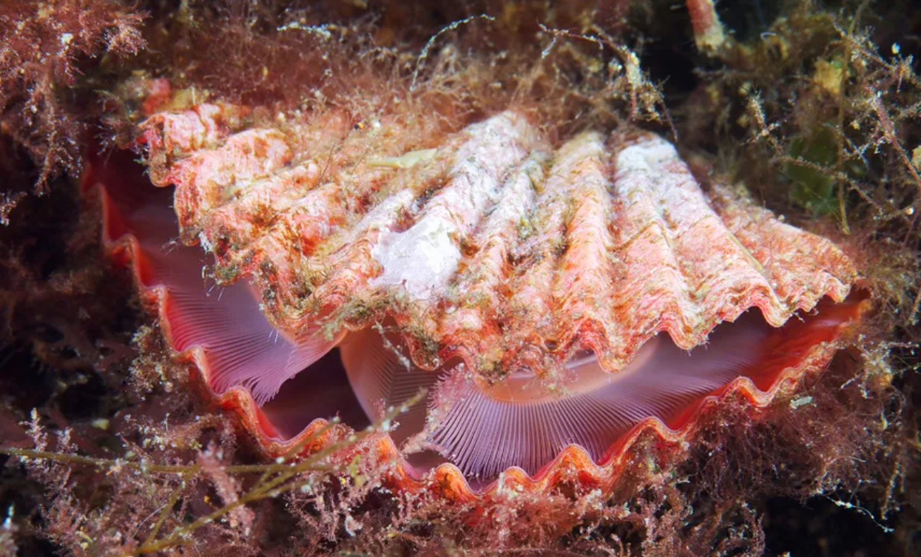
Brachiopod
Brachiopods were ancient sea creatures that looked a bit like clams—but they were their own thing! They had two hard shells, one on top and one on the bottom. Inside, they had a special feeding tentacle called a lophophore that helped them catch tiny food floating by.
They lived hundreds of millions of years ago and were the most common and diverse organism in Paleozoic seas. They used to live in tropical seas, near to coral reefs and in carbonate platforms.
Ordovician brachiopod fossil from Delta, Michigan. Photo courtesy of the Michigan Basin Fossils Project.
Today, brachiopods are still alive—but they have moved! Most live in cold, deep parts of the ocean where it’s dark and chilly. They’re much harder to find now, but they’re like quiet survivors from a long, long time ago.
Modern brachiopod. Photo by Alexander Semenov, courtesy of the Smithsonian National Museum of Natural History, in Smithsonian Ocean Portal
In Michigan, you can find brachiopod fossils in Devonian rocks of places like Rockport State Recreation Area, Alpena and Eaton Counties.

Slide 7
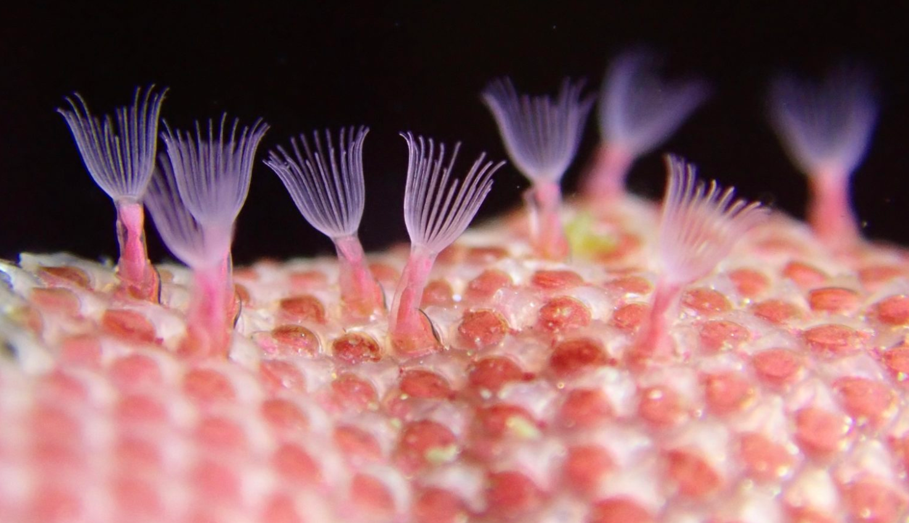
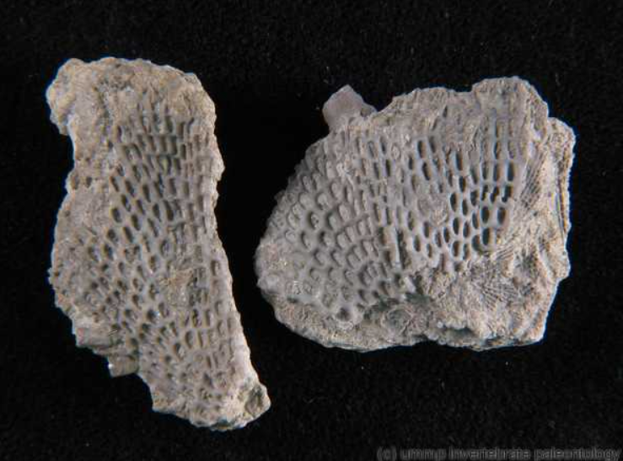
Bryozoan
Bryozoans are tiny animals that live together in colonies—kind of like underwater apartment buildings! Each little creature, called a zooid, built its own home out of hard material, and together they make shapes like fans, twigs, or lace.
They use their tiny tentacles (lophophores) to grab food from the water and pull them in when danger comes.
Bryozoans have been around for over 45 million years, but they are still alive and thriving in both marine and fresh-water environments
Zooids in Bryozoan. Photo by Christina Schwarz, licensed under CC BY-NC 4.0. Retrieved from the Digital Atlas of Ancient Life
Despite their small size, Bryozoan fossils are easy to find in Michigan. You can spot them in places like Alpena County and Rockport State Recreation Area.
Devonian bryozoan fossil from Arkona, Lambton, Ontario. Photo from the R.R. Hibbard collection, courtesy of the Michigan Basin Fossils Project.

Slide 8
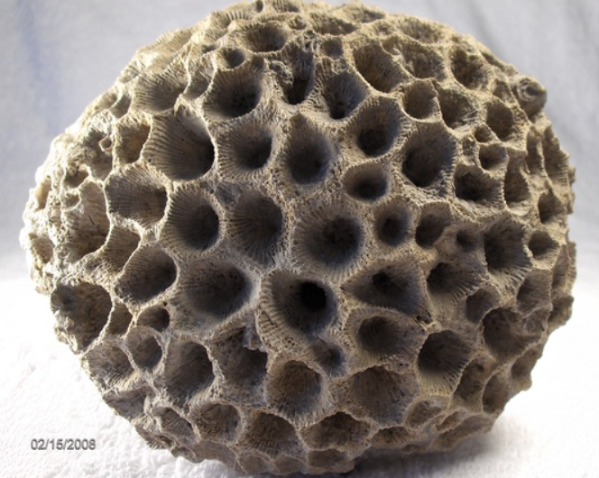
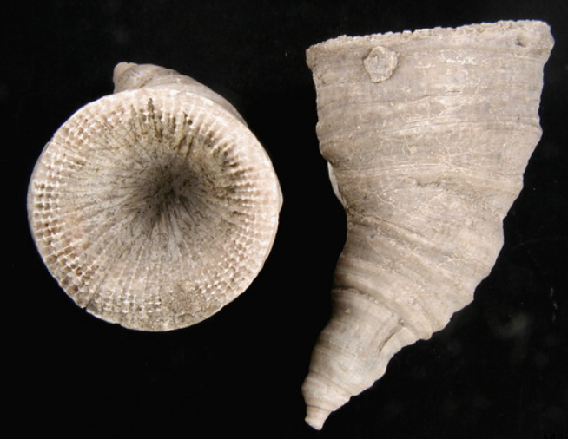
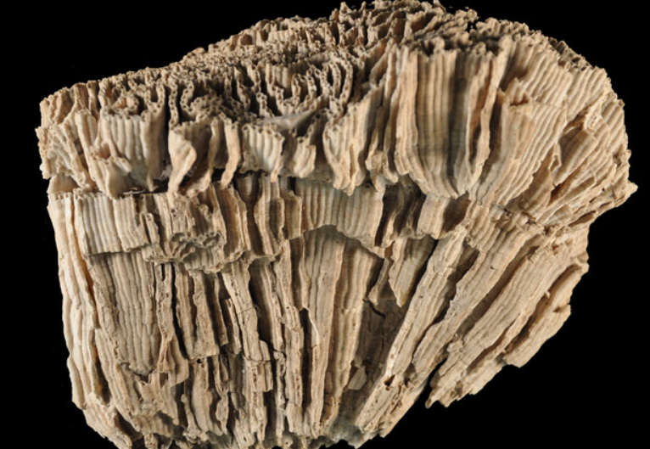
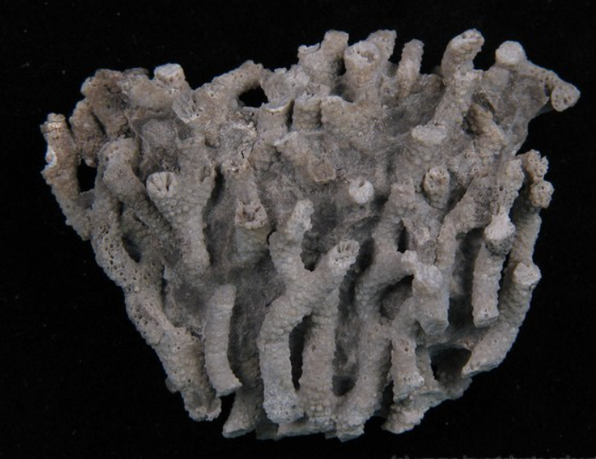
Coral
Corals are marine animals that build hard skeletons and often live in colonies, forming reefs with many shapes and colors. Though they look like plants or rocks, each coral is made up of tiny creatures called polyps that feed by catching plankton with their tentacles.
Michigan's coral fossils are found in rocks between 480-323 millions years old, although most of them are from the Devonian, around 393-382 million years ago. During this time, the state was covered by a warm, shallow sea. You can find coral fossils in places like Petoskey, Charlevoix and along Lake Michigan’s beaches. There are two common types:
RUGOSE CORALS
Rugose corals, which grew in a horn shape when they lived alone, or formed colonies, as our state stone, Petoskey Stone.
A
B
TABULATE CORALS
Tabulate corals, which always lived in colonies, forming shapes like honeycombs (Charlevoix Stone), chains, tubes or branches.
C
D
These images show different types of Devonian corals: A. Unpolished Petoskey Stone from Petoskey, Michigan (by David Thompson). B. Horn coral from Lambton, Ontario (by Mike Toper). C. Tabulate coral Halysites from Antrim, Michigan. D. Tabulate coral Favosites from Ann Arbor, Michigan. Photos courtesy of the Michigan Basin Fossils Project. ​

Slide 9
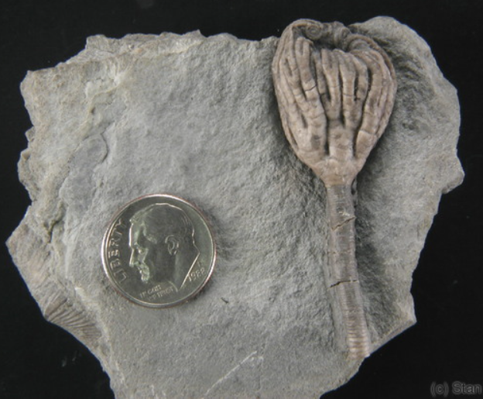
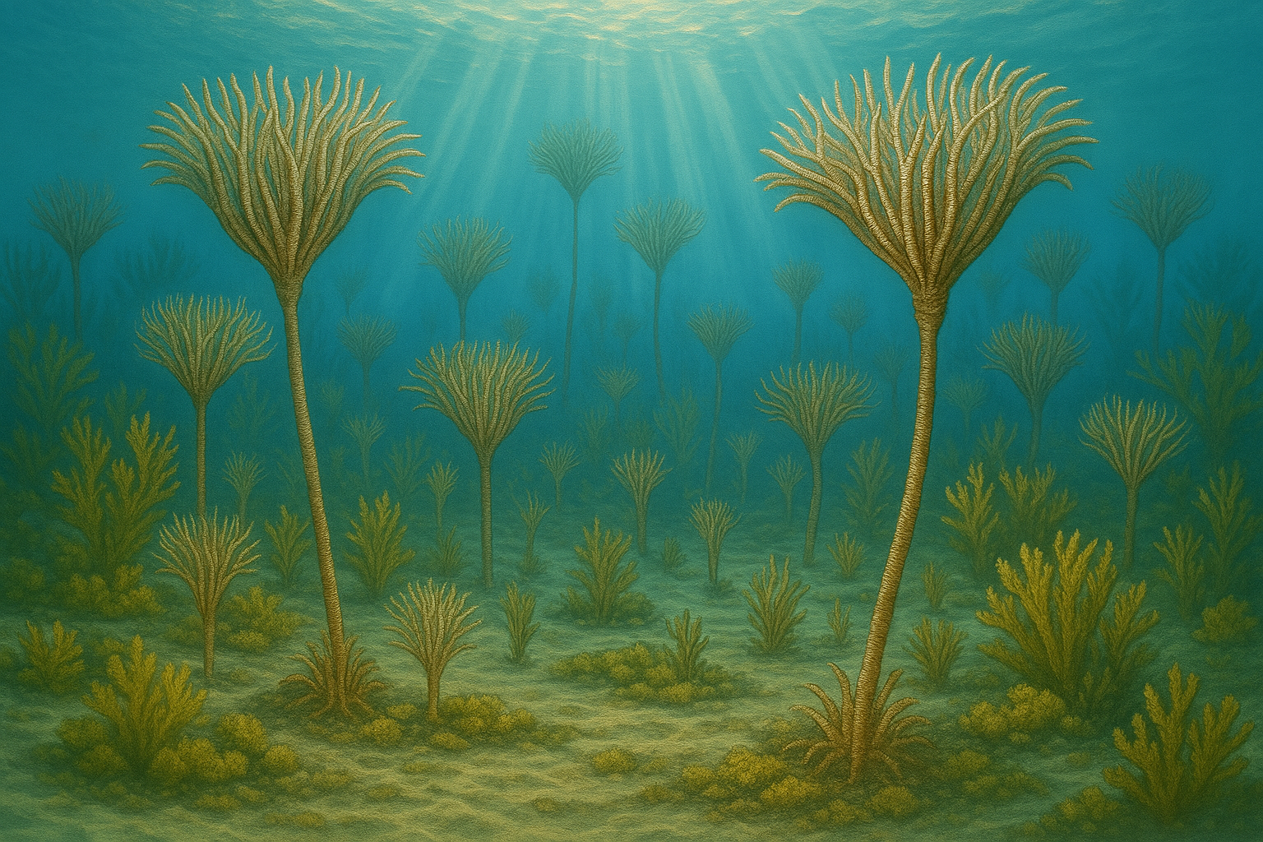
Crinoid (Sea Lily)
Crinoids, also called “sea lilies,” were ancient marine animals that looked like underwater flowers—but they were actually animals related to starfish and sea urchins. They had long stalks that anchored them to the sea floor and feathery arms that waved in the water to catch food.
A Devonian crinoid from Alpena, MI. Photo by Stan Hyne, courtesy of the Michigan Basin Fossils Project.
They have been on the Earth for a long time. Crinoids appeared 500 million years ago, and flourished during the Paleozoic Era, but some species are still alive today!
AI reconstruction of crinoids in the Devonian seas of Michigan
Crinoids in Michigan are around 390-380 million years old. They are found in many places, but the best areas are in the Rockport State Recreation Area and Presque Isle County. These fossils are often found mixed in with other sea creatures like corals and brachiopods. If you spot a fossil with a star-like pattern, a segmented tube, or a round disc with a hole in the middle, you might be holding a piece of a crinoid.

Slide 10
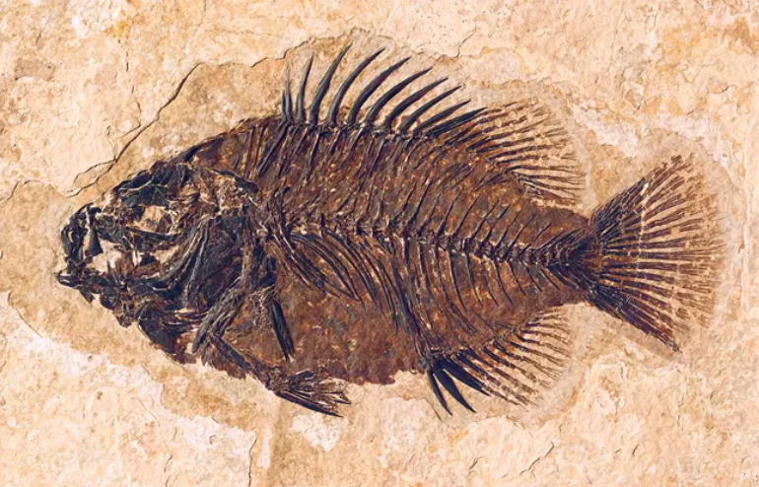
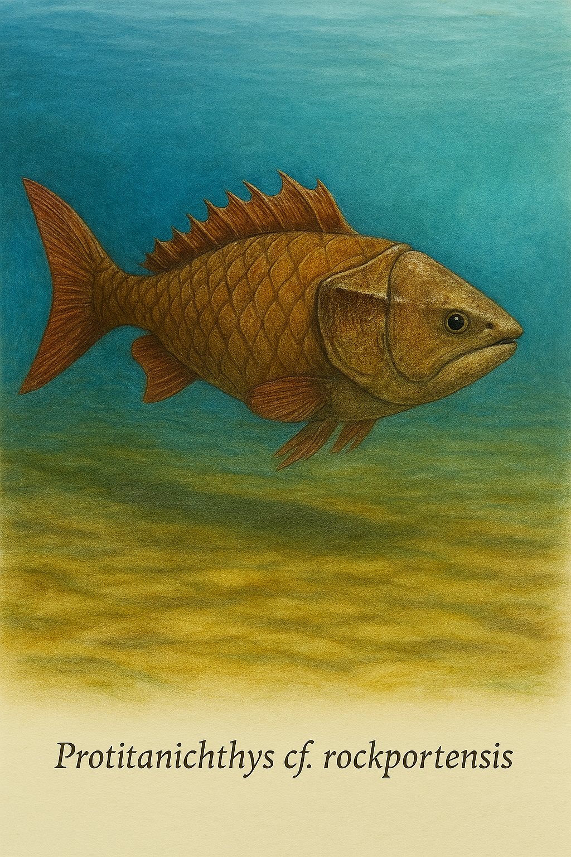
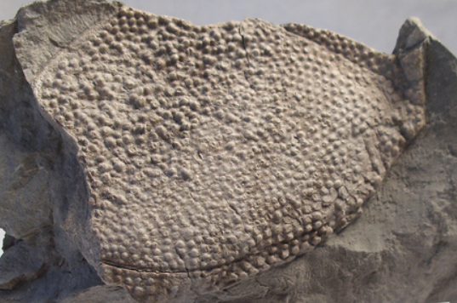
Fish
Fish have lived in Earth’s oceans for hundreds of millions of years. These ancient swimmers were some of the first vertebrates on Earth. Some fish eat other animals, others only eat algae and seaweed, or they can eat both!
Fossilized fish from Wyoming. Photo courtesy of the National Park Service
The Devonian Period is also known as "the age of fish". In Michigan, armored jawless fish are often found in places like Rockport State Recreation area and Alpena County, in rocks that are about 390 to 360 million years old.
AI reconstruction of a Devonian armored fish of Michigan Basin
You might find pieces of scales, teeth, or even impressions of whole fish in Michigan. If you spot a fossil with a ripple-like texture or a small, sharp triangle, it could be part of an ancient fish!
A Devonian fish plate from Milan, Michigan. Photo by David Thompson, courtesy of the Michigan Basin Fossils Project.

Slide 11
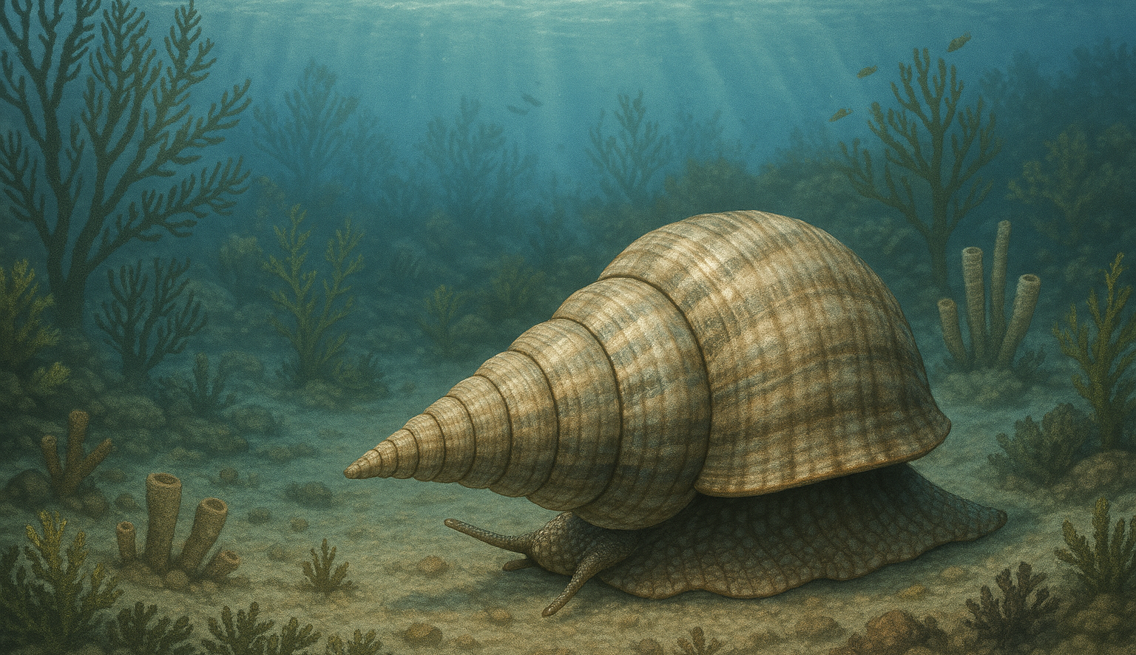
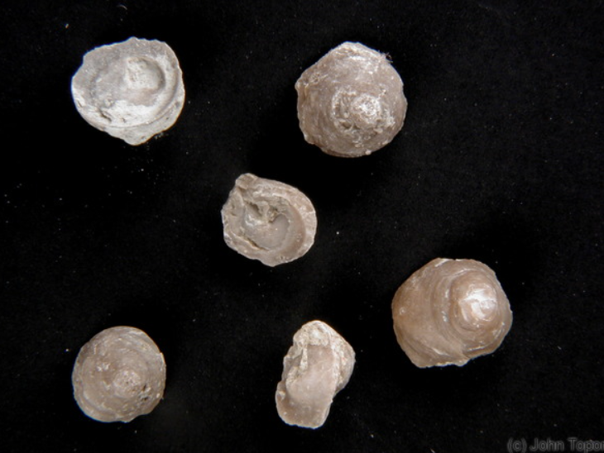
Gastropod (Snail)
Snails, also known as Gastropods, have coiled shells like tiny cinnamon rolls, and slide slowly across their habitats. Some lived in the ocean, some in freshwater, and some on land. Their shells can be smooth, bumpy or twisty-spiraled.
They munch on algae, detritus, and even tiny parts of plants and animals, using a muscular foot to move and a tongue-like radula to scrape food.
AI reconstruction of a Devonian snail of Michigan Basin, 390 million years ago
Snails still exist today; they are not extinct. But, we can find ancient snail fossils in Michigan, about 385 million years old. During that time (Devonian Period), Michigan was a warm, shallow sea near the equator.
Michigan's snails lived among corals, crinoids, and trilobites, making their homes in reefs and muddy bottoms. You can find them in places like Alpena, Rogers City, and Rockport State Recreation Area.
Devonian Gastropods from Lambton, Ontario. Photo by John Topor, courtesy of the Michigan Basin Fossils Project.

Slide 12
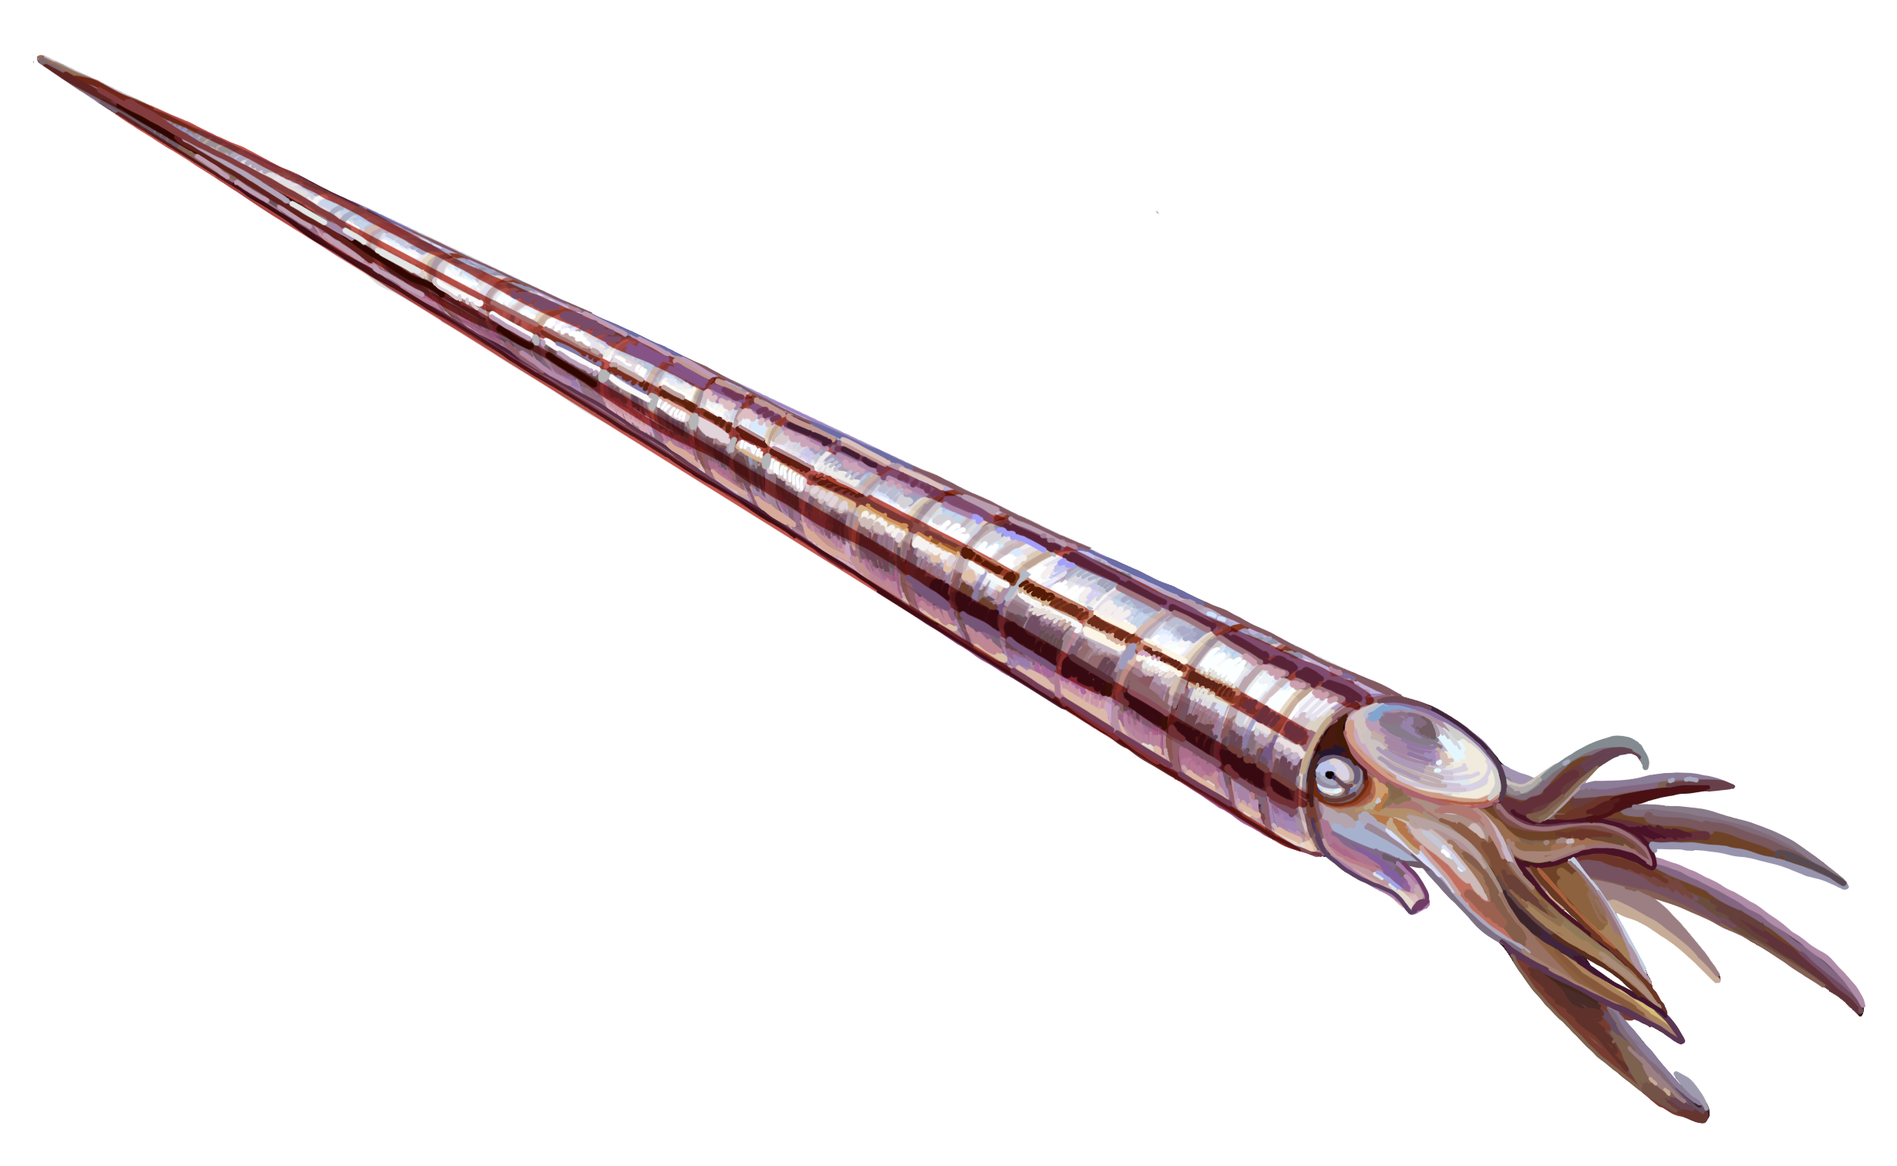
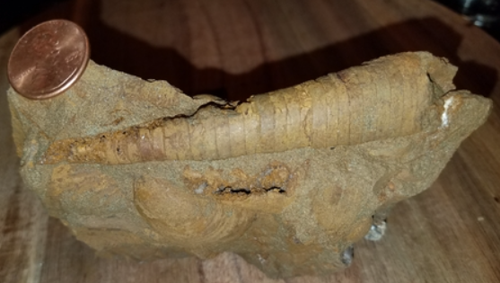
Nautiloid
Nautiloids were ancient marine animals with long, hard shells. Some had straight tube-shaped shells, while others were gently curved. They moved by jet‑propulsion, like modern squids and nautiluses, and their shells had chambers that helped them float.
Straight-shelled Nautiloid. Photo by Entelognathus. Licensed under CC BY-SA 4.0. Wikimedia commons
Nautiloids first appeared more than 470 million years ago and were important predators. All the straight-shelled kinds are extinct, but a few modern nautiluses with coiled shells still live today.
Mississipian Nautiloid from Jackson, Michigan. Photo by Mary Ann Szwaboswki, courtesy of the Michigan Basin Fossils Project.
In Michigan, Nautiloid fossils are found in both the Upper and Lower Peninsulas. The Upper Peninsula has older and much larger nautiloids (470-460 million years old), including giants over 5 feet long from places like the Sherman Hill Quarry (Keweenaw Peninsula). The Lower Peninsula has smaller and younger nautiloids (about 390-340 million years old), found in areas such as Rockport State Recreation area, Charlevoix, Alpena and Jackson Counties.

Slide 13
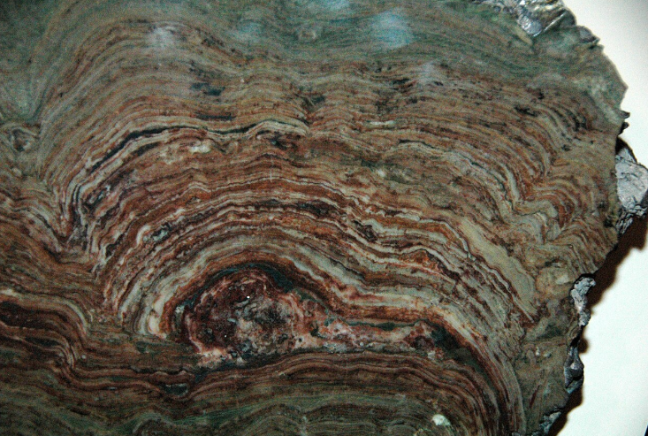
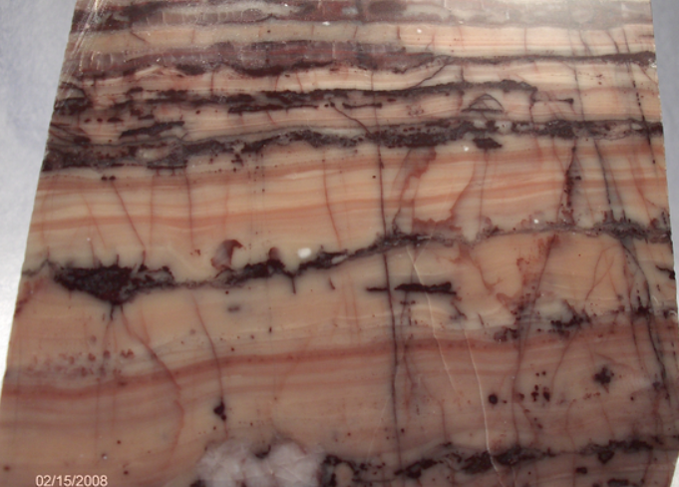
Stromatolite
Stromatolites are ancient, layered rocks made by tiny microbes cyanobacteria) that lived in shallow water, trapping sand and mud and building layers similar to a lumpy stack of pancakes. Even though they look like rocks, they are actually fossils of some of the earliest forms of life on Earth.
Precambrian stromatolite from Montana. Photo by James St. John. Licensed under CCBY-2.0. Wikimedia commons
Stromatolites were important for the development of life on Earth. About 2 billions years ago, the Earth was tough place to live, and only simple single-celled organisms existed. Cyanobacteria used high ultraviolet radiation to do photosynthesis, slowly adding oxygen to the atmosphere and making it possible for other forms of life to grow and evolve.
In Michigan, stromatolite fossils are found mainly in the Upper Peninsula along the shores of Lake Superior. The Kona Dolomite in Marquette and Horseshoe Harbor in Keweenaw Peninsula are some good places to observe them.
Kona Dolomite from Marquette, Michigan. Photo by David Thompson, courtesy of the Michigan Basin Fossils Project.

Slide 14
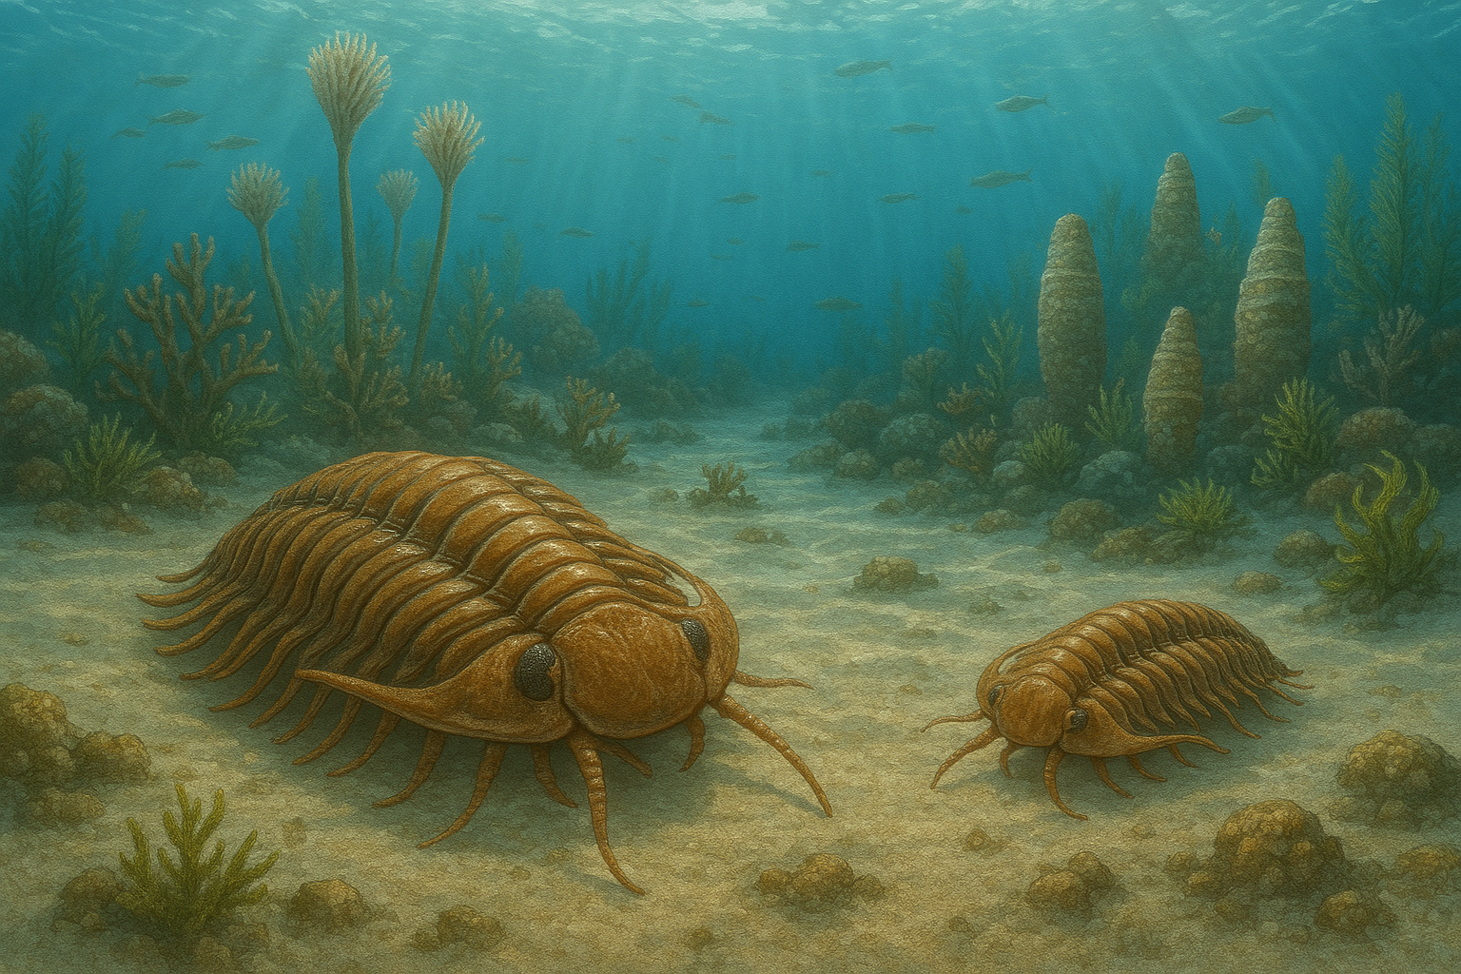
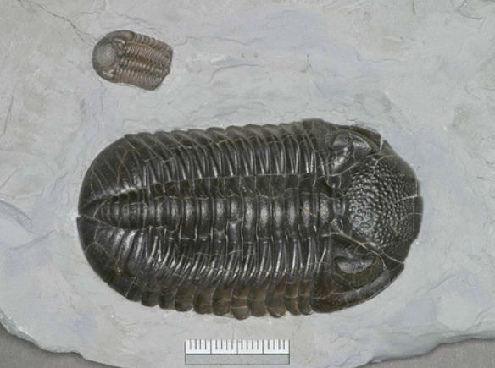
Trilobite
Trilobites were ancient marine creatures that looked a bit like underwater bugs. They had hard shells and lived on the sea floor. Their name comes from the three lobes that form the middle part of the body. They also had lots of legs underneath.
AI reconstruction of a trilobite
Trilobites lived hundreds of millions of years ago and were very abundant in the early Paleozoic seas. They became extinct around 251.9 million years ago, during the largest mass extinction event in Earth's history, when more than 90% of all species on Earth disappeared. This event was even bigger than the extinction that wiped out the dinosaurs.
About 380 million years ago, during Devonian times, trilobites crawled along Michigan's seafloor, back when the state was covered by a warm, shallow sea. We can find trilobite fossils in places like Rockport State Recreation Area, Presque Isle County, Chippewa River Shale Fossil Beds, and Grand Ledge Shale Fossil Beds.
Devonian Trilobite from Lucas, Ohio. Photo by David Thompson, courtesy of the Michigan Basin Fossils Project.

Slide 15
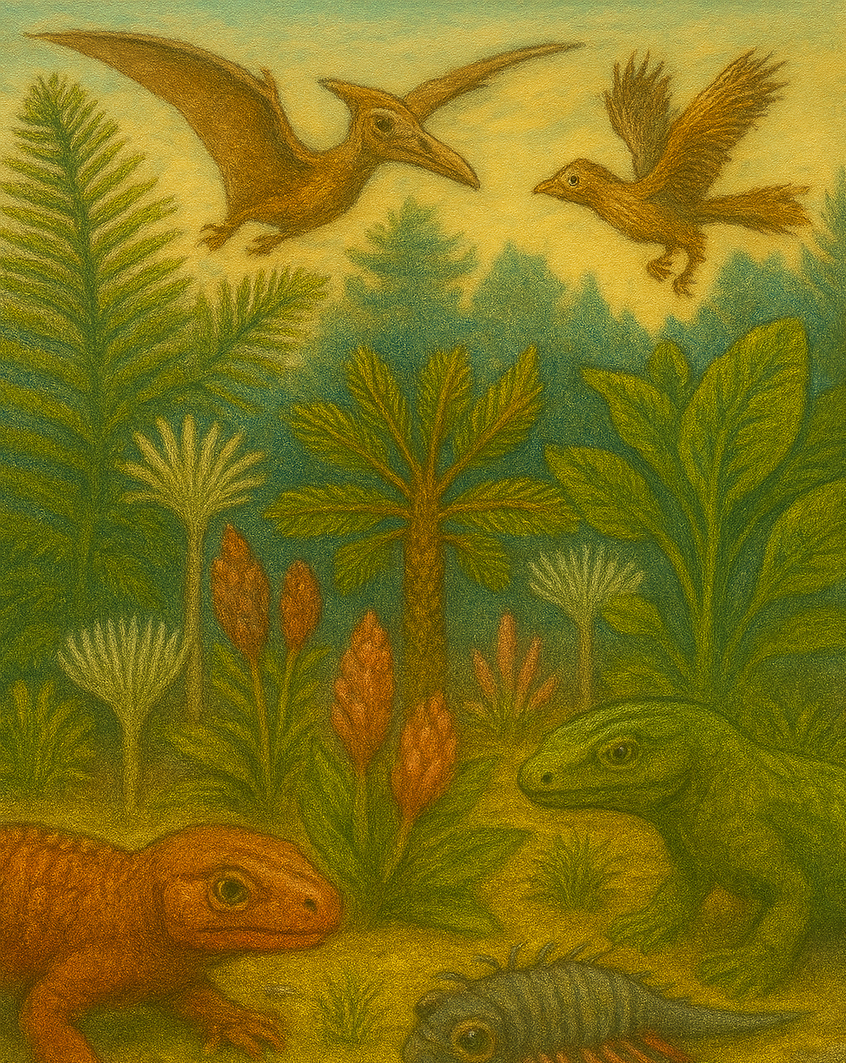
Terrestrial fossils

Slide 16
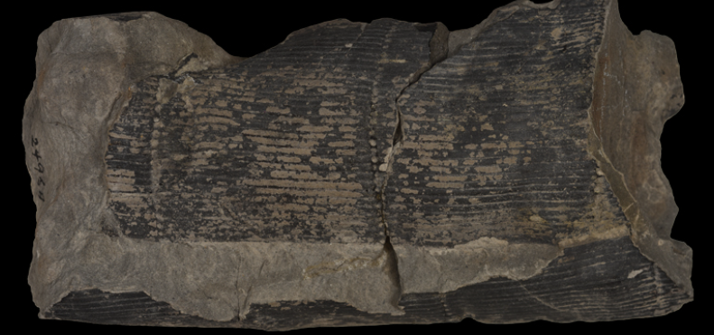
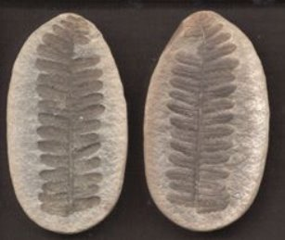
Ferns and horsetails
Ferns and horsetails have been around for over 300 million years, long before flowers bloomed or dinosaurs stomped. They are still alive, but in the Carboniferous Period, they grew tall and wild in swampy forests. Ferns spread their feathery fronds, while horsetails stood like green towers with ringed stems and brushy tops. When these plants fell into muddy water, some were buried and fossilized—leaving behind stamp-like impressions pressed into rocks. Those plants did not make seeds—they used spores, like tiny dust specks, to grow new plants.
Carboniferous horsetail from Michigan. Photo courtesy of the UoM Museum of Paleontology
Fossil ferns often show frond shapes, vein patterns, and even spore clusters. Horsetails leave behind stem impressions with ringed joints and brushy tops. Several of these plant remains have been found in Michigan's counties (Jackson, Ingham, Eaton, Shiawassee, Bay and Saginaw).
Carboniferous fern leaf from Mazon Creek (Illinois). Photo courtesy of the Illinois State Museum.

Slide 17
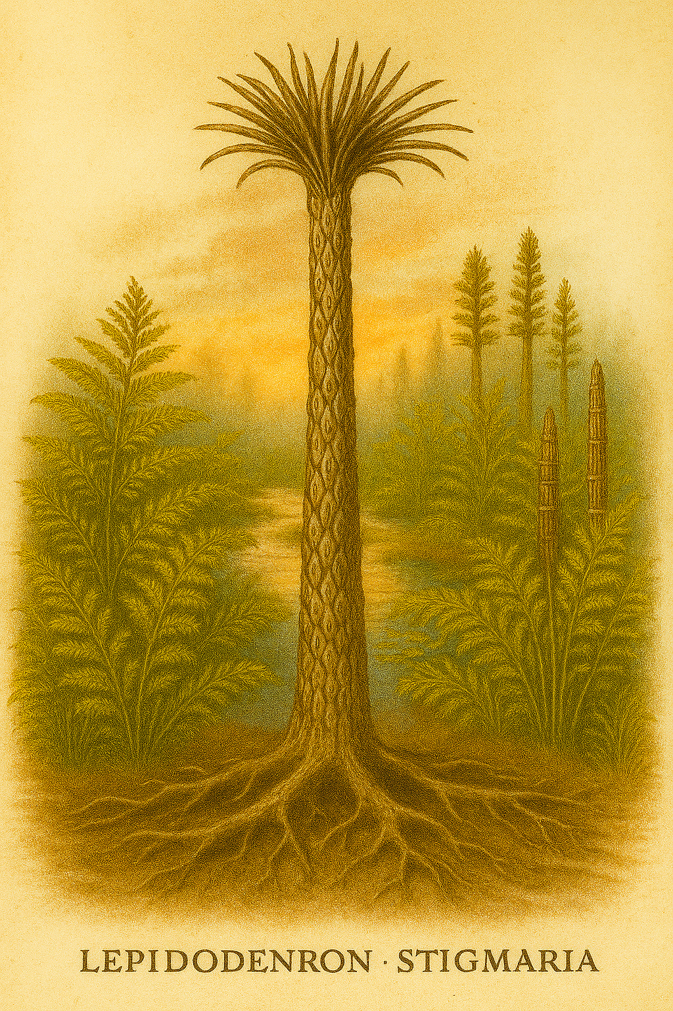
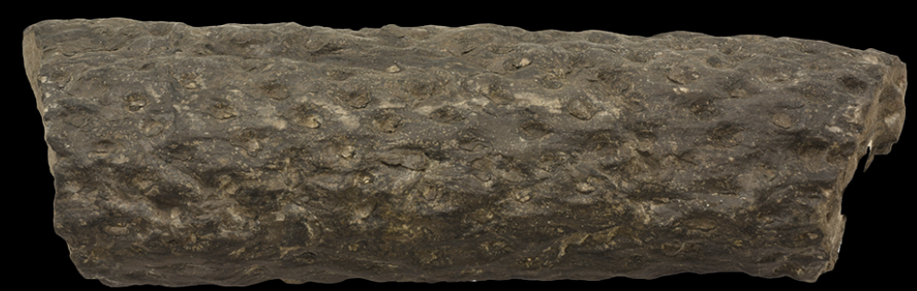
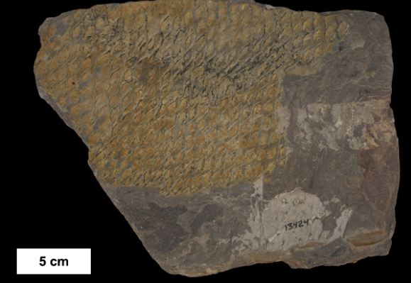
Lepidodendron/Stigmaria
Lepidodendron was a giant plant that looked like a tree but was actually a super-sized club moss. It grew over 100 feet tall in ancient Carboniferous swamps, with a straight trunk covered in diamond-shaped scales—like a pineapple stretched sky-high! Its leafy crown sat at the very top, and it reproduced with spores, not seeds.
Stigmaria was the root system of Lepidodendron. These roots had little dimples where tiny rootlets popped out—like a sponge full of straws!
AI reconstruction of a Lepidodendron club moss and Stigmaria root system
Fossils of Lepidodendron and Stigmaria are often found in Pennsylvanian-age coal beds and shales across Michigan. Both became extinct during the Permian extinction event, 251.9 million years ago, but they helped to form the coals we still use today.
Carboniferous Stigmaria roots (left) and Lepidodendron bark (right) from Michigan. Photo courtesy of the UoM Museum of Paleontology

Slide 18

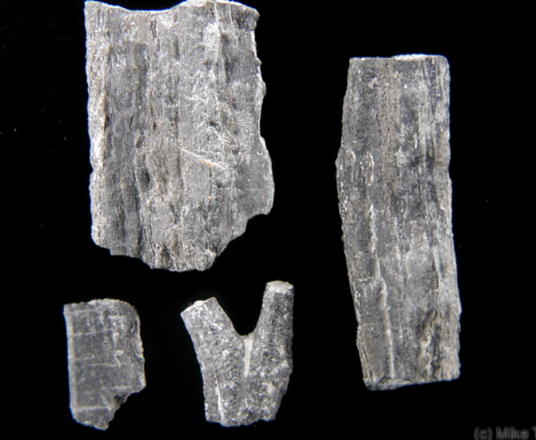
Petrified Wood
Long ago, ancient trees fell and were buried under layers of mud, ash, or sand. Instead of rotting away, they began a magical transformation: water full of minerals soaked into the wood, slowly replacing each tiny cell with stone. Over millions of years, the tree turned into a fossil—but kept its bark, rings, and shape!
Petrified wood is often made of quartz, and it can sparkle or show rainbow colors depending on the minerals inside. Unlike flat leaf fossils, petrified wood is 3D, so you can still see the tree’s texture and growth rings.
Logs of petrified wood in the National Petrified Forest, Arizona. Photo courtesy of the National Park Service.
Although we find some fossilized wood in Michigan from the Carboniferous Period (about 310 million years ago), they are not as colorful as others, and instead, they look more like dark, mineralized chunks of ancient tree materials, similar to the one in the image at the right.
Devonian tree remnants from Lambton, Ontario. Photo by Mike Topor, courtesy of the Michigan Basin Fossils Project.

Slide 19
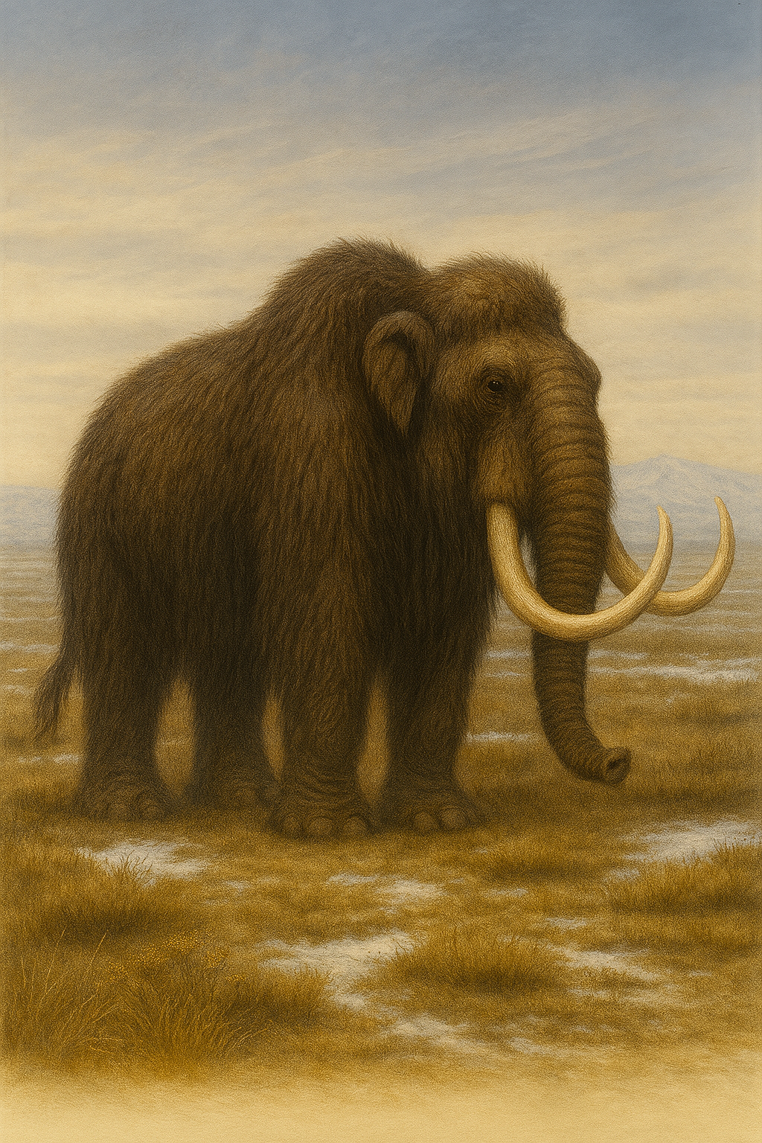
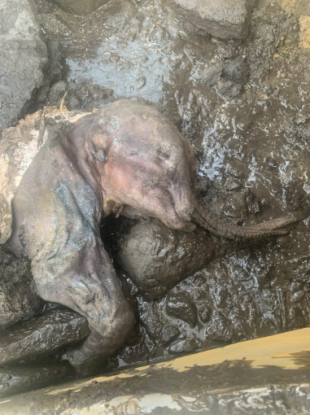
Mammoth
Mammoths were woolly giants that lived in cold places during the Ice Age. They had long, curved tusks and thick fur to keep warm—even in freezing weather. They used their tusks to dig through snow and find grass and shrubs to eat. Their teeth had flat, smooth ridges –like a washboard- so they could grind tough grass.
AI reconstruction of a Mammoth
They traveled in herds and cared for their young, just like elephants do today. Some mammoths got frozen in ice, and scientists have found their bodies still preserved— like nature’s freezer keeping a secret from the past.
Mammoth remains are mostly found in the Lower Peninsula of Michigan, especially in farm fields and places where people dig for construction. Some mammoth bones even have marks from ancient tools—proof that early humans may have hunted them!
Baby wooly mammoth found in Yukon (Canada). Photo courtesy of the Government of Yukon. Retrieved from the Smithsonian Magazine.

Slide 20
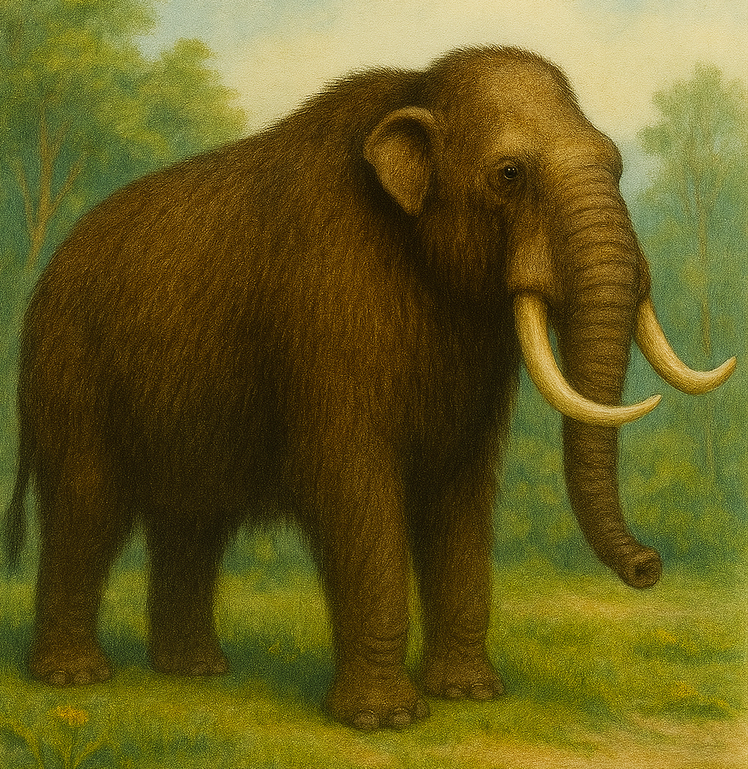
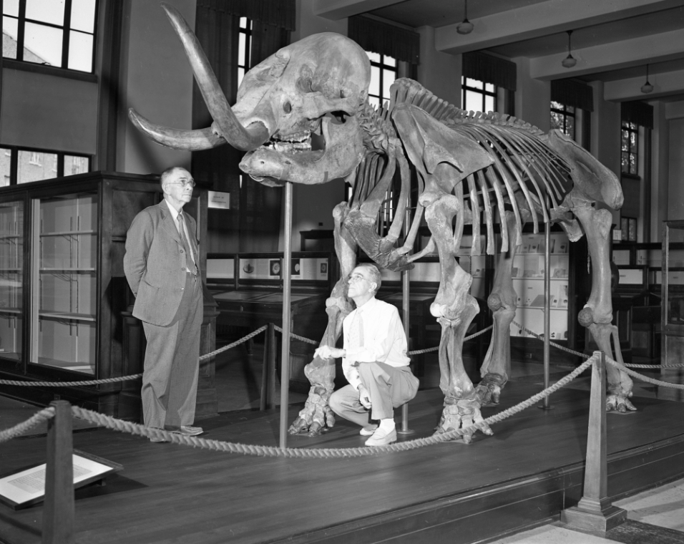
Mastodon
Mastodons were ancient relatives of elephants, with shaggy hair and long tusks. Mastodons roamed North America during the Ice Age and became extinct 10,000 years ago. They lived in forests and munched on twigs, leaves, and shrubs. Their teeth were bumpy and perfect for chewing tough plants and crushing twigs.
AI reconstruction of an Mammut americanum, also known as mastodon.
The mastodon was designated the official state fossil of Michigan in 2002. Their bones and teeth have been found in over 250 places across the state—like farm fields, muddy bogs, and even near cities!
One of the best mastodon skeletons found in Michigan was discovered in 1944 in Owosso, Michigan. It is exhibited in the University of Michigan Museum of Natural History.
Mounted skeleton of the Owosso mastodon. Image courtesy of the Ann Arbor District Library. Public domain.

Slide 21
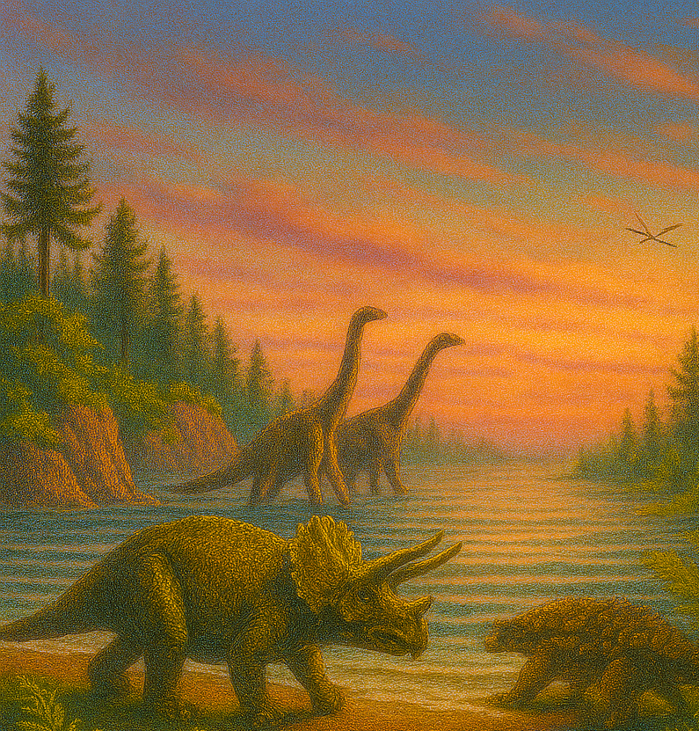
Popular fossils that are not found in Michigan

Slide 22
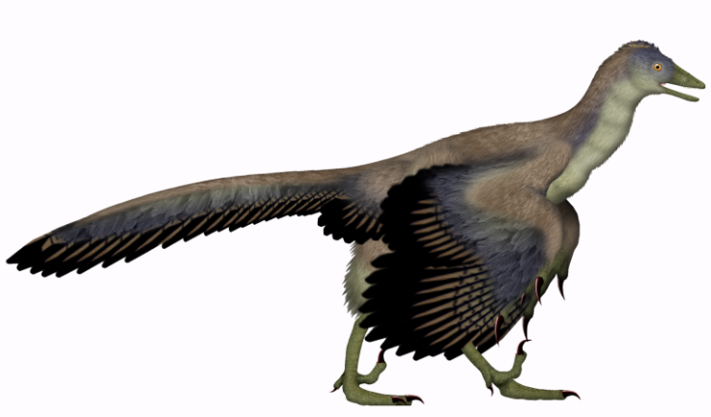
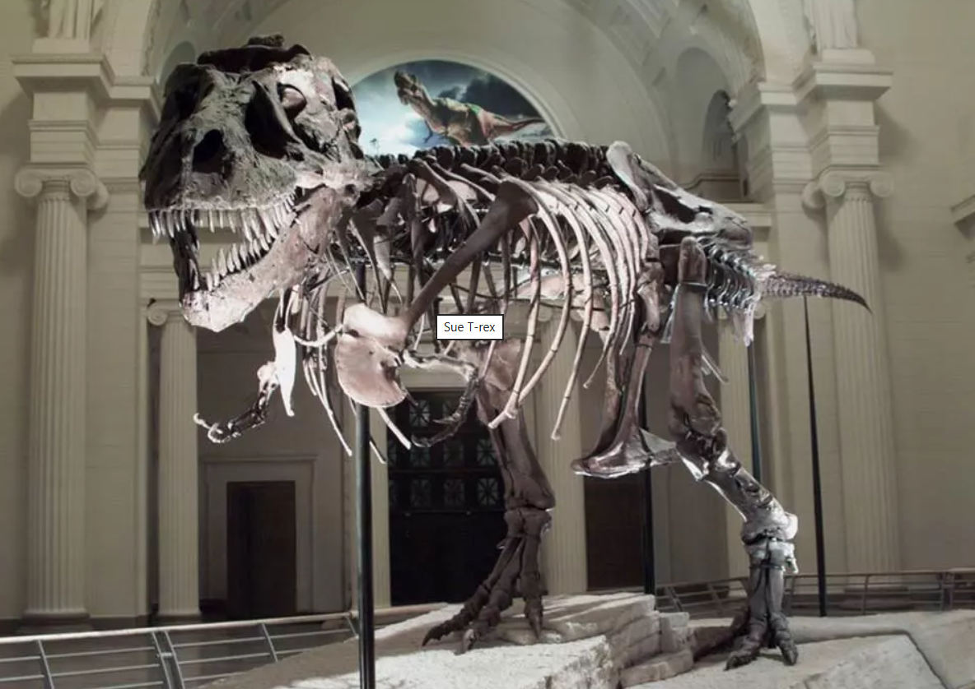
Dinosaurs
Dinosaurs were a group of amazing reptiles that lived for over 160 million years, from the Triassic to the end of the Cretaceous. They came in all shapes and sizes—from chicken-sized runners to towering giants taller than buildings! Some had horns, plates, or feathers. Some stomped through forests, while others zipped across deserts or soared through the skies. They weren’t just big—they were diverse, adaptable, and lived in many places.
Most dinosaurs went extinct when a giant asteroid struck the Earth 66 million years ago—but modern birds evolved from small, feathered species that survived.​
Archaeopteryx, the closest link between birds and dinosaurs. Image courtesy of UnexpectedDinoLesson. CC BY-SA 4.0
Although Jurassic rocks are found in Michigan, no one has discovered dinosaur fossils in them yet. The only fossils found in these rocks so far are pollen grains. However, you can see dinosaur fossils and statues in several museums, like the Schmaltz Geology Museum (WMU) or the UoM Museum of Natural History.
Skeleton of a T-Rex (Sue) exhibited in the Field Museum, Chicago, Illinois. Photo courtesy of the National Park Service.

Slide 23
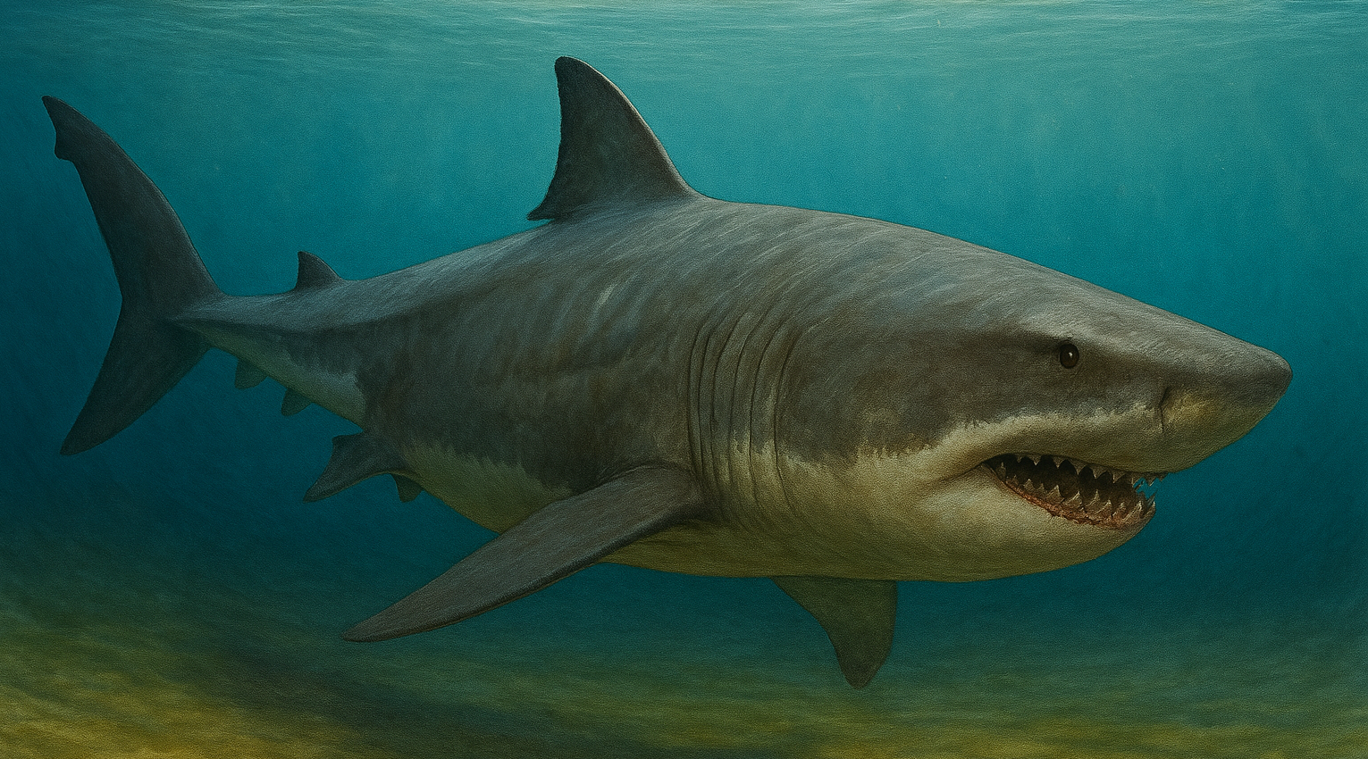
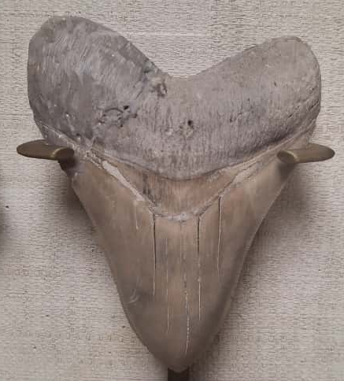
Megalodon
The megalodon was a giant shark—so big its teeth were the size of bananas! It swam in warm oceans between 23 and 3.6 million years ago.
AI reconstruction of a Megalodon
This super shark had a huge mouth full of sharp teeth and could grow longer than a school bus. It was one of the biggest and most powerful predators to ever live in the sea! It is extinct now, but its fossil teeth are found all over the world because it shed thousands of them—and teeth fossilize better than bones.
There are no megalodon fossil sites in Michigan, because the rocks here aren’t the right age. However, you can find pretty cool collections of megalodon teeth in the Schmaltz Geology Museum in Kalamazoo or the University of Michigan Museum of Natural History.
Megalodon tooth from the Schmaltz collection-WMU

Slide 24
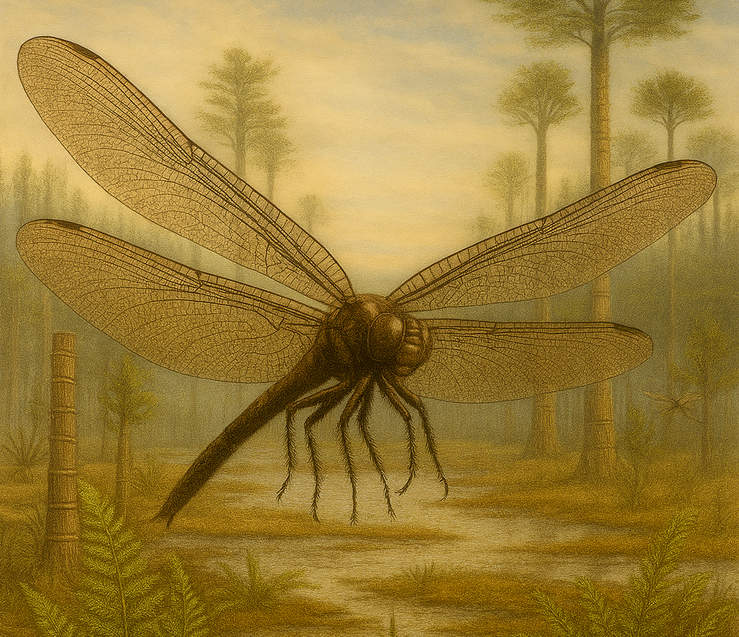
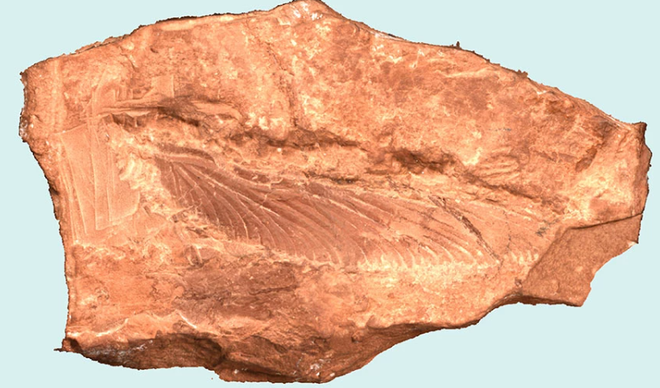
Meganeura
Long before dinosaurs stomped the Earth, giant dragonfly-like insects zipped through swampy forests. These ancient flyers had wingspans as wide as a hawk’s—some over 2 feet across! They soared above giant ferns and buzzing bugs during the Carboniferous and Permian periods, more than 300 million years ago.
Unlike today’s dragonflies, Meganeura had strong jaws, powerful flight muscles, and extra-long wings with bold veins. They were top predators of the sky, snatching up beetles, mayflies, and anything small enough to grab mid-air.
AI reconstruction of Meganeura
Although we have carboniferous rocks in Michigan, there are no reports of Meganeura fossils here. However, in Mazon Creek (Illinois), you can find some small dragonfly-like fossils among other insects, amphibians and plants.
Permian dragonfly wing from the Grand Canyon National Park. Photo by Jack Wood courtesy of the National Park Service.

Slide 25
Acknowledgments
We want to express our gratitude to Dr. Peter Voice (Western Michigan University) for reviewing this document to help ensure the accuracy of the information. We also thank Dr. Heather Petcovic (Western Michigan University) and Sara Pearson (Michigan Geological Survey) for their feedback and support, as well as everyone at the Michigan Geological Survey who contributed to the realization and publishing of this booklet.
Disclosure Statement
This material was created for educational purposes only. It is intended for classroom use and not for commercial distribution. The authors acknowledge the use of generative AI tools to support the development of age-appropriate language and visual graphics throughout this resource.

