Slide 1




THE STORIES FOSSILS TELL

Slide 2
What will we learn in this unit?
Lesson 1
Lesson 2
Lesson 3
Lesson 4
Lesson 5
FOSSILS AND ENVIRONMENTS
HOW DO FOSSILS FORM?
THE STORY OF A FOSSIL
WHERE WAS MICHIGAN IN THE PAST?
COMMON FOSSILS IN MICHIGAN

Slide 3
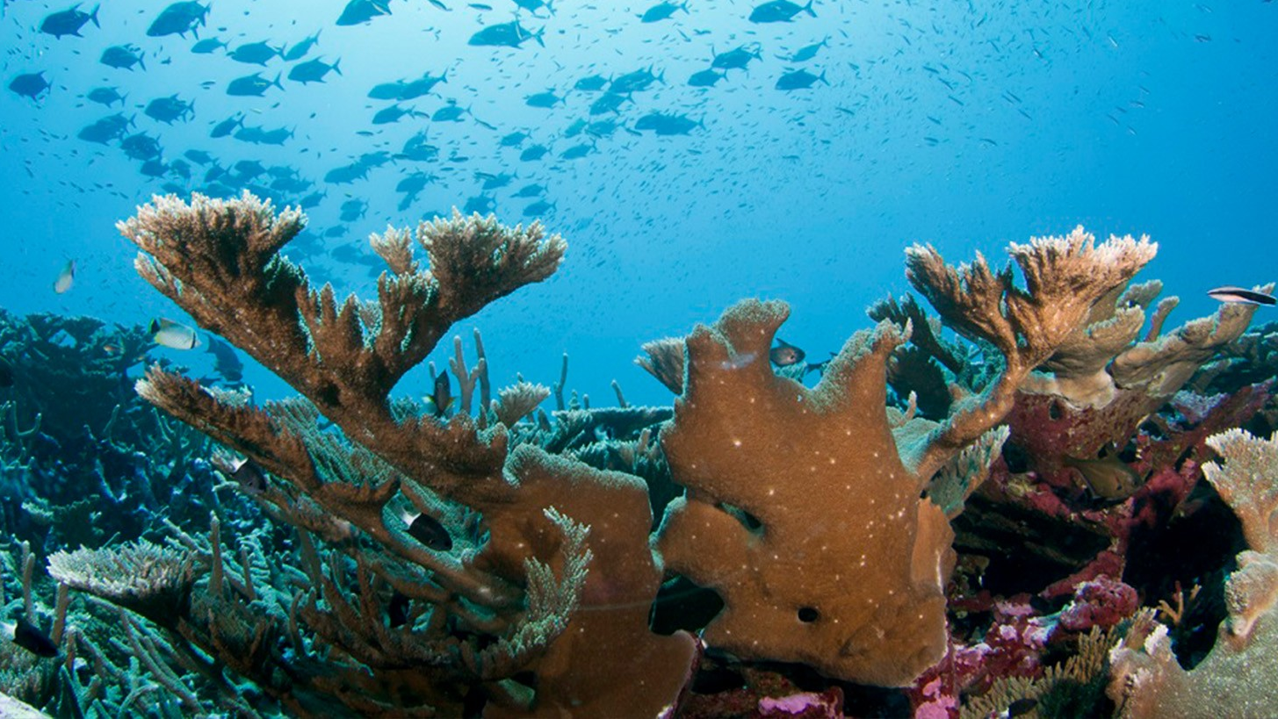
FOSSILS AND ENVIRONMENTS
LESSON 1
Image from NOAA Atlantic Oceanographic and Meteorological Laboratory (AOML). View in NOAA National Marine Ecosystem Status Page. Public Domain.

Slide 4
WHAT IS A FOSSIL?
Fossils are the preserved remains or traces of living things that lived in the past. Another name for living things is organisms.
Most fossils come from the hard parts of the organism (bones, teeth, shells) because they are tougher and less likely to be destroyed by chemical or physical processes.
But animals also can leave their footprints, eggs, or even poo! All of these can become fossils.

Slide 5
Activity
(Handout 1)
Look at the samples provided in the sorting kit bag and explain:
Which objects were ever alive?
Which objects were never alive?
Which ones are unclear?
Which ones are fossils?
Which ones could become fossils?

Slide 6
LIVING THINGS NEED:
Air: Oxygen or Carbon Dioxide
Did you use one of these today?
Water: Hydration, growth, and life processes
Food: Provides energy to grow, move and stay healthy
Shelter: Protection from weather and predators
Sunlight: For plants to make their own food – photosynthesis. For animals to regulate temperature, behavior, and produce Vitamin D.

Slide 7
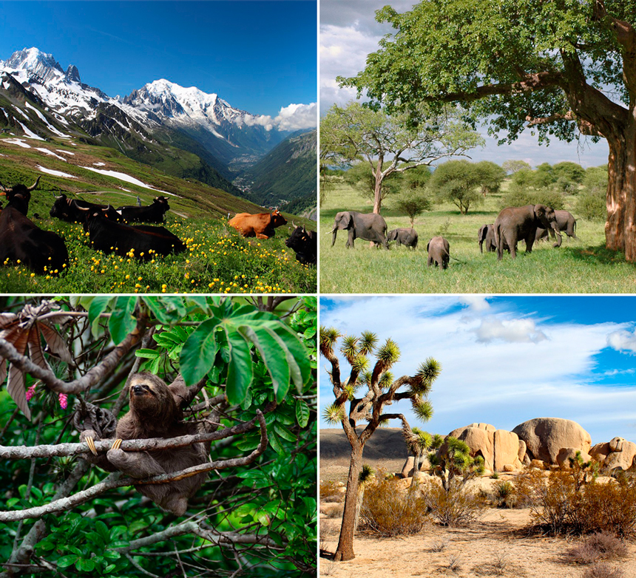
LIVING THINGS NEED A SUITABLE HABITAT
Habitat: The specific place where organisms live in (their home). The habitats must meet their physical needs for survival.
Environment: Is everything around their habitat (all the conditions that affect the habitat), such as water depth, temperature, light, etc.
Ecosystem=living community + environment + their interactions (how do they all affect each other)
Image source: “Características Ecosistema Terrestre”. Licensed under CC BY-SA 4.0 via Wikimedia Commons

Slide 8
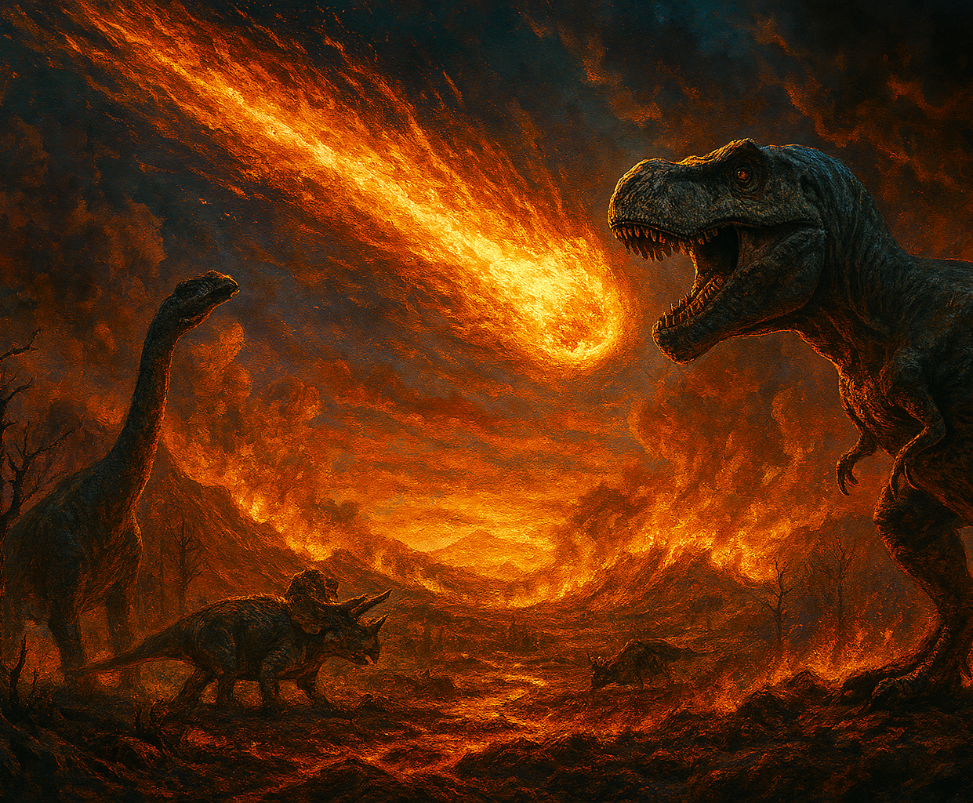
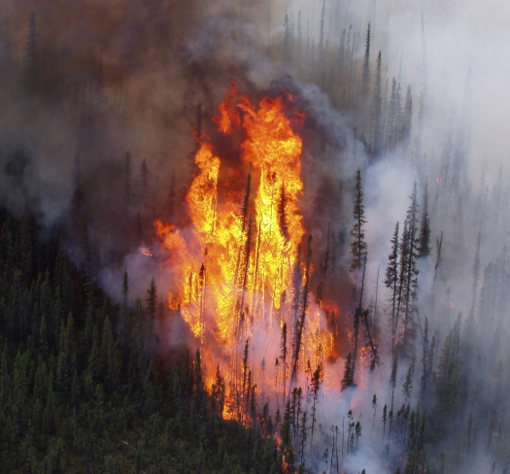
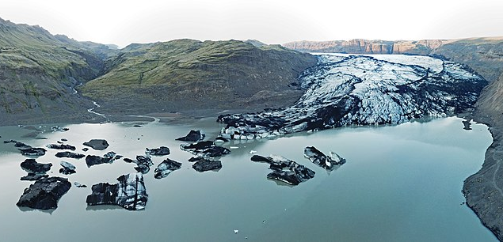
THE ENVIRONMENT CAN CHANGE
AI reconstruction of the dinosaurs exctinction event
Photo of a wildfire courtesy of the U.S. Fish and Wildlife Service. Public domain.
What might happen to the living things in that environment?
Photo of a melting glacier by Maxim Bilovitskiy. Licensed under CC BY 4.0 via Wikimedia Commons

Slide 9
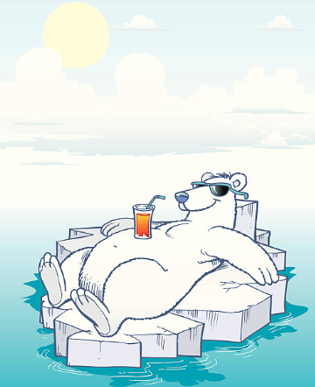
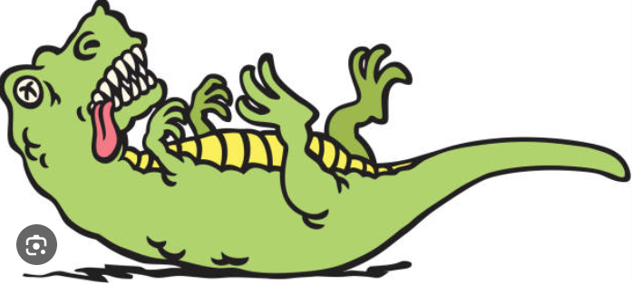


IF THE ENVIRONMENT CHANGES, ORGANISMS MIGHT:
Adapt
Die
( we call it extinction if all organisms in a species die)
Migrate
(leave their homes and move to another place)
...other new organisms move in and change the food chain

Slide 10
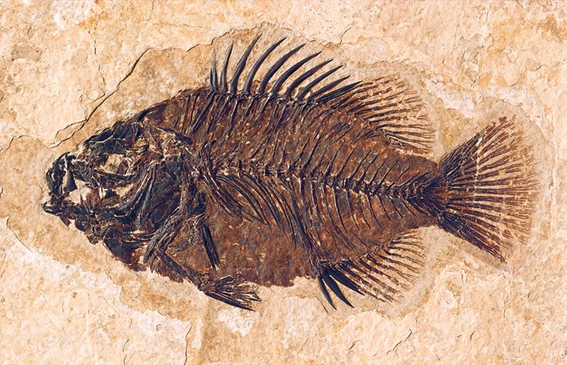
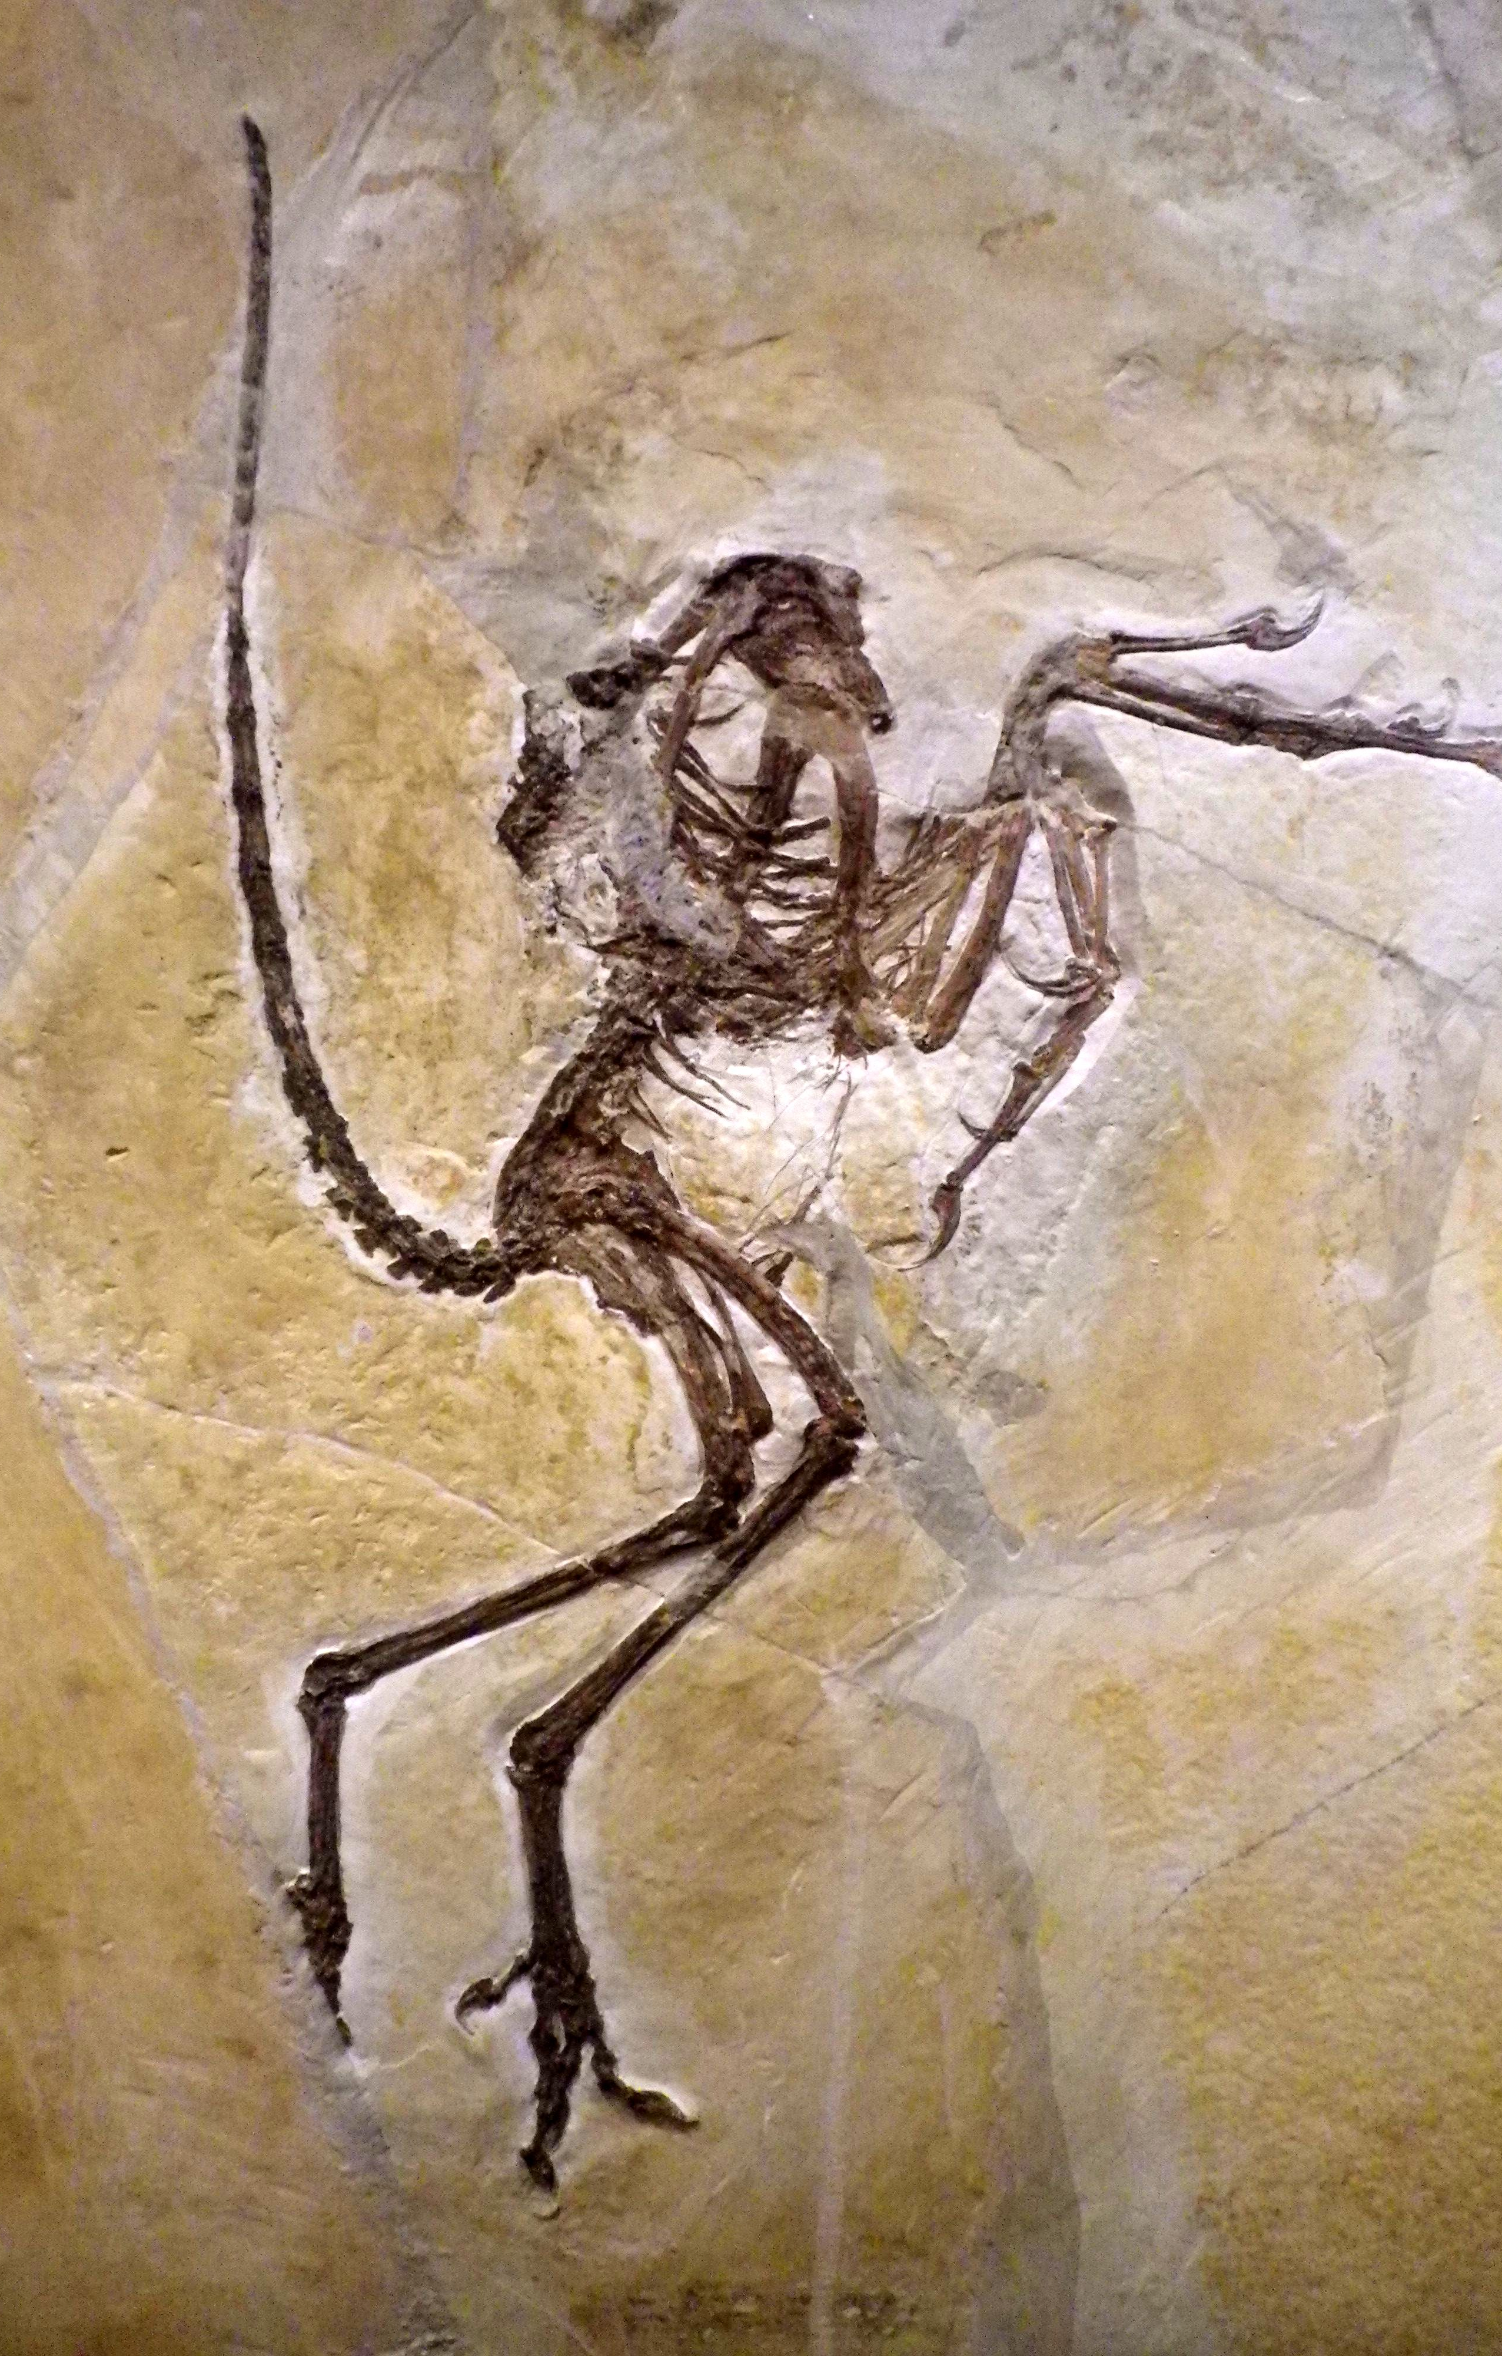
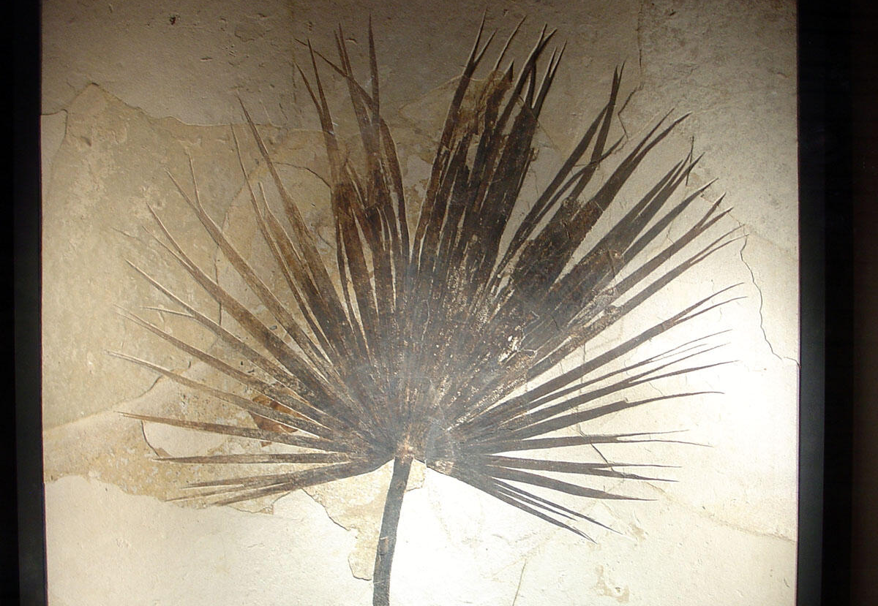
What do fossils show us about ancient environments?
Fish fossil photo, courtesy of the U.S. National Park Service, Fossil Butte National Monument. Public domain.
Photo by Chrisi1964, “Archaeopteryx in Solnhofener Plattenkalk.” Licensed under CC BY-SA 4.0 via Wikimedia Commons.
Fossil Palm leaf, courtesy of the U.S. Geological Survey. Public domain.

Slide 11
FOSSILS CAN PROVIDE
Evidence of life: What organisms lived in a location and when they lived there
Evidence of past environments: Climate, landforms
Evidence of interactions between living things and environment.
Evidence of evolutionary changes in organisms.
Fossils are irreplaceable and non-renewable! Once moved from the original location, a lot of information is lost.

Slide 12
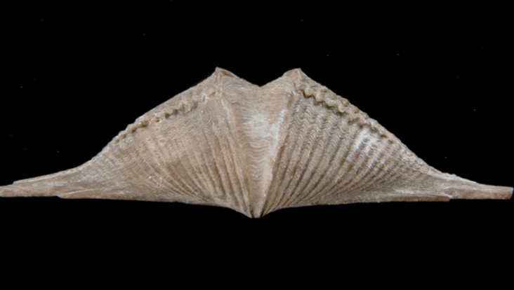
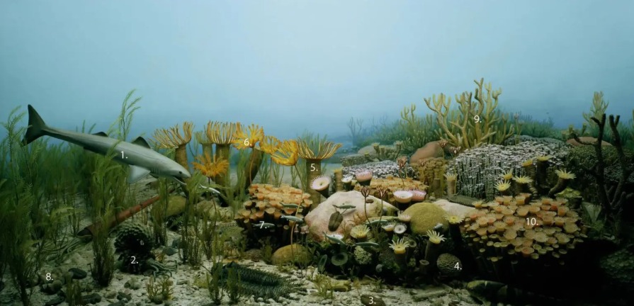
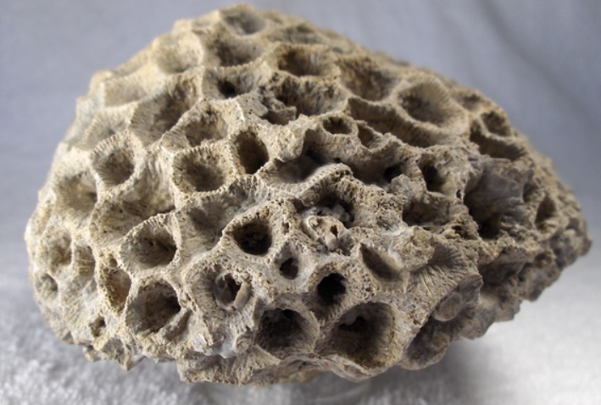
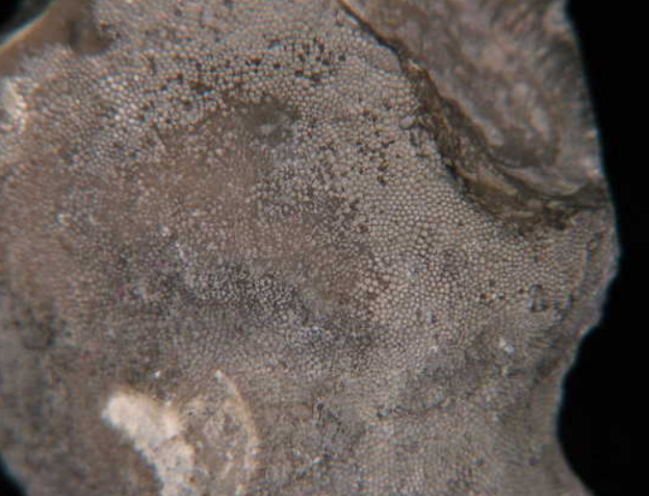
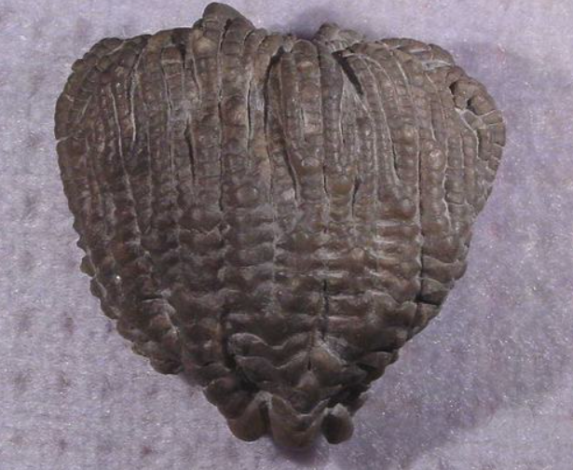
ANCIENT ENVIRONMENTS
FOSSILS AND
Image from Grand Rapids Public Museum: “Collecting Marine Fossils in Michigan”
This is how Michigan's environment looked 400 million years ago (mya).

Slide 13
Do any ancient organisms look like modern organisms?
Why would that happen?
Look at the following slides and ask yourself:
Does the ancient organism look like the modern one?
If similar, what are some possible ideas about why they are alike?
Did the organism manage to survive environmental changes over a long time period?
Did a new but similar-looking organism developed over time?

Slide 14
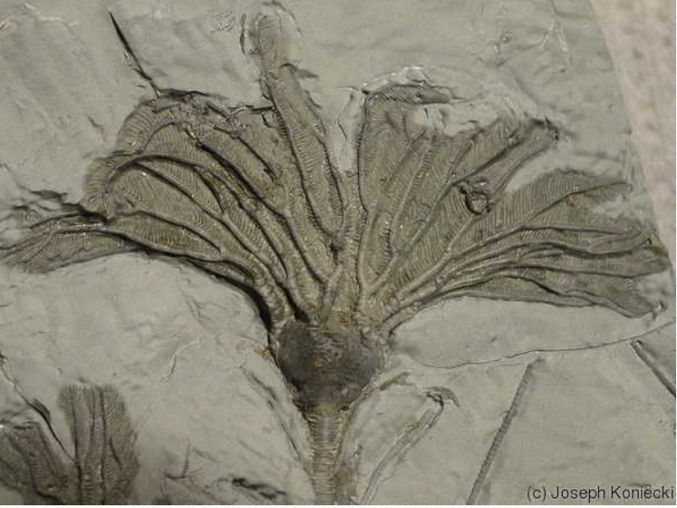
ANCIENT VS MODERN (crinoid) 1
Crinoid from Arkona, Ontario (380 mya)
Photo by Joseph Koniecki: “Crinoid with Starfish”. Copyright © Michigan Basin Fossils.

Slide 15
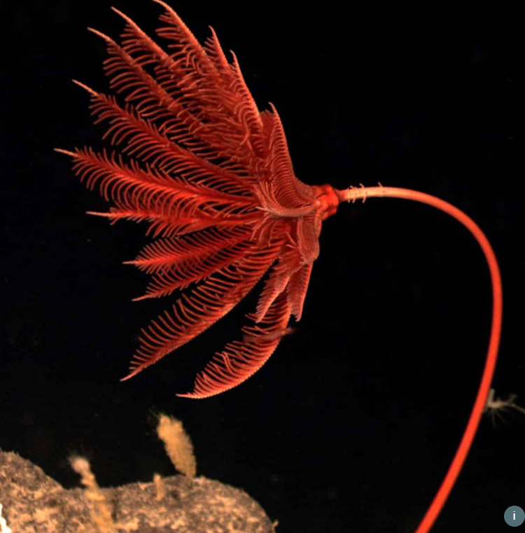
ANCIENT VS MODERN (sea lilies)
Sea Lily in Marianas region: NOAA Ocean Exploration and Research Licensed under Creative Commons Attribution 2.0 CC BY 2.0
Modern Sea Lilies, Atlantic Ocean

Slide 16
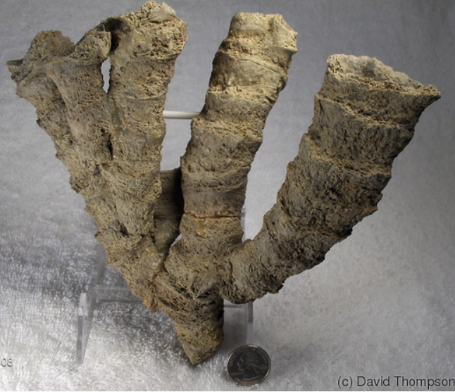
ANCIENT VS MODERN (branching coral) 3 2
Coral from Alpena, MI (390 mya)
Photo by David Thompson: “Branching Coral”. Copyright © Michigan Basin Fossils.

Slide 17
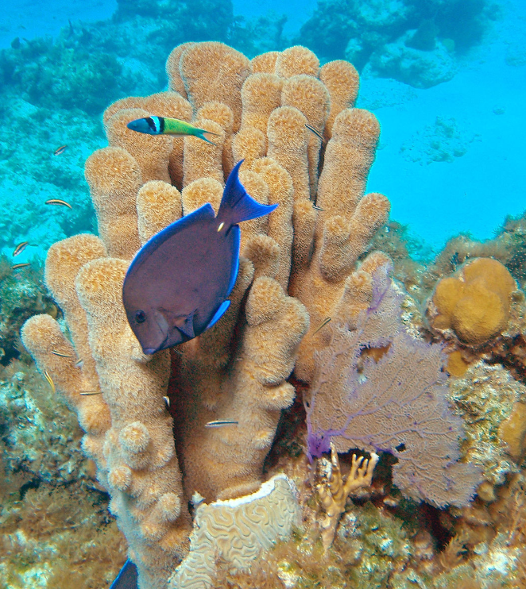
ANCIENT VS MODERN (corals)
Modern coral reefs
Photo by Mark Peter: “pillar coral” Licensed under Creative Commons Attribution 2.0 CC BY 2.0 via Wikimedia commons

Slide 18
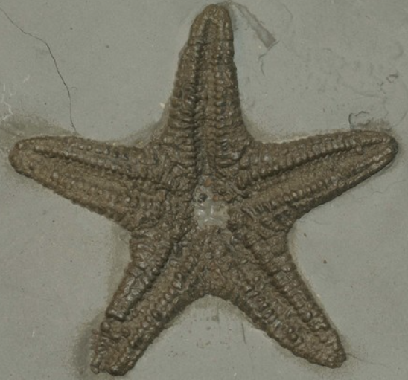
ANCIENT VS MODERN (ancient starfish)
Starfish(sea star) from Arkona, Ontario (400 mya)
Photo by John Topor: “Starfish”. Copyright © Michigan Basin Fossils.

Slide 19
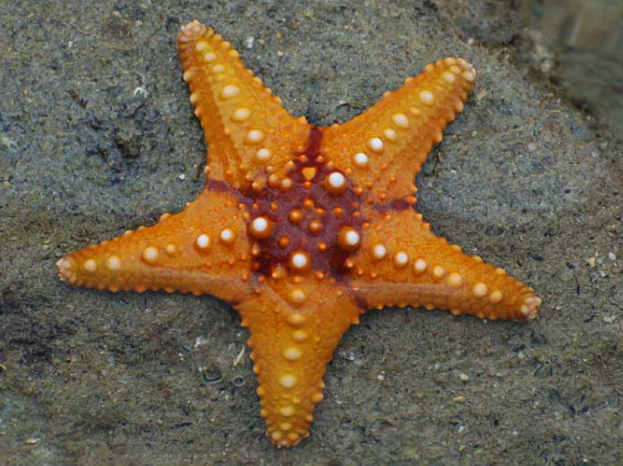
ANCIENT VS MODERN (starfish)
Photo by Paul Shaffner, from the page “Sea Life, Islands and Oceania”. Licensed under Creative Commons Attribution 2.0 Generic (CC BY 2.0).
Modern starfish (sea stars)

Slide 20
WRITING ASSIGNMENT (HOMEWORK LESSON 1)
If you were:
A fish
A tree
A cow
A lion
A polar bear
What would your habitat need in order for you to survive?
Draw or write your response for each organism.

Slide 21
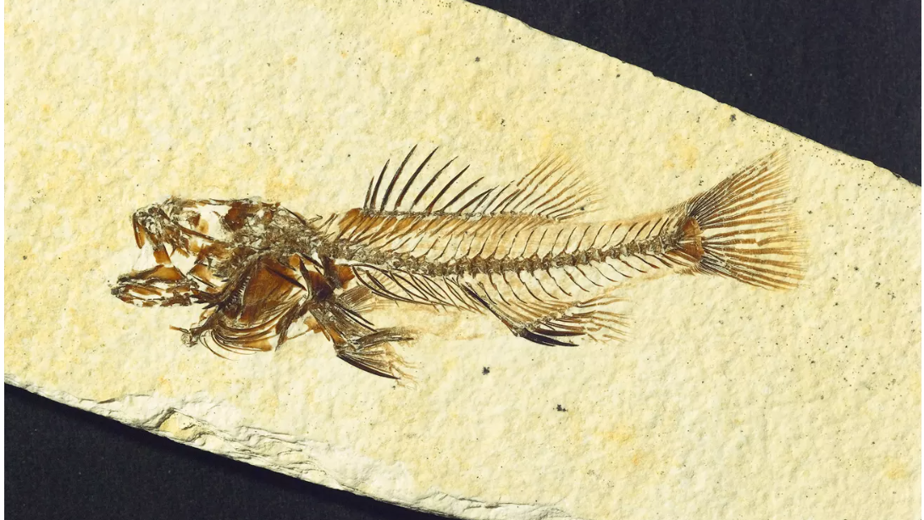
HOW DO FOSSILS FORM?
Fossil Fish from the Fossil Butte National Monument, Wyoming. Courtesy of the National Park Service. Public Domain.
LESSON 2

Slide 22
WHAT ARE FOSSILS?
WHAT IS FOSSILIZATION?
Fossils are the preserved remains or traces of living things that lived in the past. Another name for living things is organisms.
Fossilization is the process by which living things from long ago are preserved. Fossils help scientists learn about organisms that lived millions of years ago!

Slide 23
ARE ALL FOSSILS OLD?
ARE THEY EASY TO FIND?
Fossils are old! Greater than 10,000 years old – hundreds of millions of years old, some even billions of years old.
They are usually found in rock layers (sedimentary rocks).
They are rare! A tiny percentage of living things become fossils when they die, and most are never found.
Organisms are more likely to be fossilized if they died along or inside a waterbody like a lake or ocean or had a rapid burial like a mudslide.

Slide 24
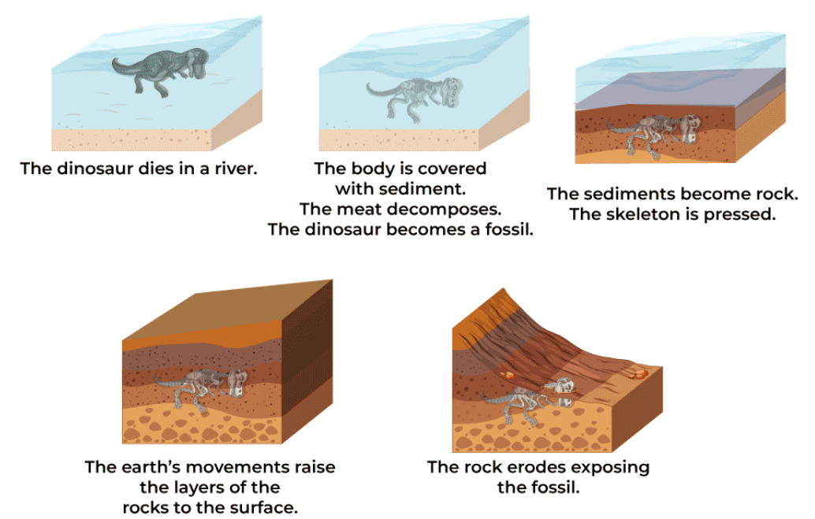
ARE ALL FOSSILS CREATED THE SAME WAY?
Illustration of the Fossilization Process. Copyright © GeeksforGeeks.
The dinosaur dies in a river.
The body is covered with sediment. The meat decomposes. The dinosaur becomes a fossil.
The sediments become rock. The skeleton is pressed.
The earth’s movements raise the layers of the rocks to the surface.
The rock erodes exposing the fossil.
This is a common way fossils are formed, but different types of fossils can involve other processes and materials.

Slide 25
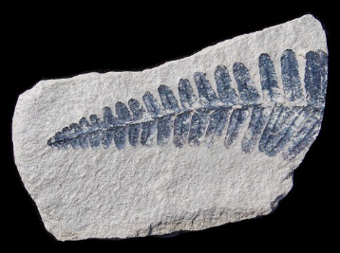
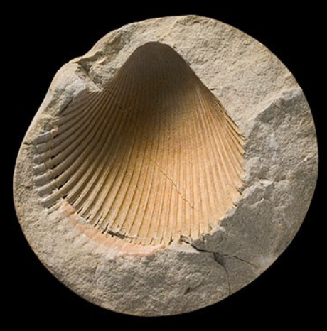
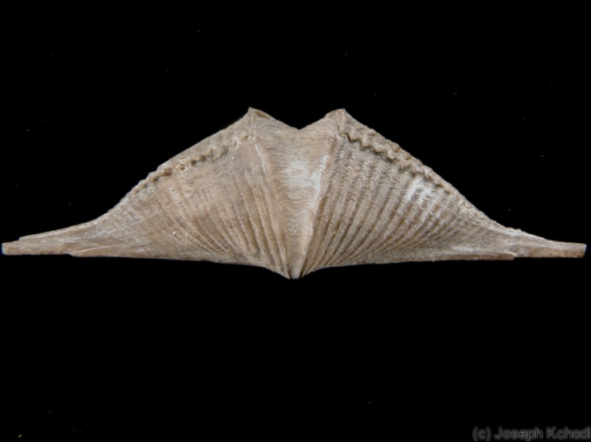
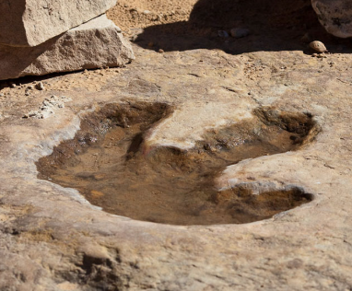
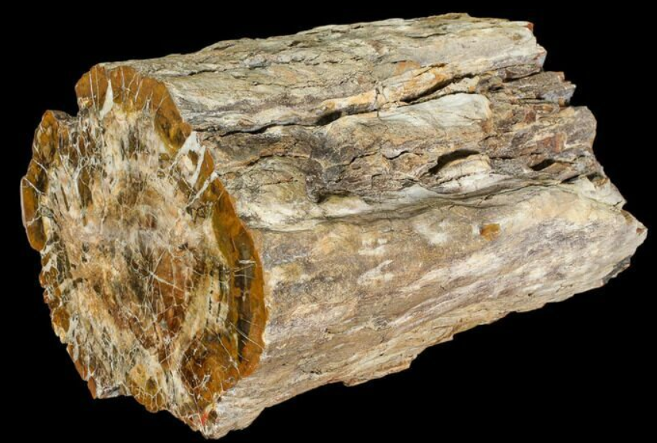
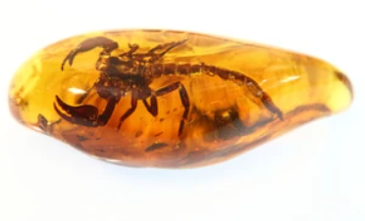
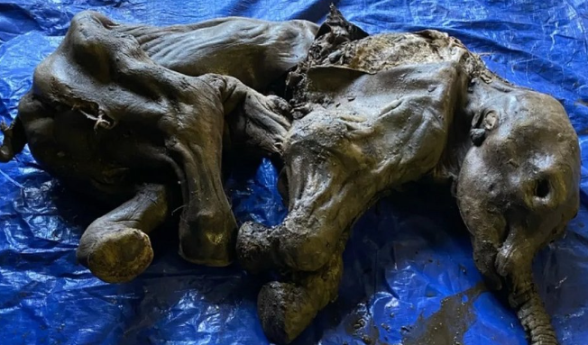
TYPES OF FOSSILS
MOLD
CAST
TRACE FOSSIL
CARBON FILM
PERMINERALIZED
PRESERVED REMAINS

Slide 26
MOLD FOSSILS
Mold fossils are natural imprints left behind when an organism is buried, then decays, leaving only a hollow space with the shape of its body.
Mold fossil of a bivalve in the NHM-London

Slide 27
CAST FOSSILS
A cast is like a 3D sculpture of an ancient creature. The original organism dissolves away, leaving an impression. Later, the impression fills with sediment or minerals and hardens, creating a replica with the shape of the original organism.
Photo by Joseph Kchodl: “Brachiopod”. Copyright © Michigan Basin Fossils
Brachiopod from Alpena, MI

Slide 28
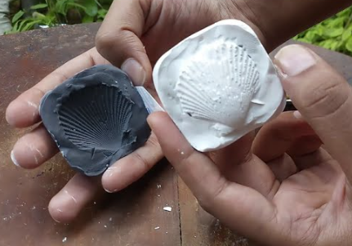
Make Your Own Mold Fossil Replica
Take a 3-D printed fossil replica and set it aside.
Draw a picture of your fossil replica on your worksheet (Handout 2).
Gently place about 3 inches of Play-Doh in the bottom of the container.
Pick the side of your fossil to mold and press it firmly into the Play-Doh layer to make an impression.
Remove your fossil and set it aside.
Using a container with plaster of Paris and water, use a wooden stick to gently stir the plaster of Paris mixture until well mixed. (Do not get plaster mix in eyes or mouth)
Pour enough of the plaster mixture into your impression to fill it to the top of the Play-Doh layer, but not over the top of the Play-Doh layer.
Put your name on your container.
Return the 3-D printed fossil, cup of plaster, and container with your mold to the drying location. Clean your work area!
Next day: Fossil replicas will be ready for you to gently remove from the container in 24 hours. Put your name and fossil cast in a plastic bag to take home. Return the container and Play-Doh to your teacher.
“How to make a fossil from Plaster of Paris”.
Watch on YouTube (Video ID VJUgSJl9AGE&t=42s)

Slide 29
TRACE FOSSILS
Photo by Greg Willis: “Dinosaur footprint” Licensed under CC BY-SA 2.0 via Wikimedia Commons.
Trace fossils are records of an organism's activity, not its body. It includes footprints, burrows, nests, and poo!
Trace fossils provide evidence of how the organism lived, moved and interacted with the environment.
Footprint of a T-Rex found in Utah

Slide 30
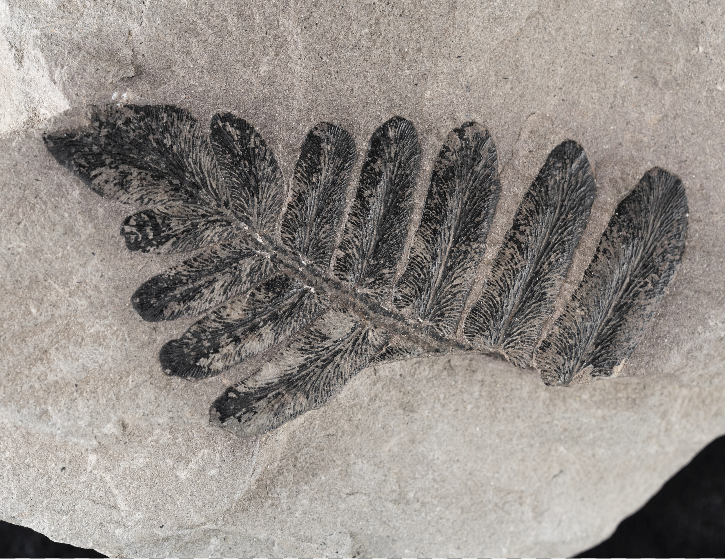
CARBON FILM FOSSILS
Carbonized fern from Indiana
Carbon film fossils are thin, black shapes left on a flat surface of a rock when a plant or animal gets crushed and only a film of carbon is left behind—like a stamp from the past.
Carbonized fern, courtesy of Indiana Geological and Water Survey (IGWS). Used for educational purposes from IGWS Fossils Outreach.

Slide 31
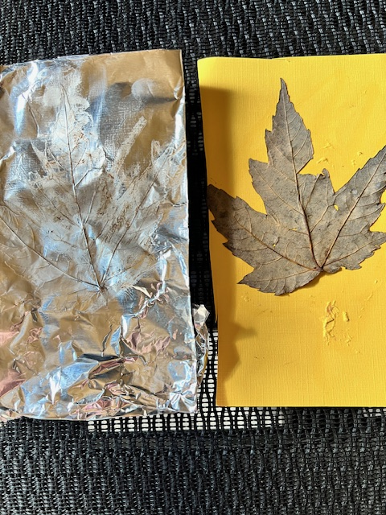
How To Make a Carbon Film Fossil Replica
Spread glue on your cardstock square. Carefully stick your dry leaf onto the glue with the vein side up.
Put your foil on the table. Place the cardstock square on the foil with the leaf side down.
Fold the foil tightly around the cardstock square and flip over.
With your finger, trace over the veins and edges of your leaf so you see them in the foil. Start from the middle and smooth out to the edges.
When you can see the veins, stem, and edges of the leaf, use a pastel crayon and lightly trace over the raised parts to give them more visibility.
When you have highlighted the leaf veins, stems and edges, unfold the foil, discard the cardstock, and fold the foil back into the original square. This is your carbon film fossil replica. Put it in a plastic bag and take it home.

Slide 32
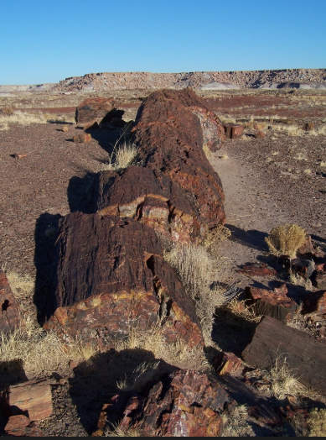
PERMINERALIZED FOSSILS
Petrified wood, photo courtesy of the National Park Service(NPS). Public domain.
Permineralized fossils are made when minerals carried by groundwater fill the tiny spaces in bones or wood and turn them into rock—keeping their shape.
The fossil is usually heavier than the original but is a 3-D replica of the organism part
Petrified Forest National Park, Arizona

Slide 33
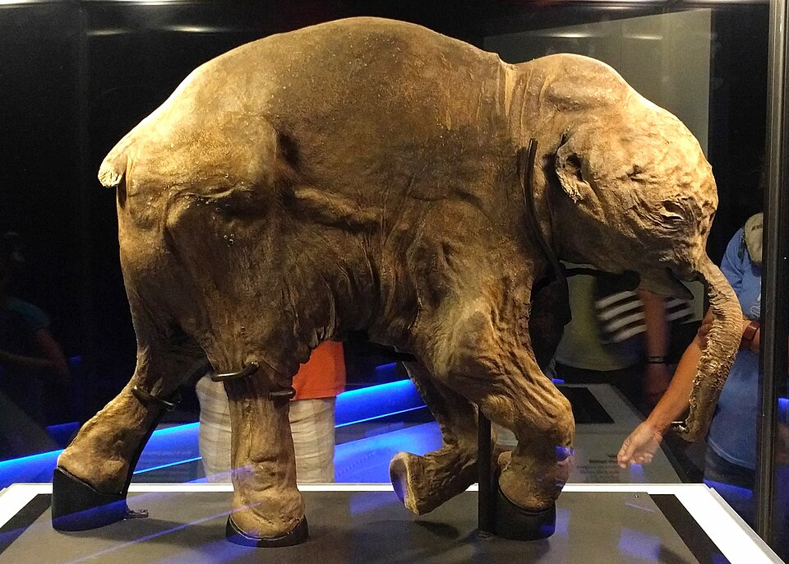
PRESERVED REMAINS
Photo by Ruth Hartnup, “Lyuba the mummified baby mammoth.” Licensed under CC BY 2.0
Preserved remains are the fossil record of an animal or plant that was protected from destruction or decay and preserved intact.
These fossils can be preserved in ice (like the pictured mammoth), amber (tiny creatures trapped in tree sap), tar pits, and even dry caves or deserts (the body dries out, preserving the skin and hair, like mummies)
A 42,000 years old baby woolly mammoth, found in Yamal's Peninsula, Siberia

Slide 34
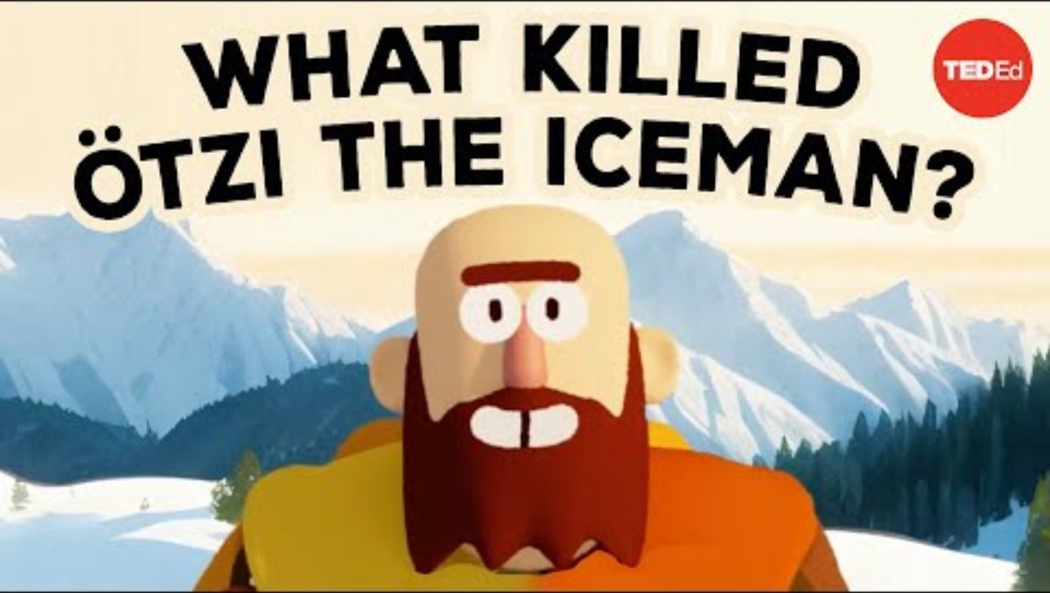
Video: What killed ötzi the iceman?

Slide 35
WRITING ASSIGNMENT (HOMEWORK LESSON 2)
Imagine you're a paleontologist uncovering a fossil from millions of years ago. Your task is to write a short story about one of the fossils we explored in class. Your story should include:
A name for your fossil character (e.g., “Shelly the Trilobite” or “Cedrick the tree”)
Talk about its habitat. Where did it live? Was it in the ocean, in a forest, or on a sandy beach?
Imagine when it lived. How many millions of years ago? Were there some important events that the Earth experienced during that time? Geologic time scale appropriate .
Explain how it died. Did it get eaten, buried in mud, or caught in a storm? Why is it a broken piece?
Explain the process of how it became a fossil. Did it leave a mold? Did it leave marks? Was it permineralized? Did only its bones remain? Use one of the fossil types we explored in class.
Can you think of any organisms today that seem like your fossilized organism?
Make sure your story makes scientific sense based on what we learned about different fossil types and how they are formed.

Slide 36
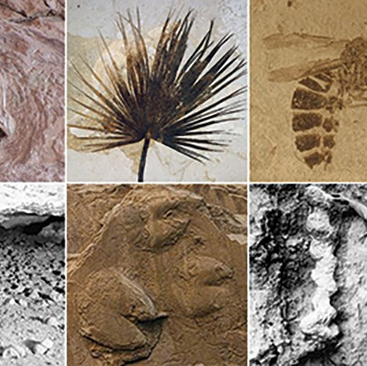
THE STORY OF A FOSSIL
LESSON 3
Body and Trace fossils. Image from the National Park Service Paleontological Heritage. Public Domain.

Slide 37
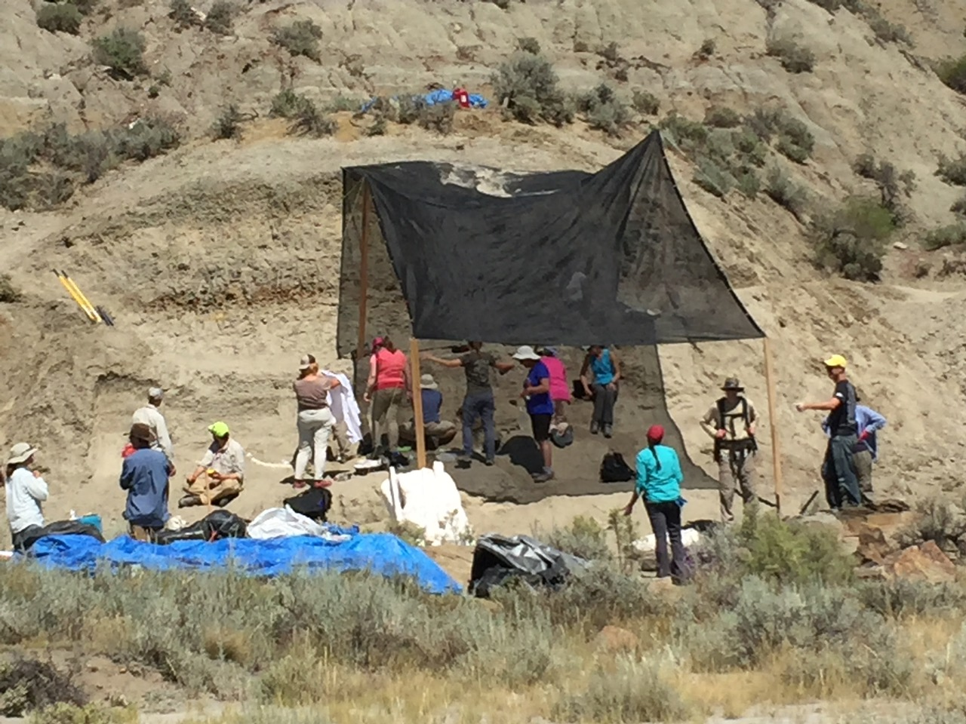
Working in a Paleontology Team
Finding and preserving fossils is usually a group activity.
In this lesson, you will form small groups, select a fossil or replica fossil from the sample table. You will also receive a fact sheet about that fossil, or the booklet ("Organisms from land and sea in Michigan").
Your team will examine the fossil carefully and read the fact sheet that provides additional information for your fossil.
Use your observations, the fact sheet, your prior knowledge, and additional research if necessary to complete the Biography of your fossil sample (Handout 3).

Slide 38
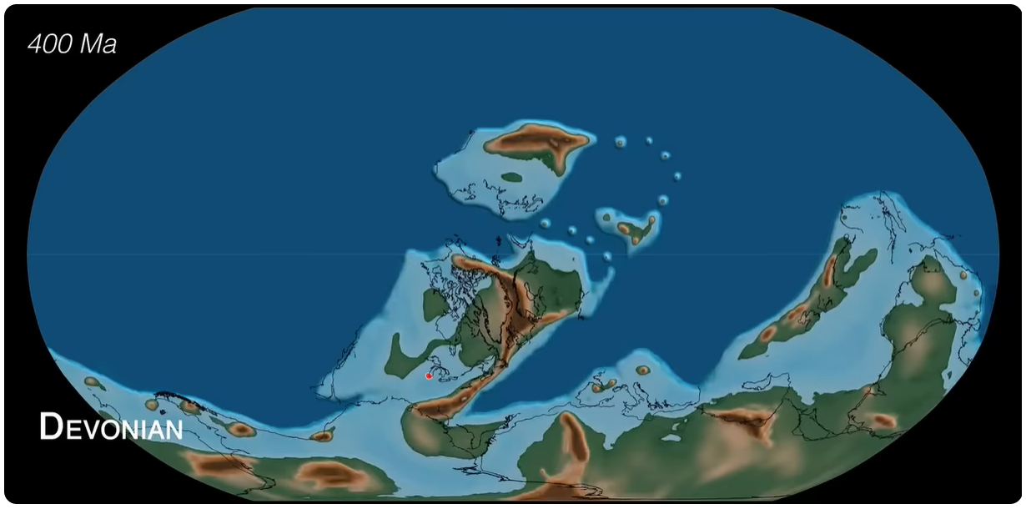
WHERE WAS MICHIGAN IN THE PAST?
MR. TRILOBITE, YOU LIVED HERE
LESSON 4

Slide 39
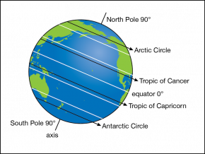
How do we find places on Earth?
A map of the Earth has a grid pattern, like the lines on graph paper.
Latitude: Sideways lines, like belts around the Earth
Longitude: Up and down lines
Diagram by Byron Inouye, from Exploring Our Fluid Earth (CRDG, University of Hawai‘i). Used with permission for non‑profit educational purposes

Slide 40
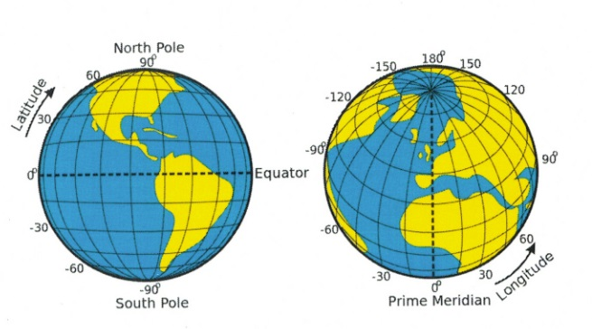
Michigan’s address
Michigan is in the United States, near the Great Lakes.
Its "address" is about 43° North, 85° West.
That means Michigan is north of the Equator and west of the Prime Meridian.
Latitude and Longitude lines. Image source: Terrance Berg, licensed under CC BY-NC-SA 4.0 via Pressbooks BCcampus

Slide 41
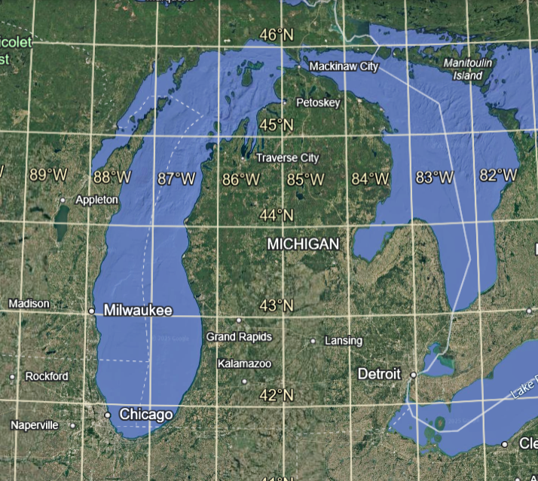
Michigan Location and Climate
Michigan is located north of the Equator, which is the line that is equidistant from the north and south poles.
Since the Equator is located at 0 degrees and the north pole is 90 degrees north, Michigan is almost exactly halfway between the two.
Since it is almost always hot at the Equator and cold at the north pole, Michigan's climate is called temperate, neither extremely hot or cold.
How do you think location on Earth affects climate in other locations?
Google Earth

Slide 42
Activity (Handout 4.1)
Use Google Maps or a globe and locate:
The Equator
The Prime Meridian
The Statue of Liberty, New York
Bogotá, Colombia
The Great Pyramid of Giza, Egypt
Svalbard, Norway
Uluru, Australia
Your city or town

Slide 43
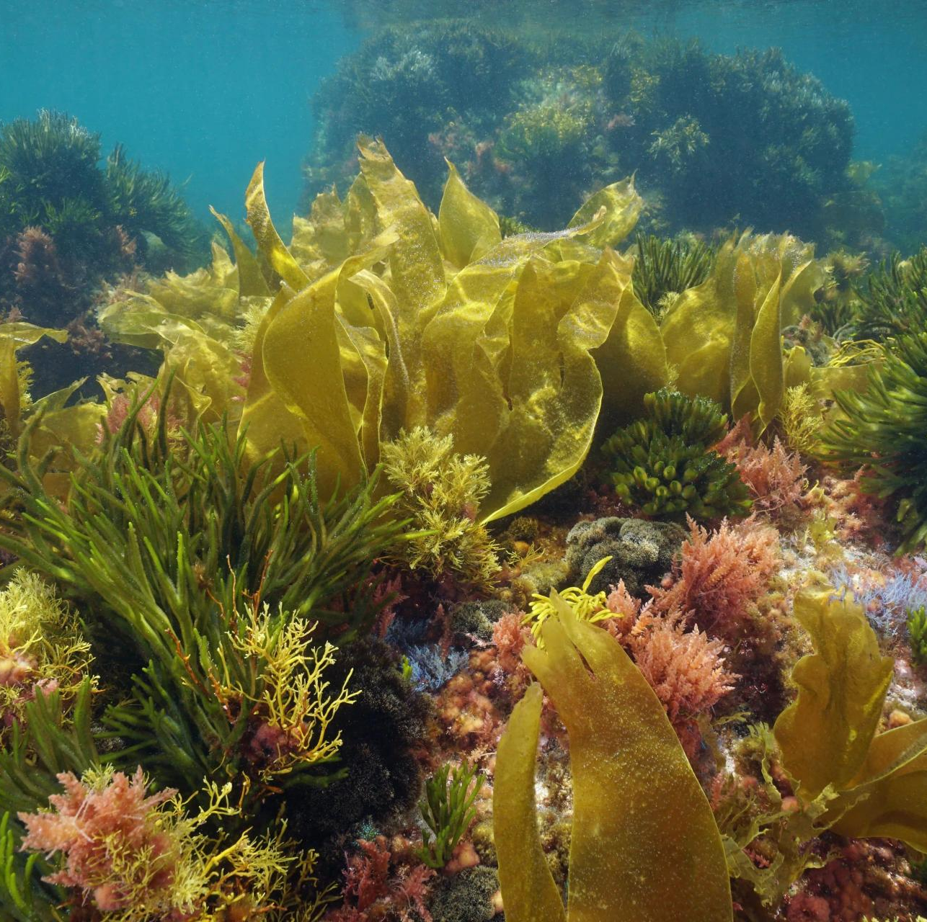
But Michigan’s location has not always been the same as it is now...

Slide 44
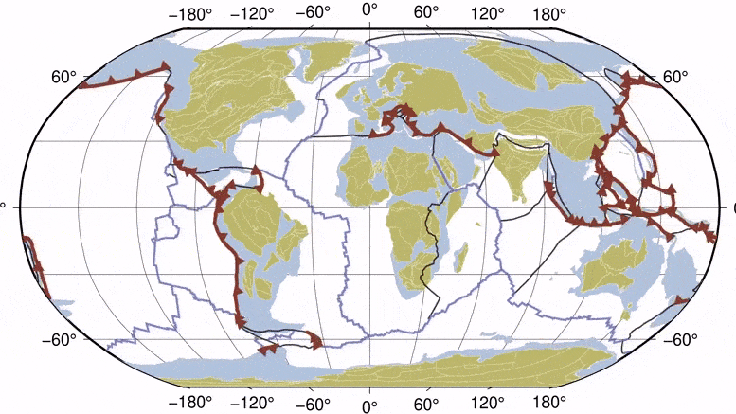
Earth's surface is always slowly moving.
Forces inside the planet shift giant slabs of Earth's crust a few centimeters per year. Over billions of years, a lot of movement can be expected. This process is called plate tectonics.
Click on the link: Scotese Plate Tectonics Paleogeography & Ice ages to watch the video, locate your place, and see how it changed over the last 500 million years

Slide 45
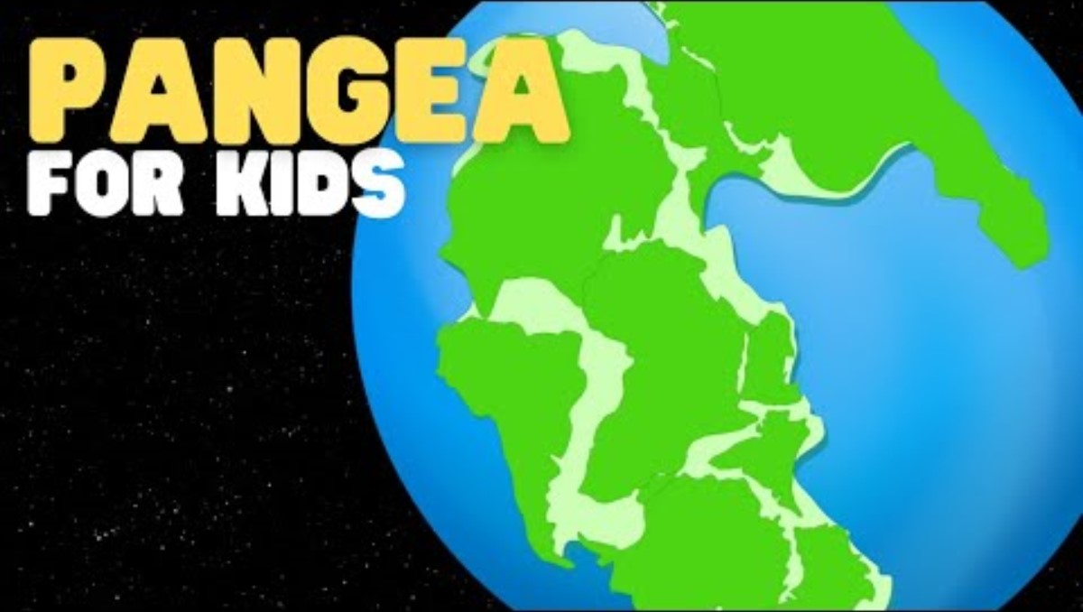
But, what is plate tectonics, really?

Slide 46

Activity – Where was Michigan in the past?
(Handout 4.2)
Look at the following slides and answer in your worksheet:
Where was Michigan 20,000 years ago? 50 million years ago? 100 million years ago?
Write the approximate latitude and which hemisphere (North or South).
Identify if Michigan was covered by a sea, ice, or it was an emerged (dry) land.

Slide 47
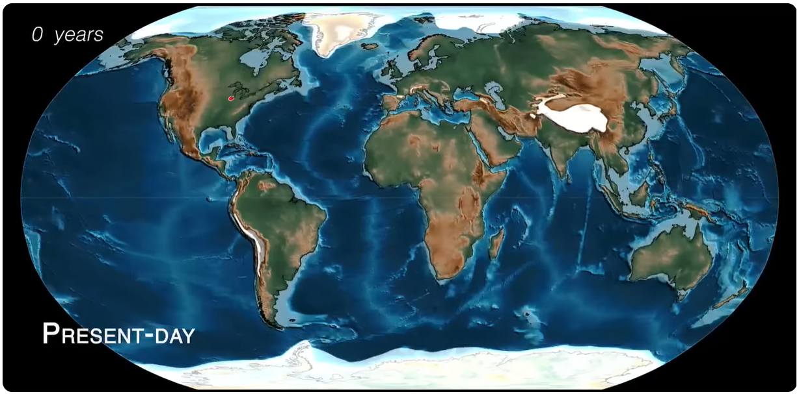
Michigan in the present
Image from Scotese, C.R. (2019). “Plate Tectonics, Paleogeography, and Ice Ages” Licensed under CC BY. Watch on YouTube (Video ID UevnAq1MTVA)
0 years(today)
43°North
Equator
Michigan is a land with many lakes, located in a temperate zone with contrasting seasons

Slide 48
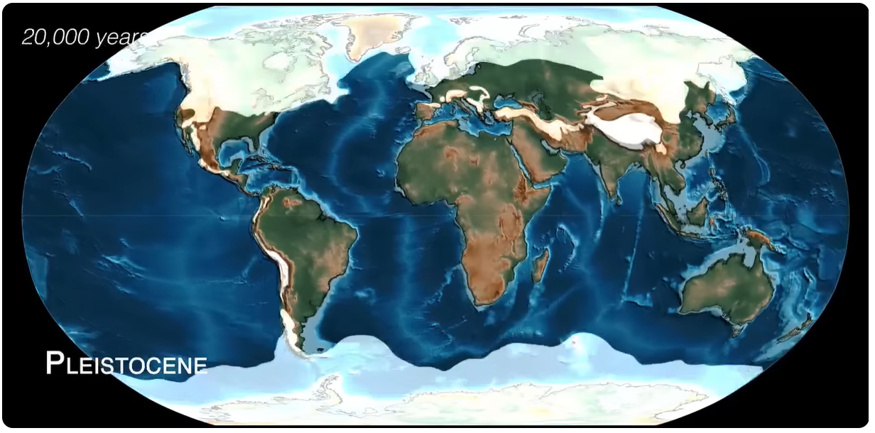
Michigan 20000 years ago
Image from Scotese, C.R. (2019). “Plate Tectonics, Paleogeography, and Ice Ages” Licensed under CC BY. Watch on YouTube (Video ID UevnAq1MTVA)
20,000 years ago
43°North
Equator
Michigan was covered by ice sheets (Ice Age)

Slide 49
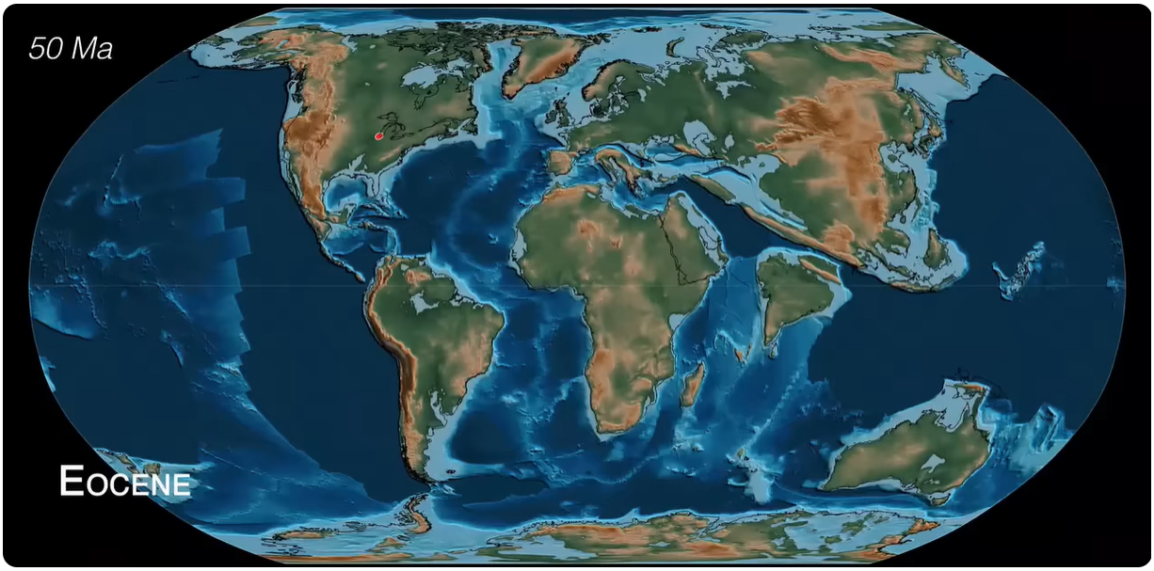
Michigan 50 million years ago
Image from Scotese, C.R. (2019). “Plate Tectonics, Paleogeography, and Ice Ages” Licensed under CC BY. Watch on YouTube (Video ID UevnAq1MTVA)
50 million years ago
38°North
Equator
Michigan was a land, much warmer and humid than today (subtropical), like Florida.

Slide 50
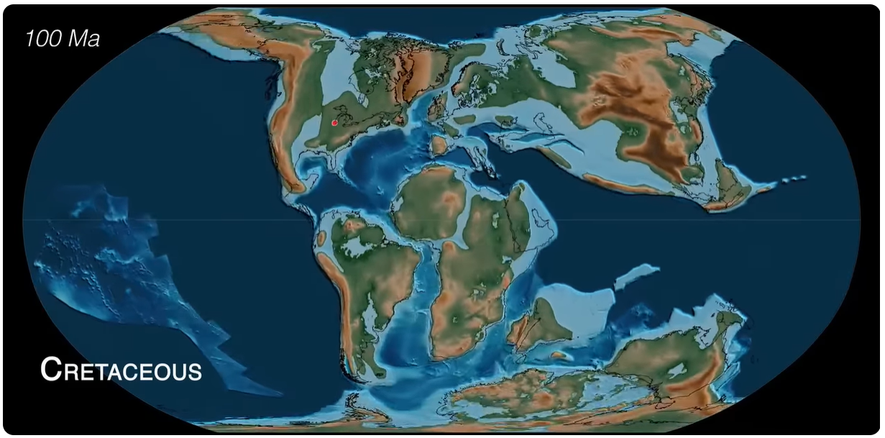
Michigan 100 million years ago
Image from Scotese, C.R. (2019). “Plate Tectonics, Paleogeography, and Ice Ages” Licensed under CC BY. Watch on YouTube (Video ID UevnAq1MTVA)
100 million years ago
35°North
Equator
The sea level was very high on Earth. Michigan was a land in a subtropical zone (like the Gulf of Mexico).

Slide 51
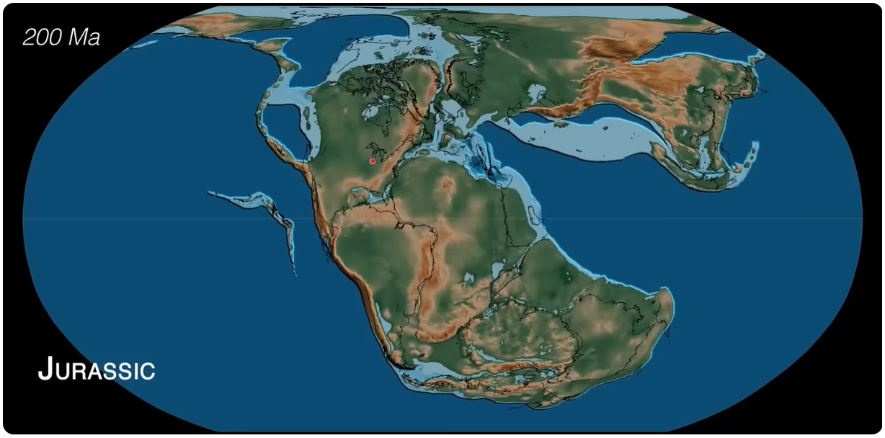
Michigan 200 million years ago
Image from Scotese, C.R. (2019). “Plate Tectonics, Paleogeography, and Ice Ages” Licensed under CC BY. Watch on YouTube (Video ID UevnAq1MTVA)
200 million years ago
25°North
Equator
Michigan was part of supercontinent (Pangea), with arid (dry) environments

Slide 52

Michigan 300 million years ago
Image from Scotese, C.R. (2019). “Plate Tectonics, Paleogeography, and Ice Ages” Licensed under CC BY. Watch on YouTube (Video ID UevnAq1MTVA)
300 million years ago
0°
Equator
Michigan was very close to the equator, with a tropical climate, and developed swamps and very shallow seas with lots of evaporation

Slide 53

Michigan 400 million years ago
Image from Scotese, C.R. (2019). “Plate Tectonics, Paleogeography, and Ice Ages” Licensed under CC BY. Watch on YouTube (Video ID UevnAq1MTVA)
400 million years ago
Equator
45°South
Michigan was covered by a tropical sea, in the southern hemisphere

Slide 54

Michigan 500 million years ago
Image from Scotese, C.R. (2019). “Plate Tectonics, Paleogeography, and Ice Ages” Licensed under CC BY. Watch on YouTube (Video ID UevnAq1MTVA)
500 million years ago
Equator
10°South
Michigan was covered by a shallow sea in the southern hemisphere. North America was rotated sideways.

Slide 55

Making the Connection: Deep Time
Does Michigan's location over millions of years help us understand why Michigan has some kinds of fossils but not others?
What are the time periods where organisms existed that could have been fossilized?
What fossils could have been formed in those time periods?
Have all those fossils been found in Michigan?

Slide 56

COMMON FOSSILS IN MICHIGAN
LESSON 5

Slide 57

What time span is preserved in the rocks of the Michigan Basin?

Slide 58

Michigan basin evolution
Image courtesy of the Michigan Geological Survey. (2024). Michigan Geology | The Michigan Basin. Watch on YouTube (Video ID 3mQAUCTxL2s)

Slide 59

Michigan basin evolution2
Image courtesy of the Michigan Geological Survey. (2024). Michigan Geology | The Michigan Basin. Watch on YouTube (Video ID 3mQAUCTxL2s)

Slide 60

Michigan basin evolution3
Image courtesy of Michigan Geological Survey (2024) — Michigan Geology | The Michigan Basin. Watch on YouTube (Video ID 3mQAUCTxL2s)

Slide 61

Michigan basin evolution4
Covered by glacial deposits (20.000-10.000 years)
300-400 Millions of years
Image courtesy of Michigan Geological Survey (2024) — Michigan Geology | The Michigan Basin. Watch on YouTube (Video ID 3mQAUCTxL2s)

Slide 62




WHAT FOSSILS CAN BE FOUND IN MICHIGAN?
Michigan was underwater for a long time, so many of the fossils we find are plants and animals that lived in the sea hundreds of millions years ago. ​
​
Trilobites
Bryozoans
Corals
Crinoids
Brachiopods

Slide 63




WHAT FOSSILS CAN BE FOUND IN MICHIGAN ? 2
Other fossils are of ancient plants (360-290 million years ago). ​
​
Fossil plants from the online repository of fossils – Museum of Paleontology, University of Michigan: MI backyard fossils

Slide 64


MICHIGAN’S STATE STONE: PETOSKEY STONE
“Hexagonaria percarinata​”

Slide 65


WHY DON’T WE HAVE DINOSAUR FOSSILS IN MICHIGAN ???
Most dinosaurs existed between 66-200 million years ago. The oldest ones can be up to 250 million years old

Slide 66
Lost Layers of Time in the Michigan Basin?
Missing time: almost 300 million years!
Glacial deposits (20.000-10.000 years)
300-400 Millions of years

Slide 67


Why No Dinosaur Fossils in Michigan?
Competing Theories!!
Dinosaurs were here, but they were never fossilized
2. Fossils formed, but later disappeared
Michigan was high and exposed to the surface, so there wasn’t enough sediment for dead dinosaurs to be covered up and become fossils.
Dinosaurs in Michigan may have turned into fossils, but over millions of years, wind, rain, and ice wore away the rocks that contained and covered them, so any fossils that were here were erased by erosion.

Slide 68

MICHIGAN MAY NOT HAVE DINOSAUR FOSSILS...BUT WE HAVE MASTODON
AND MAMMOTH FOSSILS!

Slide 69

Visit a Newly Discovered Mastodon in Grand Rapids

Slide 70




MICHIGAN’S STATE FOSSIL: AMERICAN MASTODON
The glacier cap advanced up to the red line. No grass, no bushes = No mammoths or mastodon fossils in the northern part of the Lower Peninsula or in the Upper Peninsula
There are more Mastodons than mammoth fossils in Michigan (4:1)
This is what mastodons looked like:

Slide 71




DISTANT COUSINS
Mastodon
“Mammut americanum”
Mammoth “Mammuthus”
Mastodon tooth fossil (CC0 1.0 Universal Public Domain Dedication) via Wikimedia Commons
Mammoth tooth fossil. Photo by James St. John (CC BY 2.0), via Wikimedia Commons
Bumpy molars to crush twigs & branches, and chew though plants
Flat, smooth ridges (like a washboard), to eat grass and shrubs, not to break branches

Slide 72
Fossils Tell Stories of Earth's Past.
Now You Can Understand Their Message!
Keep searching and keep learning

Slide 73


Who we are?
Lisa Wininger
Manager of Education and Outreach
Michigan Geological Survey
Former K-12 teacher, NASA's office of STEM Engagement, and Michigan MiSTEM Director.
Carolina Ayala
Geologist, MSc, MEd
PhD student – Geoscience Education at Western Michigan University

