Slide 1
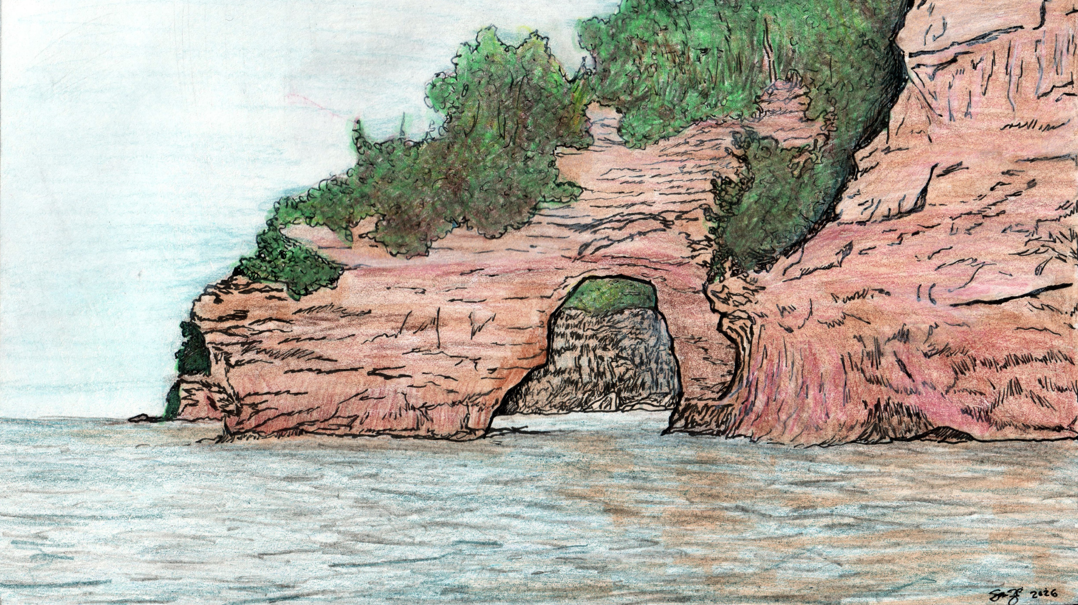
Weird Rocks
Why Are They Weird, and How Did They Get That Way?

Slide 2
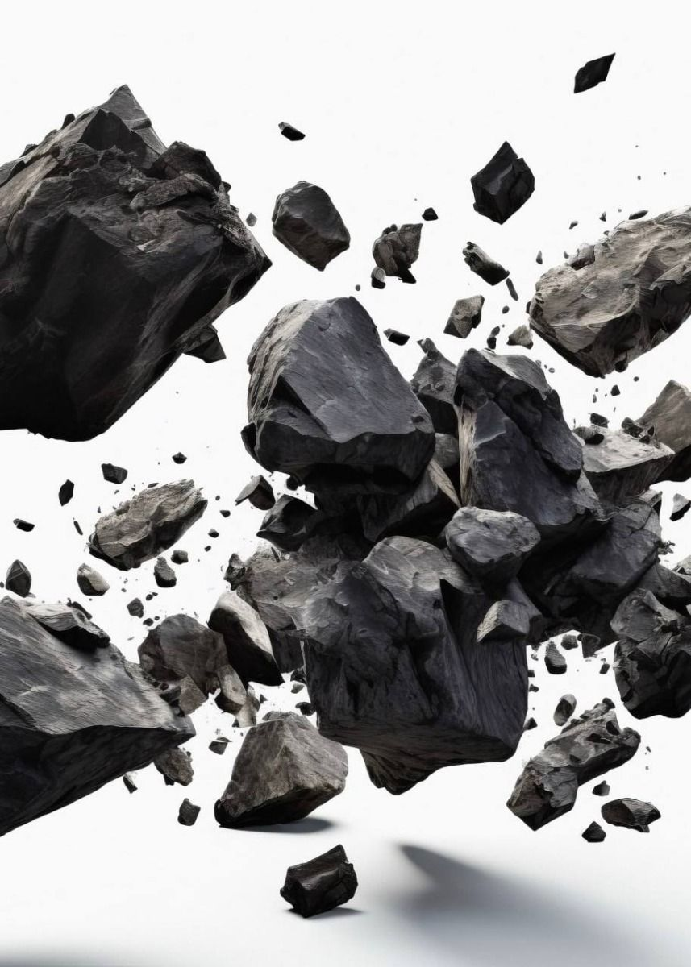
Weird Rocks
101
Rocks are made of minerals
Nearly 5,000 kinds of minerals exist on Earth with different colors, sizes, shapes, and textures.
Minerals combine in different ways to make every kind of rock unique. And some of them are just plain weird!
Follow along to learn more about weird rocks and what makes them that way.

Slide 3
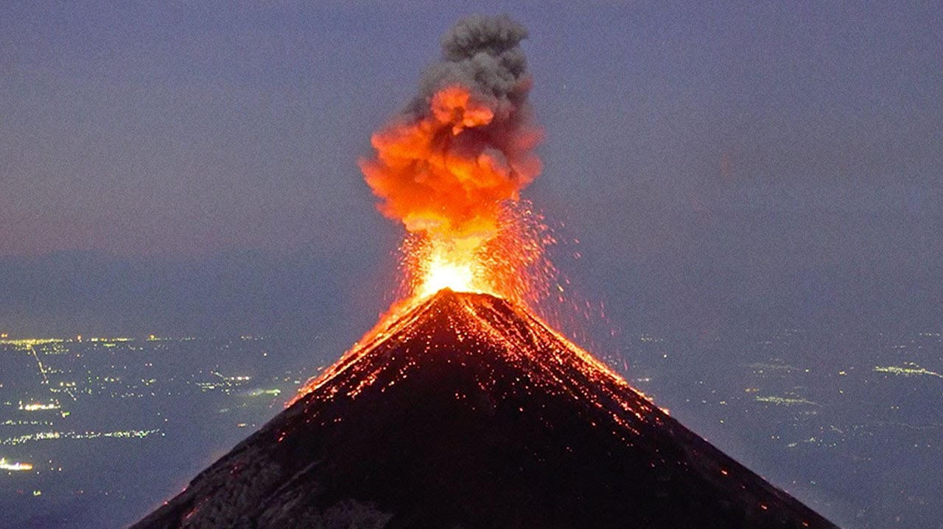
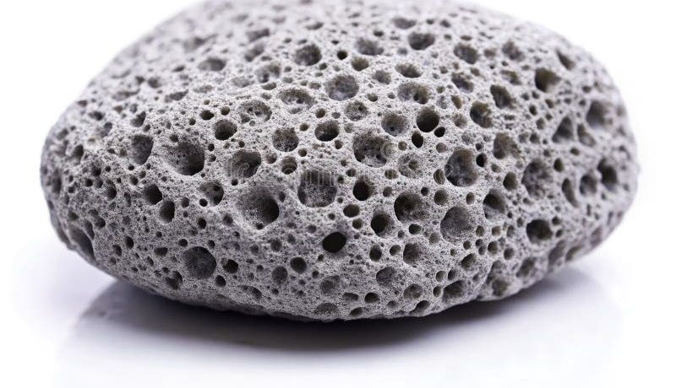
Rocks That Float??
How can a rock float? When the density of the rock is less than the density of water! That's called buoyancy.
Pumice forms when hot lava spews out of a volcano and cools rapidly, trapping air bubbles inside. Bubbles near the top pop, leaving holes but more air bubbles are trapped inside.

Slide 4
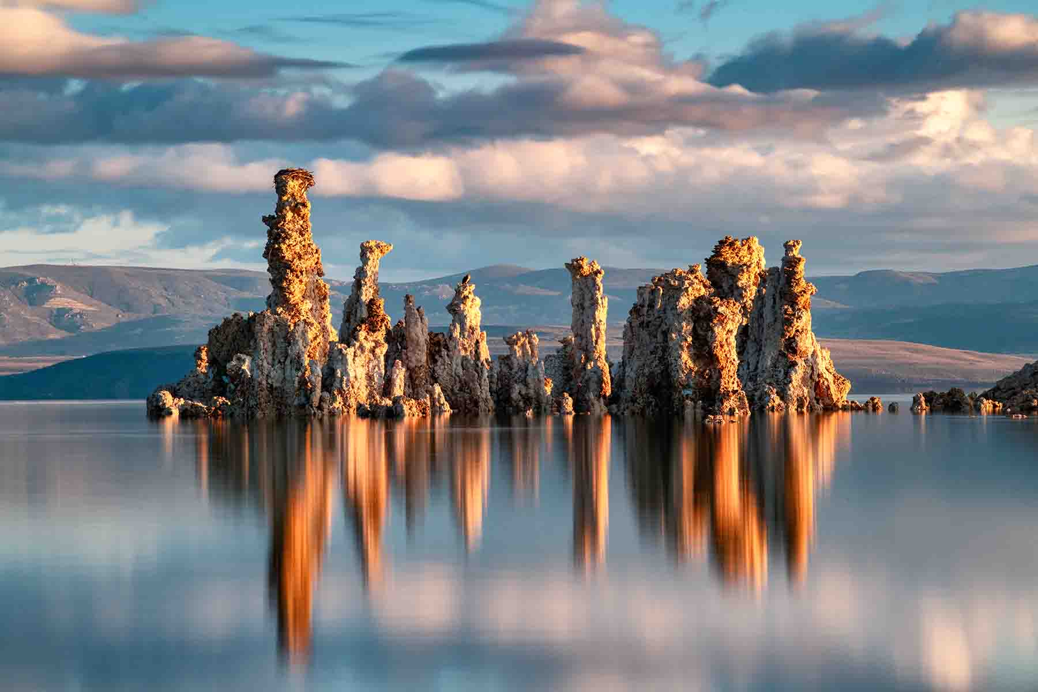
Monster Rocks??
Tufa rocks form when calcium-rich spring water bubbles up from below Mono Lake in California.
Layers of rock called tufa made from calcium carbonate are deposited around the underwater springs and grow upward from the lake bottom.
Lake levels dropped due to increased water usage and these monster shapes began to emerge like Creatures from the Black Lagoon!

Slide 5
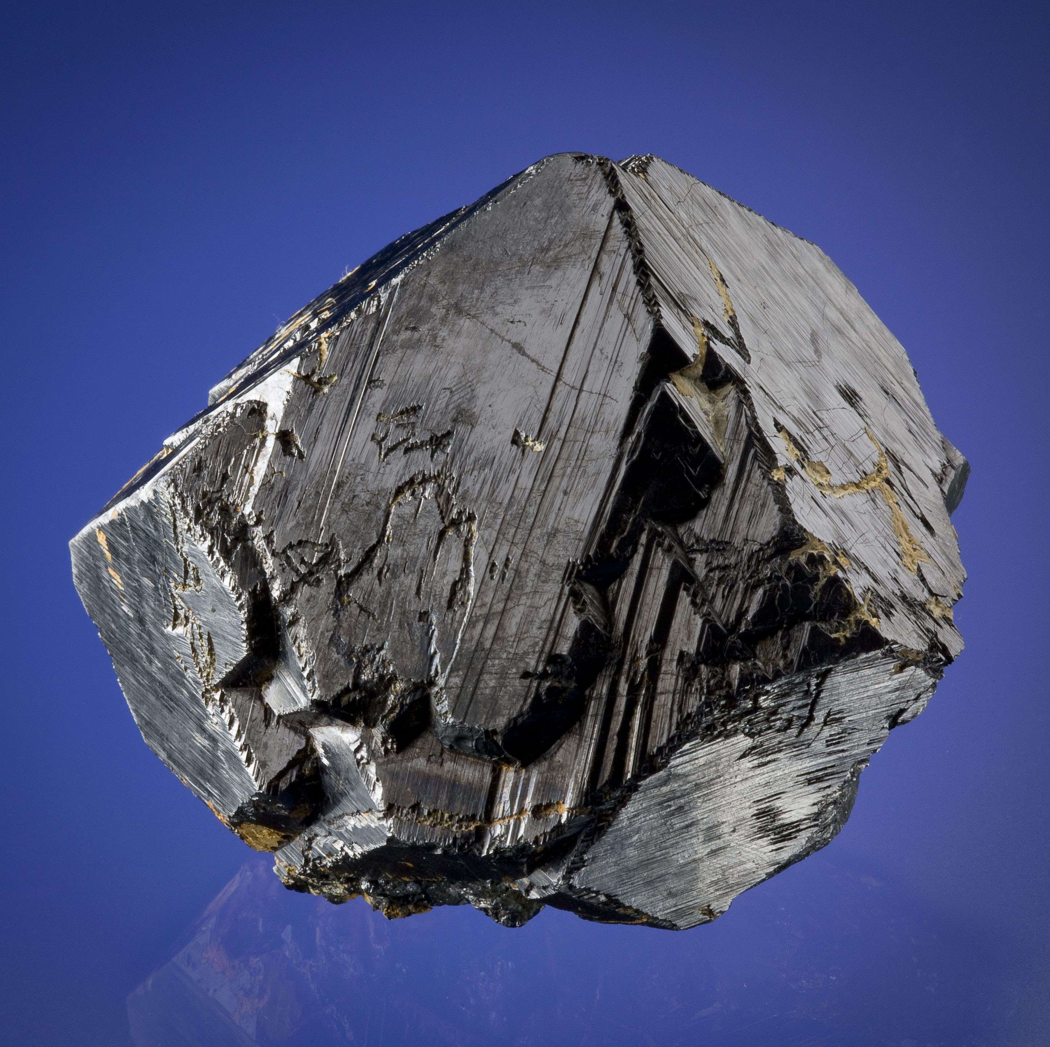
Attractive Rocks??
Some rocks are naturally magnetic!
A mineral called magnetite occurs naturally in cooled lava. Mostly made of iron, it is one of a few naturally occurring magnets.
The story goes that Magnus, a Greek shepherd, discovered it when the nails in his shoes were clinging to it.
Fact or fiction?

Slide 6
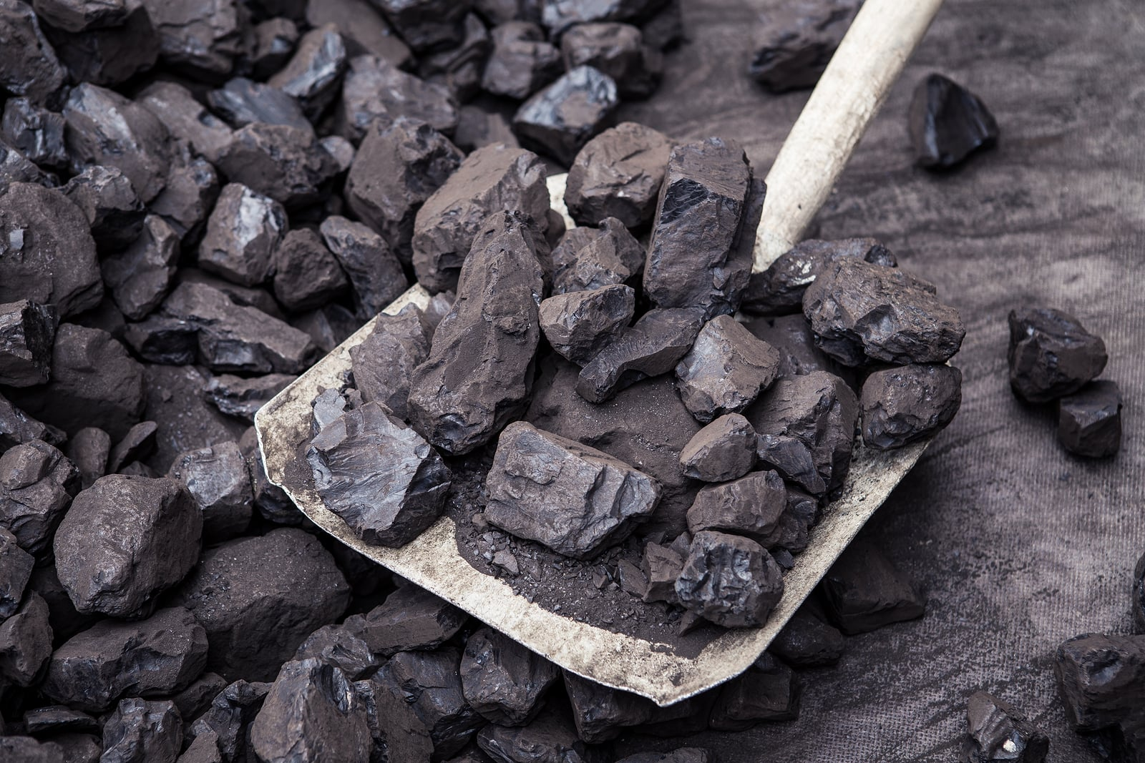
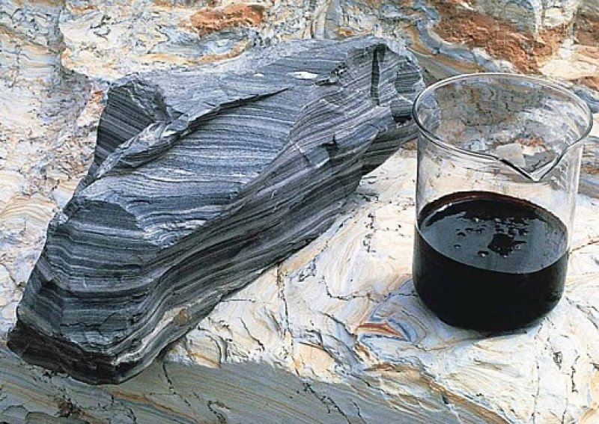
Rocks That Burn??
Can rocks catch fire like wood? They can if they were made from the remains of ancient plants and animals. That's why they're called fossil fuels.
Coal and oil shale and two kinds of rocks that burn or produce things that burn. Note: oil shale smells sort of like engine oil!

Slide 7
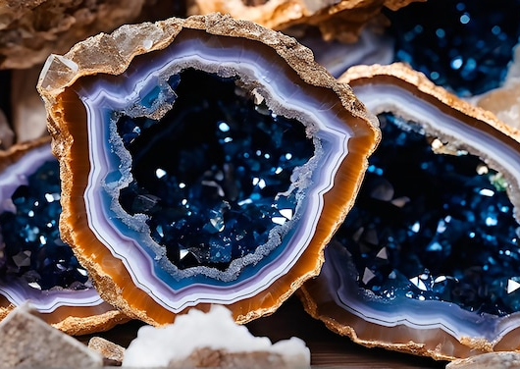
Rocks With Secrets Inside
Some plain looking looks have beautiful crystals inside!
Geodes can have hollow spaces inside that are purple or yellow. Some might be solid minerals inside and are called thunder eggs!
Thunder eggs are spherical volcanic rocks with hidden centers of colorful minerals like agate, chalcedony, jasper, or opal,

Slide 8
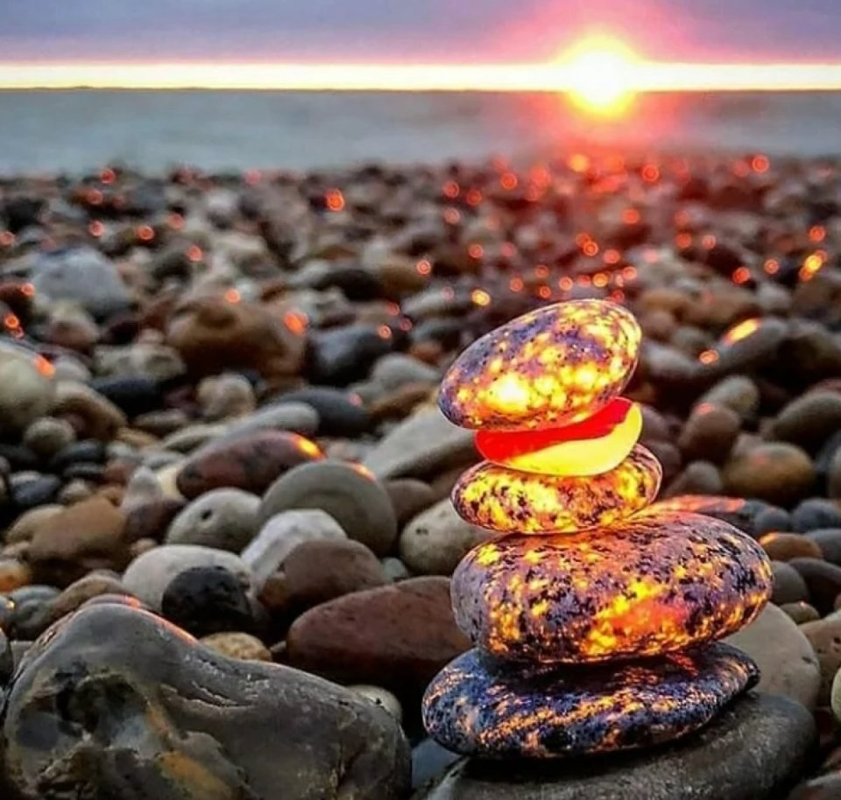
Glowing Rocks
Why do some rocks glow in the dark?
Use an ultraviolet flashlight at night and search beaches in Michigan to find "yooperlites", a syenite rock rich in fluorescent sodalite.
UV lights is trapped inside the sodalite and re-emits the energy as orange or yellow glowing light!

Slide 9
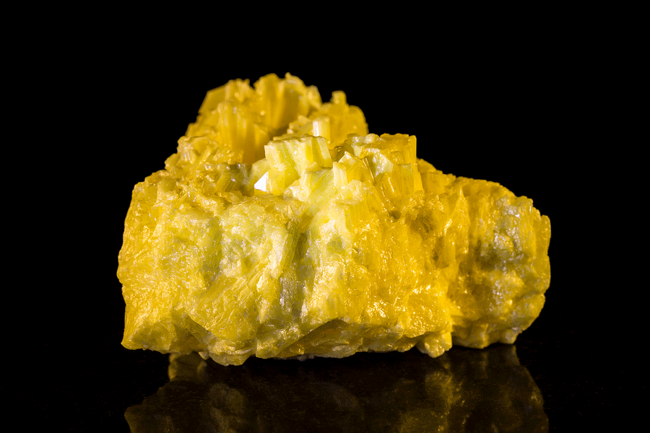
Stinky Rocks
Have you ever seen a rock that smells like rotten eggs?
A lemon-yellow mineral called sulphur is what makes rotten eggs smell bad.
Sulfur gas can be smelled at volcanic areas like Yellowstone National Park at the geysers and springs.
Sulfur is often found coating volcanic rocks.

Slide 10
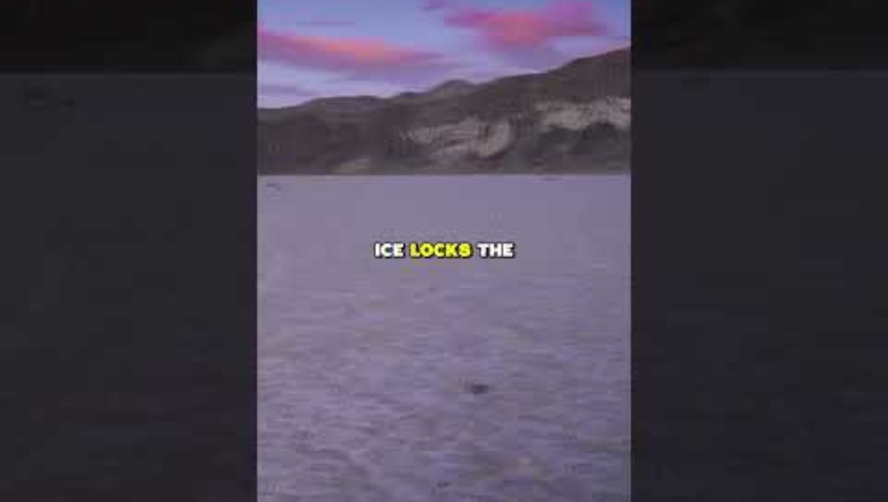
Sailing Rocks
On a dry lakebed in Death Valley, California, people discovered tracks from rocks moving nearly half a mile!
Rocks fall from the steep mountains, roll onto the flats, and when it rains, the clay lakebed gets slick.
When the wet surface freezes, the lakebed acts like an ice skating rink.
The wind blows hard enough that the rocks literally sail across the lakebed surface.

Slide 11
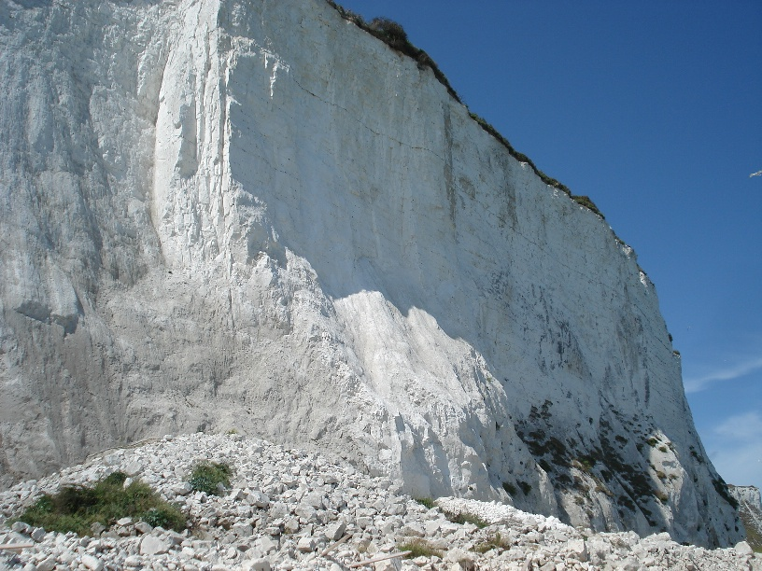
Rocks to Write With
A white rock called chalk looks, feels, and write just like blackboard chalk.
Tall white cliffs in Dover England are made of chalk.
The cliffs were formed underwater by billions of tiny organisms called algae that settled on the bottom of ancient seas.

Slide 12
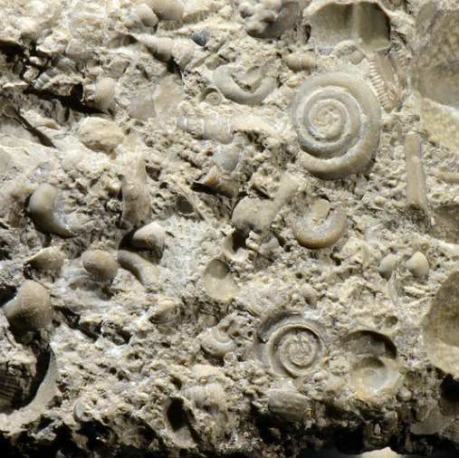
Fizzy Rocks
Some rocks can fizz like a glass of soda.
Limestone can do just that if you put a drop of acid on it.'
Limestone is ade of calcium carbonate, usually from the shells and skeletons of sea creatures.
When acid contacts calcium carbonate, carbon dioxide is released, the same gas that bubbles up from soda pop!

Slide 13
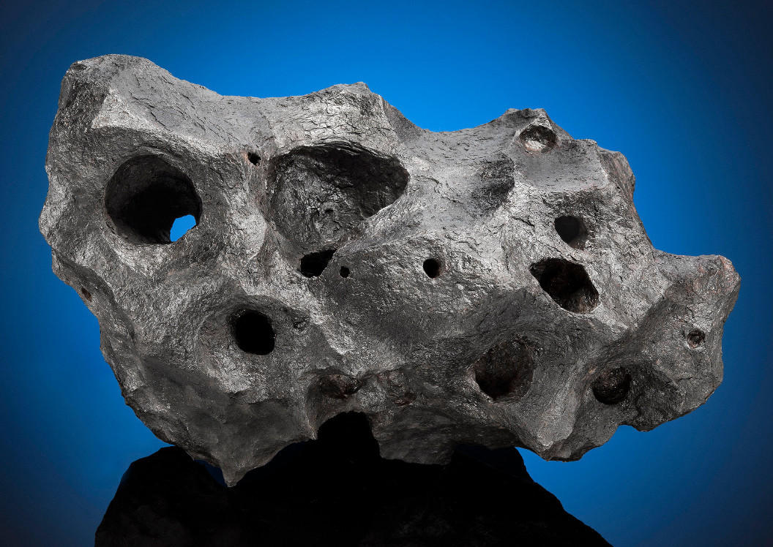
Space Rocks
A rock that travels through space and survives passing through Earth's atmosphere without burning up is called a meteorite.
Most meteorite are pretty small but occasionally, a really large meteorite crashes into Earth.
Meteorites can be valuable and can sell for a dollar per gram or more!

Slide 14
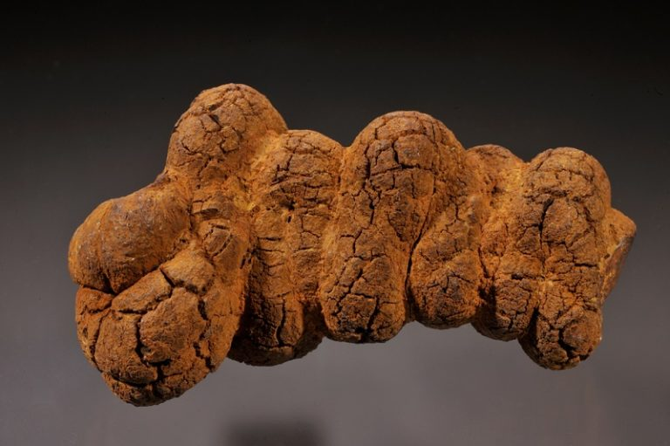
Poop Rocks?
Fossils give us evidence of organisms that existed a log time ago. Sometimes it might be bones or teeth, but it can also be tracks, skin, or even their poop!
When the poop is preserved and turned into stone, it is called a coprolite.
The biggest coprolite ever found can from a Tyrannosaurus Rex dig in Canada. The coprolite was 17 inches long, 6 inches high, and 5 inches wide!

Slide 15
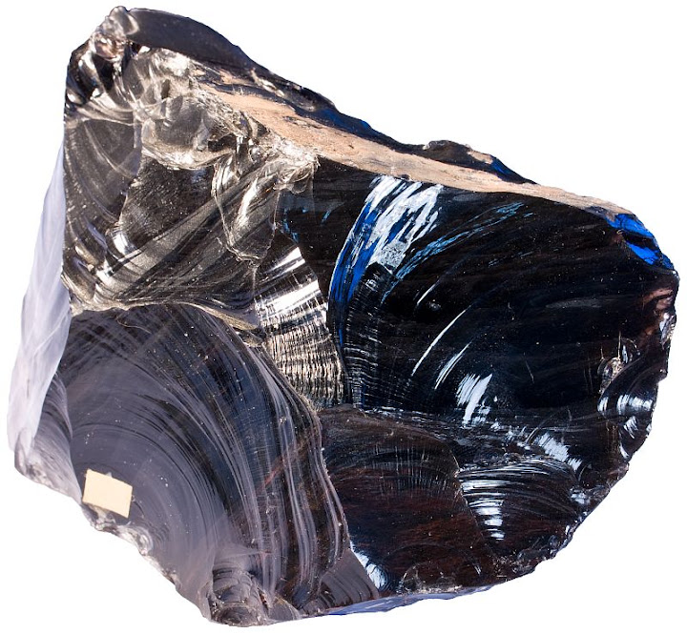
Rocks That Cut
Sometimes rock can be as sharp as a piece of glass!
Obsidian is exactly that-glass!
It is created when lava cools so rapidly that crystals don't have time to form.
Obsidian has been used fro thousands of years as a cutting, scraping, and slicing tool, although it tends to shatter quickly.

Slide 16
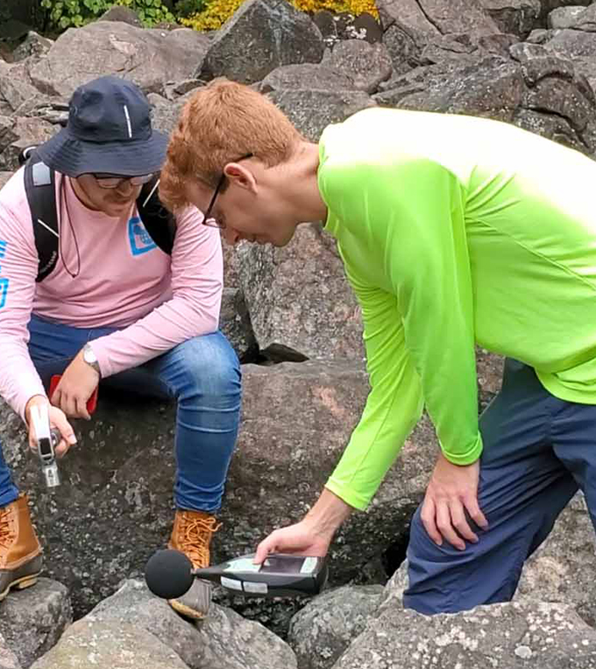
Singing Rocks
Singing rocks are rocks that resonate like a bell when struck, producing clear, bell-like tones.
They are also called sonorous rocks or lithophonic rocks and are used in idiophonic musical instruments called lithophones.
The ringing effect is often due to the rock's mineral composition, internal structure, and the way the rocks are supported by surrounding stones, though the exact mechanism remains a mystery

Slide 17
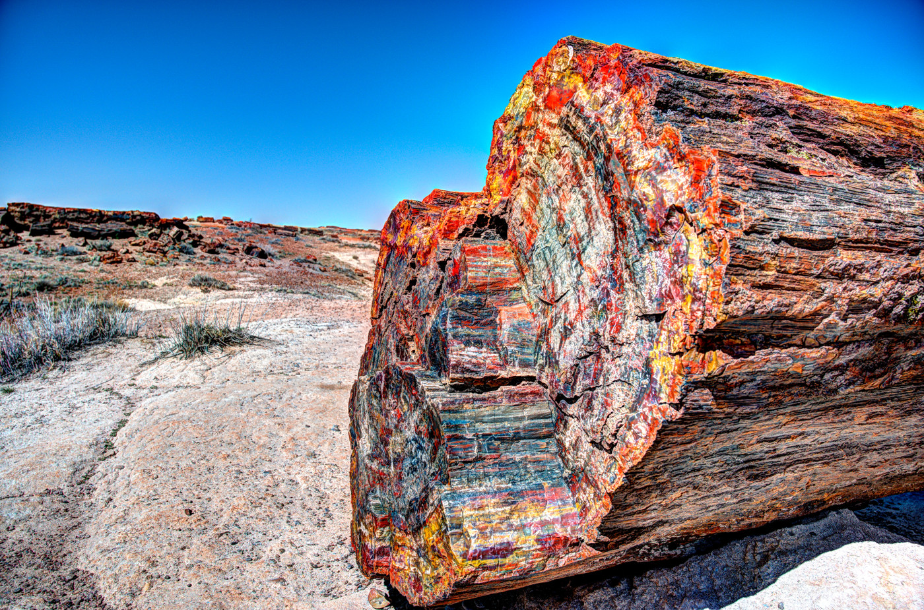
Trick Rocks
Sometimes a rock looks exactly like wood!
Dead wood usually rots but sometimes the wood is buried in a way that keeps air from getting to it.
Over time, mineralized water seeps into the pores of the tree, changing it into rock.
This how petrified wood is formed!

Slide 18
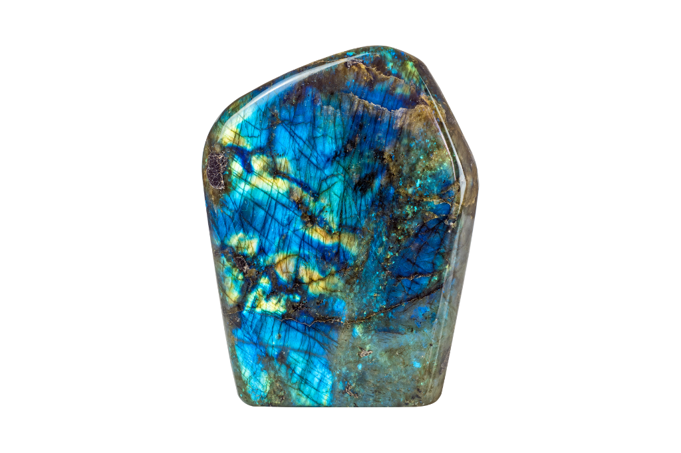
Chameleon Rocks
Labradorite is a feldspar, with a unique optical phenomenon known as labradorescence.
This effect occurs due to the scattering of light by microscopic structures within the stone, with vibrant flashes of color, including blue, green, yellow, and orange, when viewed from different angles.
This allows labradorite to color change right in front of your eyes!

Slide 19
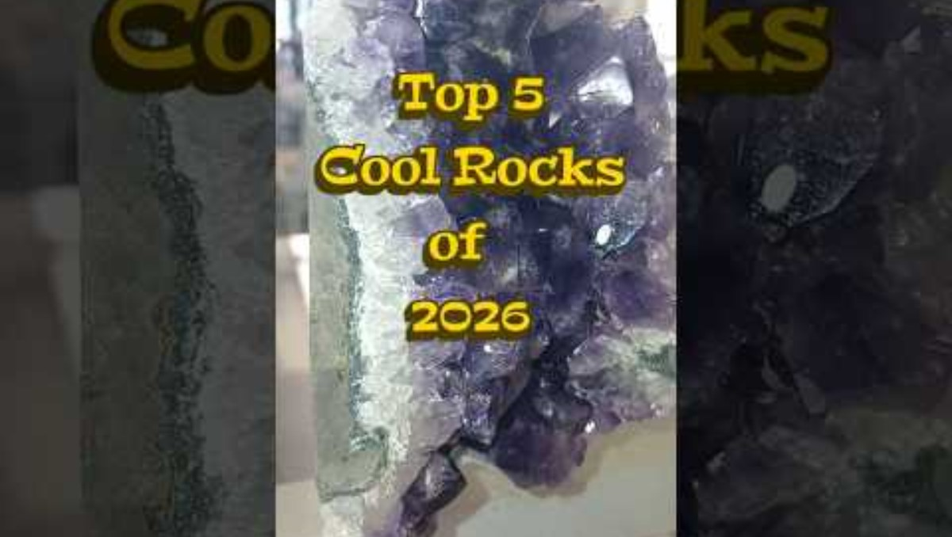
Coolest Rocks of 2026!

Slide 20

Be A Michigan Rockhound!
Even rocks that aren't "weird" are fun to find!
Visit our website at CoreKids – Michigan Geological Survey and find great rockhounding sites.
You can also make your own rockhounding trading cards!

